Slide 1


Module 01
Network Security Fundamentals
Notes:
1155881221

Slide 2

Module Objectives
1
Understanding the Goals of Network Defense
2
Understanding Information Assurance (IA) Principles
3
Understanding the Benefits and Challenges of Network Defense
4
Overview of Different Types of Network Defense Approaches
5
Understanding the Different Types of Network Security Controls
6
Understanding the Different Network Security Protocols

Slide 3

Module Flow
01
Understand Fundamentals
of Network Security
02
Discuss Essential Network Security Protocols

Slide 4

Essentials of
Network Security
A completely secure and robust network can be designed with proper implementation and configuration of network security elements
Elements of Network Security
Network Security Controls
Network Security Protocols
Network Security Devices

Slide 5

Goal of Network Defense
The ultimate goal of network defense is to protect an organization’s information, systems, and network infrastructure from unauthorized access, misuse, modification, service denial, or any degradation and disruptions
Organizations rely on information assurance (IA) principles to attain defense-in-depth security
Information Assurance (IA) principles act as enablers for an organization’s security activities to protect and defend the organizational network from security attacks

Slide 6







Information Assurance (IA) Principles
Confidentiality
Availability
Ensures information is not disclosed to unauthorized parties
Ensures information is available to authorized parties without any disruption
Cannot listen to or view the information
Services unavailable to authorized users
Authorized User
Authorized User
Server
Server
Man in the Middle
Integrity
Ensures information is not modified or tampered with by unauthorized parties
Cannot modify the information
Authorized User
Server
Man in the Middle

Slide 7





Information Assurance (IA) Principles (Cont’d)
Non-repudiation
Authentication
Ensures that a party in a communication cannot deny sending the message
Ensures the identity of an individual is verified by the system or service
Transfer amount 500 to User
User denies transaction
Authorized User,
Transfer amount 500
User
Server
Authorized User
Server

Slide 8

Network Defense Benefits
Protect information assets
Comply with government and industry specific regulations
Ensure secure communication with clients and suppliers
Reduce the risk of being attacked
Gain competitive edge over competitor by providing more secure services

Slide 9


Network Defense Challenges
Distributed Computing Environments
Emerging Threats
Lack of Network Security Skills
With the advancement in modern technology and to meet business requirements, networks are becoming vast and complex, potentially leading to serious security vulnerabilities. Attackers exploit exposed security vulnerabilities to compromise network security
Potential threats to the network evolve each day. Network security attacks are becoming technically more sophisticated and better organized
Organizations are failing to defend themselves against rapidly increasing network attacks due to the lack of network security skills

Slide 10

Types of Network Defense Approaches
Preventive Approaches
Retrospective Approaches
Consist of methods or techniques that are used to avoid threats or attacks on the target network
Consist of methods or techniques that examine the causes for attacks, and contain, remediate, eradicate, and recover from damage caused by the attack on the target network
Reactive Approaches
Proactive Approaches
Consist of methods or techniques that are used to detect attacks on the target network
Consist of methods or techniques that are used to make informed decisions on potential attacks in the future on the target network

Slide 11
Network Security Controls: Administrative Security Controls
    The management implements administrative access controls to ensure the safety of the organization
Examples of Administrative Security Controls
01
Regulatory framework Compliance
02
Security policy
03
Employee Monitoring and Supervising
04
Information Classification
05
Security Awareness and Training

Slide 12
Network Security Controls: Physical Security Controls
This is a set of security measures taken to prevent unauthorized access to physical devices
Examples of Physical Access Controls
Locks
Fences
Badge system
Security guards
Mantrap doors
Biometric system
Lighting
Motion detectors
Closed-circuit TVs
Alarms

Slide 13

Network Security Controls: Technical Security Controls
This is a set of security measures taken to protect data and systems from unauthorized personnel
Examples of Technical Security Controls
01
03
05
Access Controls
Authorization
Auditing
Security Protocols
Network Security Devices
Authentication
04
02
06

Slide 14

Module Flow
01
Understand Fundamentals
of Network Security
02
Discuss Essential Network Security Protocols

Slide 15

Network Security Protocols
RADIUS
Secure HTTP
TACACS+
HTTPS
Kerberos
TLS
PGP
SSL
S/MIME
IPsec

Slide 16




Remote Authentication Dial-in User Service (RADIUS)
Remote authentication dial-in user service (RADIUS) is an authentication protocol which provides centralized authentication, authorization, and accounting (AAA) for remote access servers to communicate with a central server
Authentication Steps in RADIUS
A client initiates a connection by sending the access-request packet to the server
The server receives the access request from the client and compares the credentials with the ones stored in the database.
If the provided information matches, then it sends the access-accept message along with the access-challenge to the client for additional authentication, else it sends back an accept-reject message
Client sends the accounting-request to the server to specify the accounting information for a connection that was accepted
Packet Type-Access Request (Username, Password)
Access-Accept/Access-Reject(User Service, Framed Protocol)
Access Challenge (optional) (Reply Message)
Access Server
RADIUS Server

Slide 17











Remote Authentication Dial-in User Service (RADIUS) (Cont’d)
Radius Accounting Steps
RADIUS
Client
RADIUS
Server
Client sends the accounting-request to the server to specify the accounting information for a connection that was accepted
RADIUS: Accounting- Request [acct_status_type=start]
RADIUS: Accounting-Response
RADIUS: Accounting- Request [acct_status_type=interim update]
RADIUS: Accounting-Response
The server receives this message and sends back the accounting-response message which states the successful establishment of the network
RADIUS: Accounting- Request [acct_status_type=stop]
RADIUS: Accounting-Response

Slide 18










Terminal Access Controller Access Control System Plus (TACACS+)
The terminal access controller access control system plus (TACACS+) is a network security protocol used for AAA of network devices such as switches, routers, and firewalls through one or more centralized servers
TACACS+ encrypts the entire communication between the client and the server including the user’s password which protects it from sniffing attacks
It is a client-server model approach where the client (user or network device) requests for connection to a server, the server authenticates the user by examining their credentials
TACACS+
Security Server
Remote User
Public Switched Telephone Network (PSTN)/ Integrated Services Digital Network (ISDN)
TACACS+
Client
Router
Corporate Network
Remote User
AAA Client
TACACS+ Server
The AAA client receives a resource request from a user. This is assuming that the authentication has already taken place
2. REQUEST is sent to AAA server for service shell
3. RESPONSE is returned to the AAA client indicating a pass or fail
4. AAA client may grant or deny access to the service shell

Slide 19
Kerberos
Client
KDC (Kerberos)
Kerberos is an authenticating method for accessing a network
Key Distribution Center (KDC) request
Ticket request
Ticket generated and encrypted using a server secret key
Kerberos authentication protocol (KAP)
01
A user sends his/her credentials to an authentication server (AS)
The AS hashes the password of the user and verifies their credentials in the active directory database. If the credential matches, then AS (consisting of the ticket granting service, TGS) sends back the TGS session key and ticket granting ticket (TGT) to the user to create a session
02
Decrypt the ticket response and forward the
ticket to the server
Ticket response
03
Once users are authenticated, they send the TGT to request a service ticket to the server or TGS for accessing the services
Server
The TGS authenticates the TGT and grants a service ticket to the user. The service ticket consists of the ticket and a session key
Ticket
Decrypt the ticket and confirm the
identity of the client
04
05
The client sends the service ticket to the server. The server uses its key to decrypt the information from the TGS and the client is authenticated to the server

Slide 20











Pretty Good Privacy (PGP)
Pretty good privacy (PGP) is an application layer protocol which provides cryptographic privacy and authentication for network communication
It encrypts and decrypts email communication as well as authenticates messages with digital signatures and encrypts stored files
File Encryption
File Decryption
Random Key
User’s Private Key
File
Encryption
Encrypted File
Decryption
Encrypted File
with the User’s Public Key in the Header
Encrypted Key
User’s Public Key
Encrypted File
with the User’s Public Key in the Header
Encryption
Encrypted File
Decryption
File
Encrypted Key

Slide 21
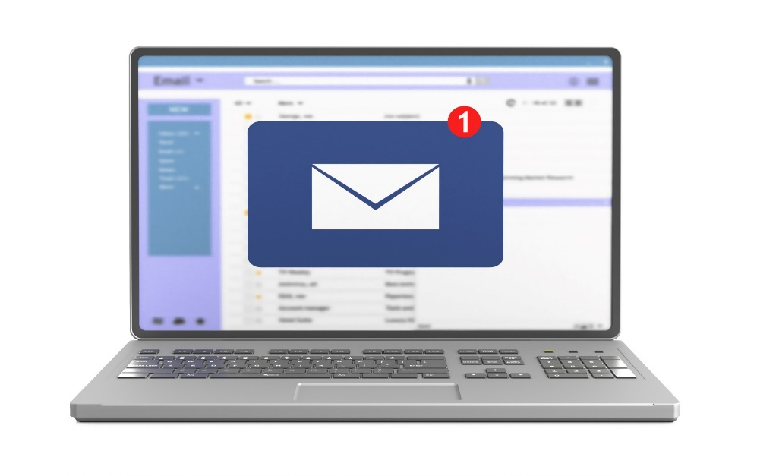
Secure/Multipurpose Internet Mail Extensions (S/MIME)
01
Secure/multipurpose internet mail extensions (S/MIME)
is an application layer protocol which is used for sending digitally signed and encrypted email messages
02
It uses the RSA system for email encryption
03
Network defenders need to enable S/MIME-based security for mailboxes in their organizations

Slide 22














Secure/Multipurpose Internet Mail Extensions (S/MIME) (Cont’d)
Alice
Public
Bob
Message
Certificate Alice
OK?
Public Key Alice
Private Key Alice
Signing
Digital Signature
Signature Checking
Encryption (DES)
Encrypted Message
Decryption (DES)
Message
Secret Key
Secret Key
Encryption (RSA)
Decryption (RSA)
Public Key Bob
OK?
Certificate Bob
Private Key Bob

Slide 23

Differences between PGP and S/MIME
Mandatory Features | S/MIME v3 | OpenPGP
Message Format | Binary, Based on CMS | Application/Pkcs 7-mime
Certificate Format | Binary, Based on X.509v3 | Binary, Based on previous PGP
Symmetric Encryption Algorithm | Triple DES (DES, EDE3, and CBC) | Triple DES (DES, EDE3, and Eccentric CFB)
Signature Algorithm | Diffie-Hellman (X9.42) with DSS or RSA | ElGamal with DSS
Hash Algorithm | SHA- 1 | SHA- 1
MIME Encapsulation of Signed Data | Choice of Multipart/signed or CMS Format | Multipart/signed ASCII armor
MIME Encapsulation of Encrypted Data | Application/Pkcs 7-mime | Multipart/Encrypted

Slide 24


Secure Hypertext Transfer Protocol (S-HTTP)
  Secure hypertext transfer protocol (S-HTTP) is an application layer protocol that is used to encrypt web communications carried over HTTP
  It is an alternative for the HTTPS (SSL) protocol
  It ensures secure data transmission of individual messages, while SSL establishes a secure connection between two entities thus ensuring security of the entire communication
Client Machine
Server Machine
WWW Client
HTTP
WWW Server
S-HTTP Application- Level Security
Crypto Smart
Crypto Smart
Encrypted and/or Signed Messages
Encrypted and/or Signed Messages
Unencrypted Channel
Network Layer
Network Layer
Note: Not all Web browsers and servers support S-HTTP

Slide 25
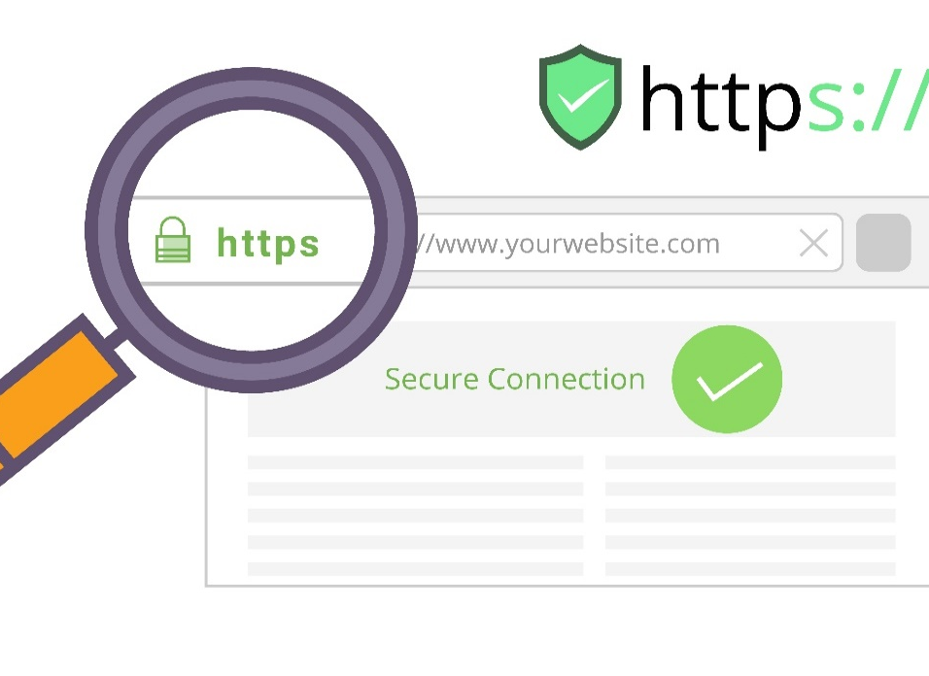


Hypertext Transfer Protocol Secure (HTTPS)
  Hypertext transfer protocol secure (HTTPS) ensures secure communication between two computers over HTTP
  The connection is encrypted using a transport layer security (TLS) or SSL protocol
  It is often used in confidential online transactions
  It protects against man-in-the-middle attacks since the data are transmitted over an encrypted channel
HTTPS
A
B
“Mypass”
“Xz54p6kd”
“Mypass”
Encryption
Decryption
Sends the Password
Receive the Password
Unauthorized Access
Gets “Xz54p6kd”

Slide 26
Transport Layer Security (TLS)
Transport layer security (TLS) ensures a secure communication between client-server applications over the internet
It prevents the network communication from being eavesdropped or tampered
Security
Application
Application
Layers of TLS Protocol
TLS Record Protocol
It ensures connection security with encryption
TLS Handshake Protocol
It ensures server and client authentication
TLS Handshake Protocol
TLS Handshake Protocol
TLS Record Protocol
TLS Record Protocol
TCP/IP
TCP/IP
Network Hardware
Network Hardware

Slide 27







Secure Sockets Layer (SSL)
Secure sockets layer (SSL) was developed by Netscape for managing the security of a message transmission on the internet
It uses the RSA asymmetric (public key) encryption to encrypt data transferred over SSL connections
Client Hello message (includes SSL version, randomly generated data, encryption algorithms, session ID, key exchange algorithms, compression algorithms, and MAC algorithms)
Determines the SSL version and encryption algorithms to be used for the communication; sends Server Hello message (Session ID) and Certificate message (local certificate)
Sends a Server Hello Done message
Verifies the Digital certificate; generates a random premaster secret (Encrypted with server's public key) and sends Client Key Exchange message with the premaster secret
Sends a Change Cipher Spec message and also sends Finished message (hash of handshake message)
Hash value is calculated for the exchanged handshake messages and then compared to the hash value received from the client; If the two match, the key and cipher suite negotiation succeeds. Sends a Change Cipher Spec message and also sends Finished message (hash of handshake message)

Slide 28




Internet Protocol Security (IPsec)
Internet protocol security (IPsec) is a network layer protocol that ensures a secure IP level communication
It provides end-to-end security at the internet layer of the internet protocol suite
It encrypts and authenticates each IP packet in the communication
It supports network-level peer authentication, data origin authentication, data integrity, data confidentiality (encryption), and replay protection
LAN – Internal IP
LAN – Internal IP
Internet
Firewall
Firewall
IPsec Tunnel
External IP
External IP

Slide 29
Module Summary
This module has discussed the essentials of network security, goal of network defense, and the information assurance (IA) principles
It has discussed benefits and challenges of network defense
It also discussed different types of network defense approaches and types of network security controls
Security
Finally, this module ended with a detailed discussion of various network security protocols
In the next module, we will discuss in detail on identification, authentication, and authorization concepts

