Slide 1


Module 02
Identification, Authentication, and Authorization
Notes:
1758541982

Slide 2


Module Objectives
Understanding the Terminology, Principles, and Models of Access Control
Understanding Identity and Access Management (IAM)
Understanding User Access Management
Overview of Different Types of Authentication
Overview of Different Types of Authorization
Understanding User Accounting

Slide 3
Module Flow
Discuss Access Control Principles, Terminologies, and Models
1
Discuss Identity and Access Management (IAM) Concepts
2

Slide 4






Access Control
Access control is the selective restriction of access to an asset or a system/network resource
It protects the information assets by determining who can access what
Access control mechanism uses user identification, authentication, and authorization to restrict or grant access to a specific asset/resource
Authorization Database
Administrator
Authentication
Access Control
Authentication Function
Access Control Function
User
System Resources

Slide 5
Access Control Terminologies
Subject
This refers to a particular user or process that wants to access a resource
Object
This refers to a specific resource that the user wants to access such as a file or a hardware device
Reference Monitor
It checks the access control rule for specific restrictions
Operation
It represents an action taken by a subject on an object
Access Request
Access Request
Granted
Subject
Reference Monitor
Object
Authentication
Authorization

Slide 6
Access Control Principles
Separation of Duties (SoD)
Involves a breakdown of the authorization process into various steps
Different privileges are assigned at each step to the individual subjects requesting for a resource
This ensures that no single individual has the authorization rights to perform all functions and simultaneously denies access of all the objects to a single individual
Need-to-know
Under the need-to-know access control principle, access is provided only to the information that is required for performing a specific task
Principle of Least Privilege (POLP)
Principle of least privilege extends the need-to-know principle in providing access to a system
POLP believes in providing employees a need–to-know access, i.e., not more, not less;
It helps an organization by protecting it from malicious behavior, achieving better system stability, and system security

Slide 7

Access Control Models
Access control models are the standards which provide a predefined framework for implementing the necessary level of access control
Mandatory Access Control (MAC)
Only the administrator/system owner has the rights to assign privileges
It does not permit the end user to decide who can access the information
Discretionary Access Control (DAC)
End user has complete access to the information they own
Role-based Access Control (RBAC)
Permission are assigned based on user roles
Rule-based Access Control (RB-RBAC)
Permissions are assigned to a user role dynamically based on a set of rules defined by the administrator

Slide 8
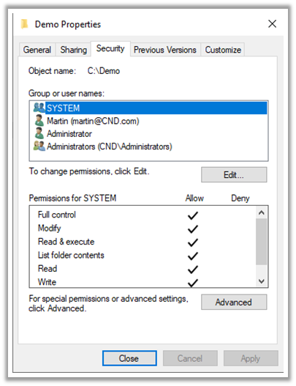
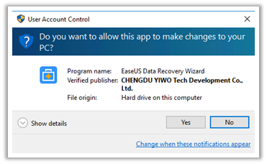
Logical Implementation of DAC, MAC, and RBAC
DAC Implementation: Windows File Permissions
Logical implementation of access control is performed using access control lists (ACLs), group policies, passwords, and account restrictions
MAC Implementation: The User Account Control (UAC) tool of Windows OS

Slide 9

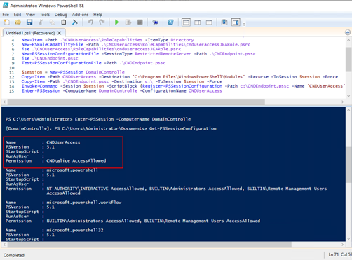
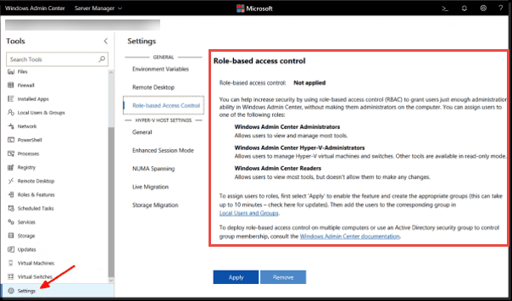
Logical Implementation of DAC, MAC, and RBAC (Cont’d)
RBAC Implementation: Just Enough Administration (JEA)
RBAC Implementation: Windows Admin Center (WAC)

Slide 10
Module Flow
Discuss Access Control Principles, Terminologies, and Models
1
Discuss Identity and Access Management (IAM) Concepts
2

Slide 11
Identity and Access Management (IAM)
IAM is responsible for providing the right individual with right access at the right time
Access Management
Authentication | Authorization
Identity Management | Identity Repository
Identity Management

Slide 12








Identity and Access Management (IAM) (Cont’d)
Application
System
Administrator
Requester Approver
Application
Identity Management (IDM)
Identity Repository
Access Management (AM)
Application
Human Resource (HR)
Application
Customer relationship management (CRM)
Application
Users

Slide 13

User Identity Management (IDM)
Identity Management
Identity Repository
  User Identification involves a method to ensure that an individual holds a valid identity
  Examples of user identity includes attributes such as a username, account number, user roles, etc.
  Identify Management involves storing and managing user attributes in their repositories
  The user repository is a database where attributes related to the users' identities are stored

Slide 14

    User Access Management (AM): Authentication
Authentication involves validating the identity of an individual with a system, application, or network
Types of Authentication
Password Authentication
Smart Card Authentication
Biometric Authentication
Two-factor Authentication
Single Sign-on (SSO) Authentication

Slide 15

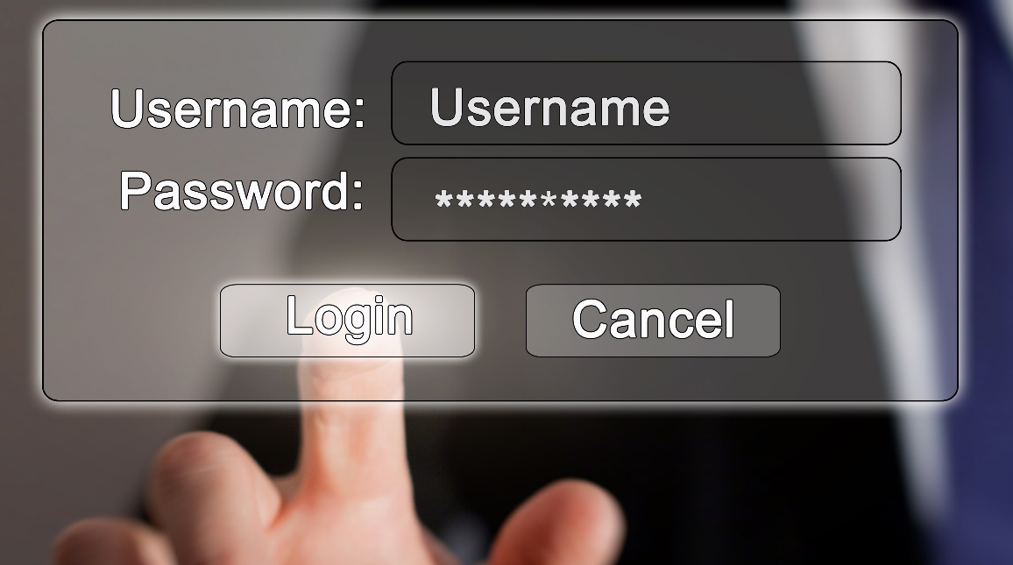
    Types of Authentication
Password Authentication
Password Authentication uses a combination of a username and a password to authenticate the network users
The password is checked against a database and the user is given access if it matches
Password authentication can be vulnerable to password cracking attacks such as brute force or dictionary attacks

Slide 16

Types of Authentication (Cont’d)
Smart Card Authentication
Smart card is a small computer chip device that holds a users’ personal information required to authenticate them
Users have to insert their smart cards into the card reader machines and enter their personal identification number (PIN) to authenticate themselves
Smart card authentication is a cryptography-based authentication and provides stronger security than password authentication

Slide 17

Types of Authentication (Cont’d)
Biometric Authentication
Biometrics refers to the identification of individuals based on their physical characteristics
Biometric Identification Techniques
Fingerprint Scanning
Retinal Scanning
Iris Scanning
Compares two fingerprints for verification and identification on the basis of the patterns on the finger
Analyzes the layer of blood vessels at the back of their eyes to identify a person
Analyzes the colored part of the eye suspended behind the cornea
Vein Structure Recognition
Face Recognition
Voice Recognition
Analyzes thickness and location of veins to identify a person
Uses facial features to identify or verify a person
Uses voice patterns to identify or verify a person

Slide 18

Types of Authentication (Cont’d)
Two-factor Authentication
Two-factor authentication involves using two different authentication factors out of three (something you know, something your have, and something you are) to verify the identity of an individual in order to enhance the security in authentication systems
1
Combinations of two-factor authentication: password and smart card/token, password and biometrics, password and one-time password (OTP), smart card/token and biometrics, etc.
2
3
“Something you are” is the best companion of two-factor authentication as it is considered as the hardest to forge or spoof

Slide 19







Types of Authentication (Cont’d)
Single Sign-on (SSO) Authentication
It allows a user to authenticate themselves to multiple servers on a network with a single password without re-entering it every time
Advantages
01
No need to remember passwords of multiple applications or systems
02
Reduces the time for entering a username and password
03
Reduces the network traffic to the centralized server
Users need to enter credentials only once for multiple applications
04
User
        APPLICATION SERVER
        EMAIL SERVER
        DATABASE SERVER
User
        Single Sign-on (SSO) Authentication

Slide 20
User Access Management (AM): Authorization
Authorization involves controlling the access of information for an individual (E.g.: A user can only read a file, but not write in it or delete it)
Types of Authorization Systems
Centralized Authorization
Implicit Authorization
Authorization for network access is done using a single centralized authorization unit
It maintains a single database for authorizing all the network resources or applications
It is an easy and inexpensive authorization approach
Users can access the requested resource on behalf of others
The access request goes through a primary resource to access the requested resource
Decentralized Authorization
Explicit Authorization
Each network resource maintains its authorization unit and performs authorization locally
It maintains its own database for authorization
Unlike implicit authorization, explicit authorization requires separate authorization for each requested resource
It explicitly maintains authorization for each requested object

Slide 21






User Access Management (AM): Accounting
Accounting is a method of keeping track of user actions on the network. It keeps track of who, when, and how the users access the network.
It helps in identifying authorized and unauthorized actions
The account data can be used for trend analysis, data breach detection, forensics investigations, etc.
Accountability
Authentication
Authorization
(Who are you?)
(What rights do you have?)
Identity
Object

Slide 22

Module Summary
This module has discussed the access control principles, terminologies, and models
It has discussed identity and access management concepts
It also discussed different methods used for user access management
It has discussed different types of authentication and authorization techniques
Finally, this module ended with an overview of user accounting and accountability
In the next module, we will discuss in detail on network security controls - administrative controls

