Slide 1

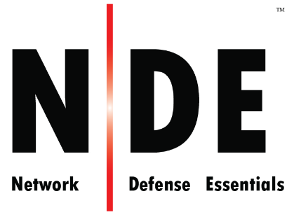
Module 03
Network Security Controls - Administrative Controls
Notes:
534823582

Slide 2

Module Objectives
1
Understanding Various Regulatory Frameworks, Laws, and Acts
2
Understanding Why Organizations Need Compliance
3
Understanding the Need for and Characteristics of Good Security Policy
4
Understanding How to Design and Develop Security Policies
5
Overview of Different Types of Security Policies
6
Understanding the Different Types of Security and Awareness Training

Slide 3

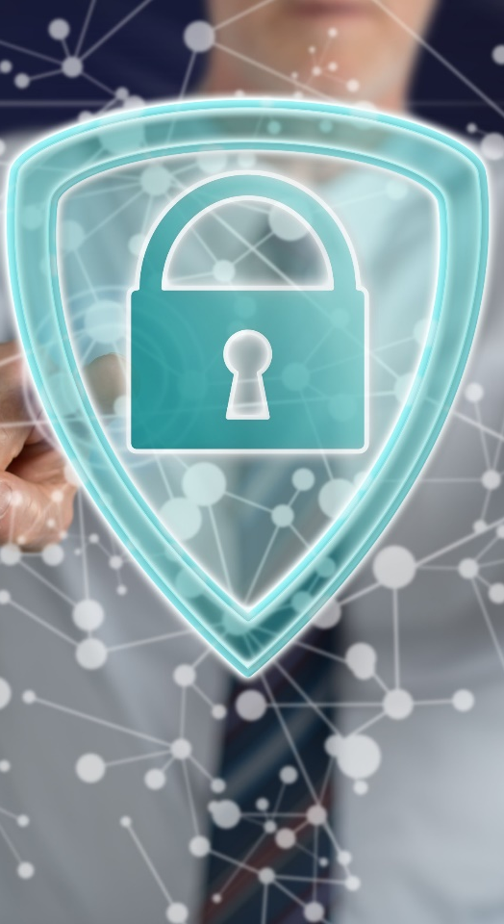

Module Flow
Discuss Various Regulatory Frameworks, Laws, and Acts
1
2
Learn to Design and Develop Security Policies
3
Learn to Conduct Different Types of Security and Awareness Training

Slide 4
Regulatory Frameworks Compliance
It is often required for the organizations to comply with some type of security regulation
Complying with regulatory frameworks is a collaborative effort between governments and private bodies to encourage voluntary/mandatory improvements to cybersecurity
IT security regulatory frameworks contain a set of guidelines and best practices

Slide 5

Regulatory Frameworks Compliance (Cont’d)
Role of Regulatory Frameworks Compliance in an Organization’s Administrative Security
Regulatory Frameworks
Example: PCI–DSS:
Requirements 3: Encrypt cardholder data
Policies
Example:
Encryption Policy
Example:
Encryption standards such as Data Encryption Standard, Advanced Encryption Standard, and Rivest–Shamir–Adleman algorithm
Standards
Procedures, Practices, and Guidelines
Example: Data encryption procedures, practices, and guidelines

Slide 6

Why Organizations Need Compliance
Improves Security
Minimize Losses
Maintain Trust
IT security regulation and standards improve overall security of an organization by meeting regulatory requirements
Improved security, in turn, prevents security breaches, which can cost loss to company
Customer trusts the organization in belief that their information is safe

Slide 7

Identifying Which Regulatory Framework to Comply
An organization needs to assess itself to determine which regulatory framework applies to it best
For example, following table shows different regulations and which organization would be subject to the scope of the regulatory framework
Regulatory Framework | Organizations within Scope
Health Insurance Portability and Accountability Act (HIPAA) | Any company or office that deals with healthcare data, including, but not limited to, doctor’s offices, insurance companies, business associates, and employers
Sarbanes Oxley Act | U.S. public company boards, management, and public accounting firms
Federal Information Security Management Act of 2002 (FISMA) | All federal agencies must develop a method of protecting information systems
Gramm Leach Bliley Act (GLBA) | Companies that offer financial products or services to individuals such as loans, financial or investment advice, or insurance
Payment Card Industry Data Security Standard (PCI-DSS) | Companies handling credit card information

Slide 8
Deciding on How to Comply to Regulatory Framework
When an organization falls within scope of certain regulatory framework, it needs to correctly interpret regulatory requirements in the regulator framework to be complied with
Based on those regulatory requirements, an organization needs to establish policies, procedures, and security controls to manage and maintain compliance
For example, the following table shows some of the PCI–DSS regulatory requirements:
 | PCI-DSS
Regulatory requirements | PCI–DSS requirement No 1.1.1: “A formal process for approving and testing all network connections and changes to the firewall and router configurations.” PCI–DSS Requirement No 1.2.1: “Restrict inbound and outbound traffic to that which is necessary for the cardholder data environment, and specifically deny all other traffic.”
Policies, procedures, and controls to satisfy the requirements | Provision for detecting all unauthorized network connections to/from an organization’s IT assets
 | PCI-DSS
Regulatory requirements | PCI–DSS requirement no 1.1.6: “Documentation and business justification for use of all services, protocols, and ports allowed, including documentation of security features implemented for those protocols considered to be insecure.”
Policies, procedures, and controls to satisfy the requirements | Provision for looking insecure protocols and services running on systems

Slide 9

Deciding on How to Comply to Regulatory Framework (Cont’d)
 | PCI-DSS
Regulatory requirements | PCI–DSS requirement no 1.3.1: “Implement a DMZ to limit inbound traffic to only system components that provide authorized publicly accessible services, protocols, and ports.” PCI–DSS Requirement No 1.3.2: “Limit inbound Internet traffic to IP addresses within the DMZ.” PCI–DSS Requirement NO 1.3.5: “Do not allow unauthorized outbound traffic from the cardholder data environment to the Internet.”
Policies, procedures, and controls to satisfy the requirements | Provision for checking how traffic is flowing across the DMZ to/from the internal network
 | PCI-DSS
Regulatory requirements | PCI–DSS requirement no 5.1: “Deploy anti-virus software on all systems commonly affected by malicious software (particularly personal computers and servers).” PCI–DSS requirement no 5.3: “Ensure that anti-virus mechanisms are actively running and cannot be disabled or altered by users, unless specifically authorized by management on a case-by-case basis for a limited time period.”
Policies, procedures, and controls to satisfy the requirements | Provision for detecting malware infection when anti-virus protection is disabled on the machines

Slide 10

Regulatory Frameworks, Laws, and Acts

Slide 11
Payment Card Industry Data Security Standard (PCI–DSS)
The Payment Card Industry Data Security Standard (PCI DSS) is a proprietary information security standard for organizations that handle cardholder information for major debit, credit, prepaid, e-purse, ATM, and POS cards
PCI DSS applies to all entities involved in payment card processing — including merchants, processors, acquirers, issuers, and service providers, as well as all other entities that store, process, or transmit cardholder data
PCI Data Security Standard — High Level Overview
Build and Maintain a Secure Network
Maintain a Vulnerability Management Program
Regularly Monitor and Test Networks
Protect Cardholder Data
Implement Strong Access Control Measures
Maintain an Information Security Policy
https://www.pcisecuritystandards.org
Failure to meet the PCI DSS requirements may result in fines or the termination of payment card processing privileges

Slide 12
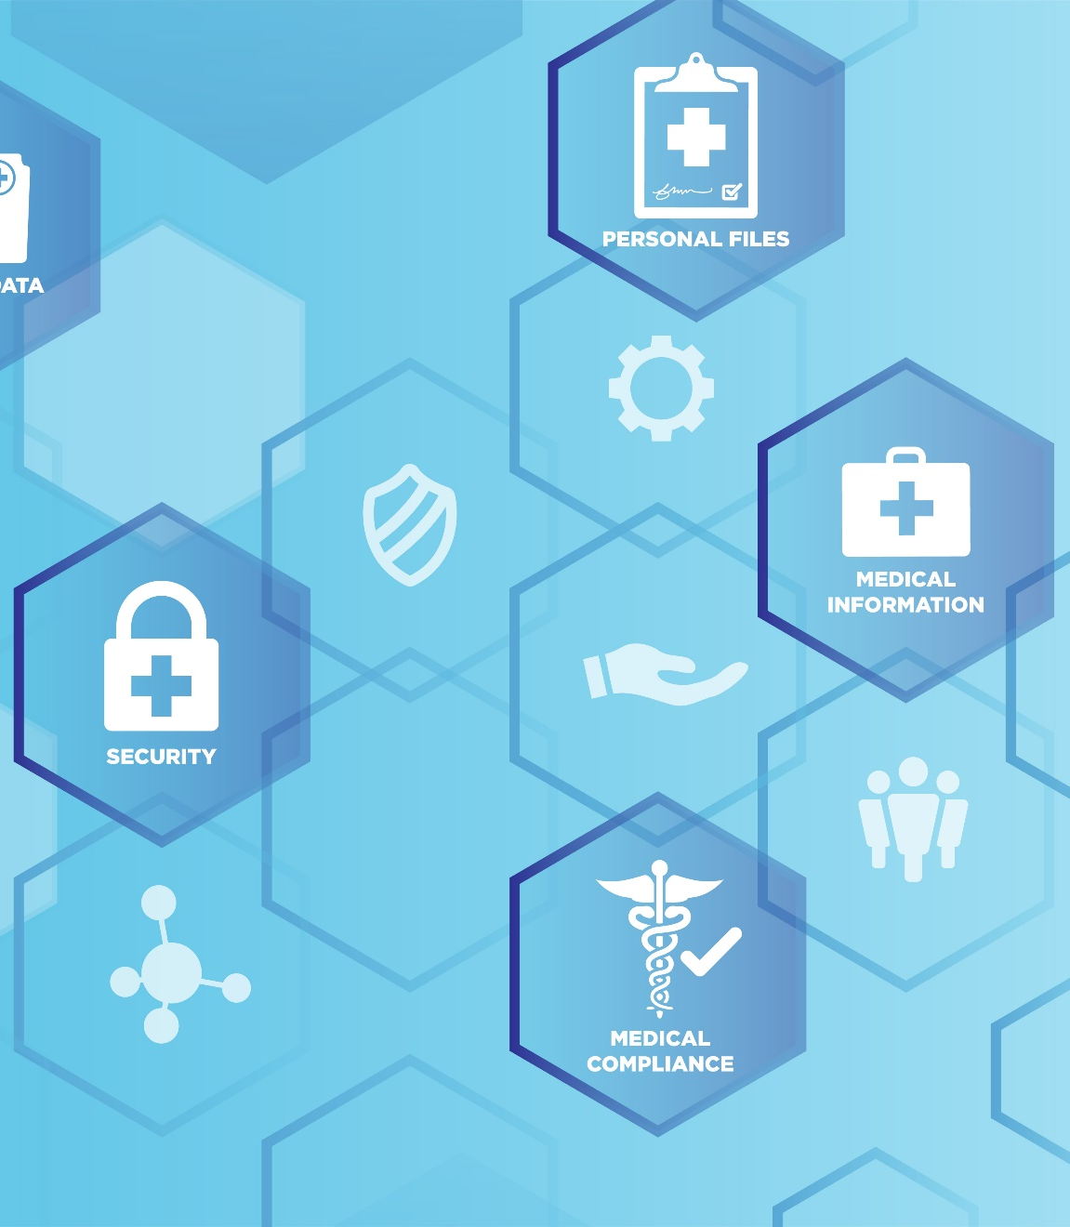
Health Insurance Portability and Accountability Act (HIPAA)
HIPAA's Administrative Simplification Statute and Rules
Electronic Transaction and Code Set Standards
Requires every provider who does business electronically to use the same health care transactions, code sets, and identifiers
Provides federal protections for the personal health information held by covered entities and gives patients an array of rights with respect to that information
Privacy Rule
Specifies a series of administrative, physical, and technical safeguards for covered entities to use to ensure the confidentiality, integrity, and availability of electronically protected health information
Security Rule
National Identifier Requirements
Requires that health care providers, health plans, and employers have standard national numbers that identify them attached to standard transactions
Enforcement Rule
Provides the standards for enforcing all the Administration Simplification Rules
https://www.hhs.gov

Slide 13

Sarbanes Oxley Act (SOX)
    Enacted in 2002, the Sarbanes-Oxley Act is designed to protect investors and the public by increasing the accuracy and reliability of corporate disclosures
    The key requirements and provisions of SOX are organized into 11 titles:
Title I
Title II
Title III
Public Company Accounting Oversight Board (PCAOB) provides independent oversight of public accounting firms providing audit services (“auditors”)
Auditor Independence establishes the standards for external auditor independence, intended to limit conflicts of interest and address new auditor approval requirements, audit partner rotation, and auditor reporting requirements
Corporate Responsibility mandates that senior executives take individual responsibility for the accuracy and completeness of corporate financial reports
https://www.sec.gov

Slide 14

Sarbanes Oxley Act (SOX) (Cont’d)
Title IV
Enhanced Financial Disclosures describe enhanced reporting requirements for financial transactions, including off-balance-sheet transactions, pro-forma figures, and the stock transactions of corporate officers
Title V
Analyst Conflicts of Interest consist of measures designed to help restore investor confidence in the reporting of securities analysts
Title VI
Commission Resources and Authority defines practices to restore investor confidence in securities analysts
Title VII
Studies and Reports includes the effects of the consolidation of public accounting firms, the role of credit rating agencies in the operation of securities markets, securities violations and enforcement actions, and whether investment banks assisted Enron, Global Crossing, or others to manipulate earnings and obfuscate true financial conditions

Slide 15
Sarbanes Oxley Act (SOX) (Cont’d)
Title VIII
Corporate and Criminal Fraud Accountability describes specific criminal penalties for fraud by the manipulation, destruction, or alteration of financial records, or other interference with investigations while providing certain protections for whistle-blowers
Tax
Title X
White Collar Crime Penalty Enhancement increases the criminal penalties associated with white-collar crimes and conspiracies. It recommends stronger sentencing guidelines and specifically adds the failure to certify corporate financial reports as a criminal offense
Title IX
Corporate Tax Returns states that the Chief Executive Officer should sign the company tax return
Title XI
Corporate Fraud Accountability identifies corporate fraud and record tampering as criminal offenses and assigns them specific penalties. It also revises sentencing guidelines and strengthens their penalties. This enables the SEC to temporarily freeze large or unusual payments

Slide 16

Gramm-Leach-Bliley Act (GLBA)
The objective of the Gramm–Leach–Bliley Act was to ease the transfer of financial information between institutions and banks while making the rights of the individual more specific through security requirements
Key Points include:
Protecting consumer’s personal financial information held by financial institutions and their service providers
The officers and directors of the financial institution shall be subject to, and personally liable for, a civil penalty of not more than $10,000 for each violation
https://www.ftc.gov

Slide 17

General Data Protection Regulation (GDPR)
GDPR regulation was put into effect on May 25, 2018 and
one of the most stringent privacy and security laws globally
The GDPR will levy harsh fines against those who violate its privacy and security standards, with penalties reaching tens of millions of euros
GDPR Data Protection Principles
Lawfulness, fairness, and transparency
Purpose limitation
Data minimization
Accuracy
Storage limitation
Integrity and confidentiality
Accountability
https://gdpr.eu

Slide 18
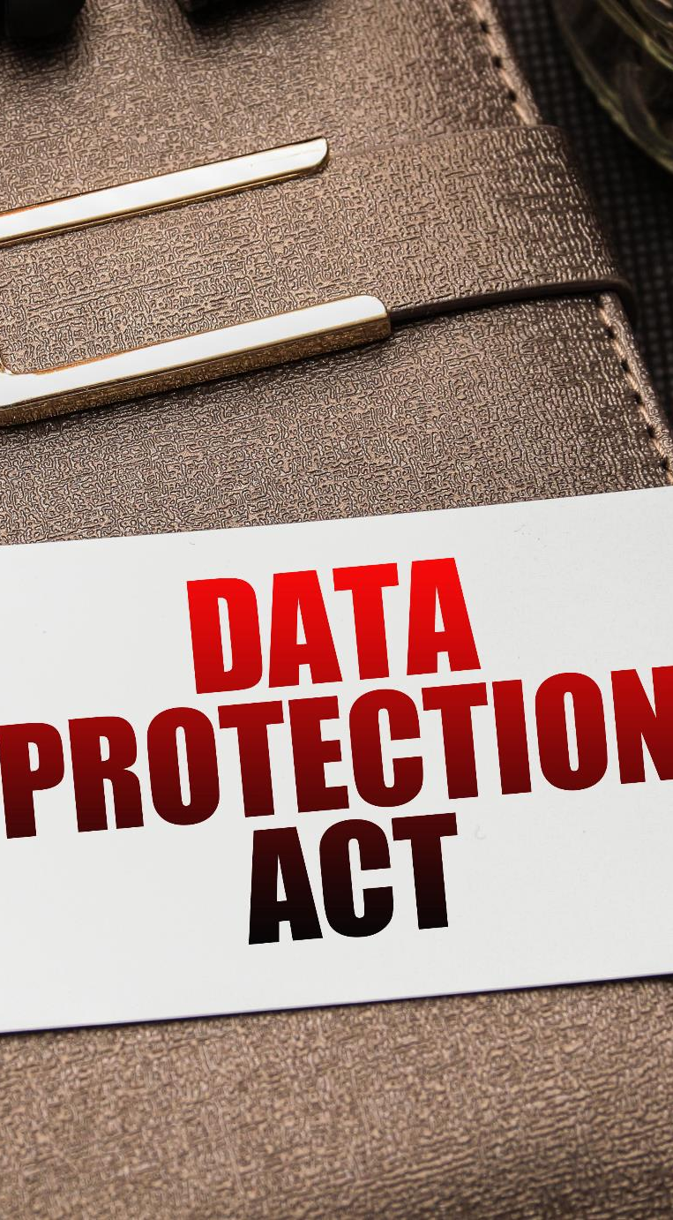

Data Protection Act 2018 (DPA)
The DPA is an act to make provision for the regulation of the processing of information relating to individuals; to make provision in connection with the Information Commissioner’s functions under specific regulations relating to information; to make provision for a direct marketing code of practice, and connected purposes
The DPA protects individuals concerning the processing of personal data, in particular by:
Requiring personal data to be processed lawfully and fairly, based on the data subject’s consent or another specified basis,
Conferring rights on the data subject to obtain information about the processing of personal data and to require inaccurate personal data to be rectified, and
Conferring functions on the Commissioner, giving the holder of that office responsibility to monitor and enforce their provisions
https://www.legislation.gov.uk
Notes:
https://www.legislation.gov.uk/ukpga/2018/12/pdfs/ukpga_20180012_en.pdf

Slide 19
ISO Information Security Standards
Sr. No. | Standards | Objective
1 | ISO/IEC 27001 | Formal ISMS specification
2 | ISO/IEC 27002 | Information security controls
3 | ISO/IEC 27003 | ISMS implementation guide
4 | ISO/IEC 27004 | Information security metrics
5 | ISO/IEC 27005 | Information security risk management
6 | ISO/IEC 27006 | ISMS certification guide
7 | ISO/IEC 27007 | Management system auditing
8 | ISO/IEC TR 27008 | Technical auditing
9 | ISO/IEC 27010 | For inter-organization communication
10 | ISO/IEC 27011 | Iso27k in telecoms
11 | ISO/IEC 27013 | ISMS & ITIL/service management
12 | ISO/IEC 27014 | Information security governance
13 | ISO/IEC TR27015 | Iso27k in financial services
14 | ISO/IEC TR 27016 | Information security economics
15 | ISO/IEC 27017 | Cloud security controls
Sr. No. | Standards | Objective
16 | ISO/IEC 27018 | Cloud privacy
17 | ISO/IEC TR 27019 | Process control in energy
18 | ISO/IEC 27031 | ICT business continuity
19 | ISO/IEC 27032 | Cybersecurity
20 | ISO/IEC 27033-1 to -5 | Network security
21 | ISO/IEC 27034 -1 & -5 | Application security
22 | ISO/IEC 27035 | Incident management
23 | ISO/IEC 27036-1 -2 & -3 | ICT supply chain
24 | ISO/IEC 27037 | Digital evidence [forensics]
25 | ISO/IEC 27038 | Document reduction
26 | ISO/IEC 27039 | Intrusion prevention
27 | ISO/IEC 27040 | Storage security
28 | ISO/IEC 27041 | Investigation assurance
29 | ISO/IEC 27042 | Analyzing digital evidence
30 | ISO/IEC 27043 | Incident investigation
31 | ISO 27799 ISO27k | In healthcare
https://www.iso27001security.com

Slide 20

The Digital Millennium Copyright Act (DMCA)
The DMCA is a United States copyright law that implements two 1996 treaties of the World Intellectual Property Organization (WIPO)
It defines the legal prohibitions against the circumvention of technological protection measures employed by copyright owners to protect their works, and against the removal or alteration of copyright management information
https://www.copyright.gov

Slide 21
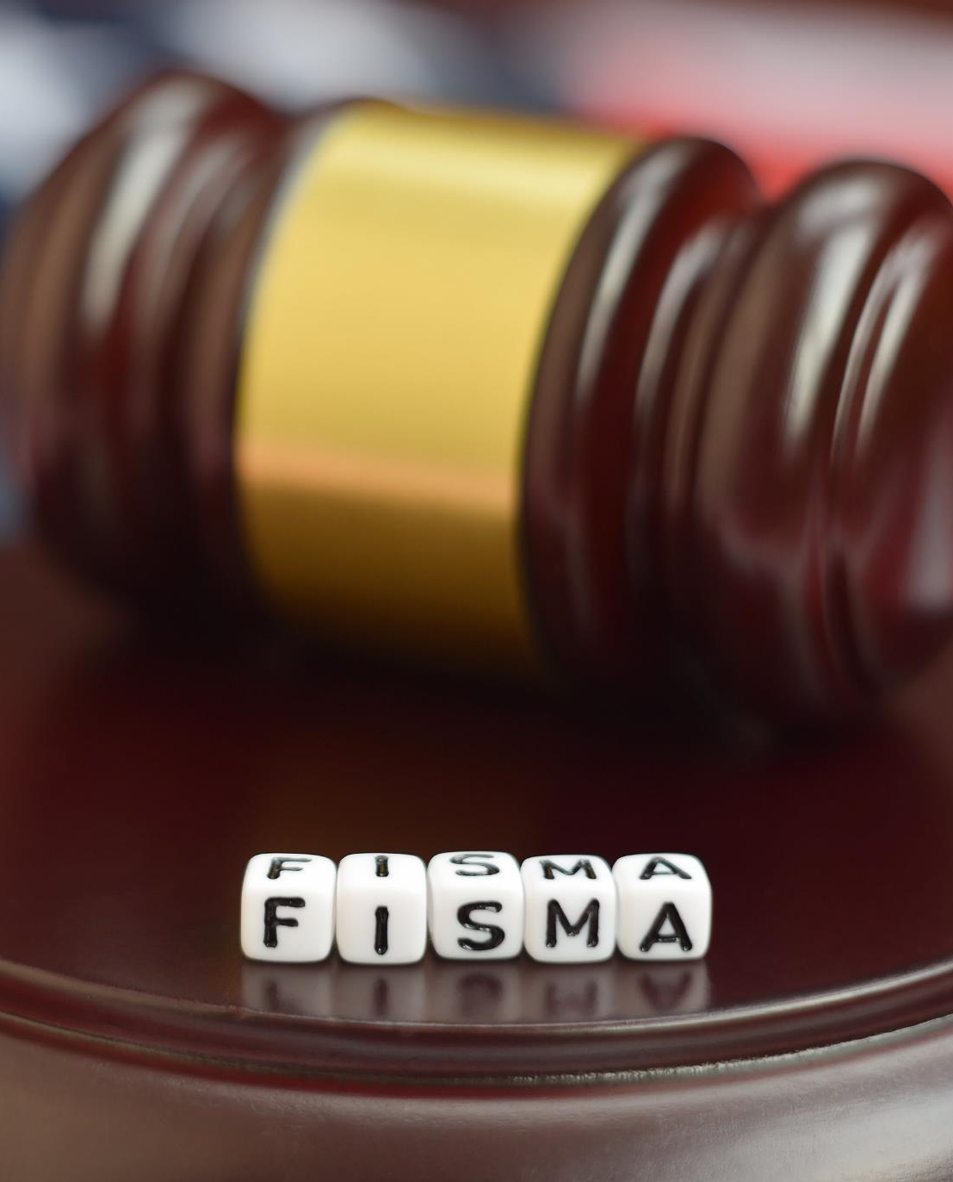
The Federal Information Security Management Act (FISMA)
Anna Stewart
The FISMA provides a comprehensive framework for ensuring the effectiveness of information security controls over information resources that support Federal operations and assets
It includes
Standards for categorizing information and information systems by mission impact
Standards for minimum security requirements for information and information systems
Guidance for selecting appropriate security controls for information systems
Guidance for assessing security controls in information systems and determining security control effectiveness
Guidance for security authorization of information systems
https://csrc.nist.gov

Slide 22
Other Information Security Acts and Laws
USA Patriot Act 2001
1
The Human Rights Act 1998
4
Freedom of Information Act (FOIA)
The Freedom of Information Act 2000
2
5
The Electronic Communications Privacy Act
3
Computer Fraud and Abuse Act
6

Slide 23

Cyber Law in Different Countries
Country Name | Laws/Acts | Website
United States | Section 107 of the Copyright Law mentions the doctrine of “fair use” | https://www.copyright.gov
 | Online Copyright Infringement Liability Limitation Act
 | The Lanham (Trademark) Act (15 USC §§ 1051 - 1127) | https://www.uspto.gov
 | Foreign Intelligence Surveillance Act | https://fas.org
 | Protect America Act of 2007 | https://www.justice.gov
 | Privacy Act of 1974 | https://www.justice.gov
 | National Information Infrastructure Protection Act of 1996 | https://www.nrotc.navy.mil
 | Computer Security Act of 1987 | https://csrc.nist.gov
 | Federal Identity Theft and Assumption Deterrence Act | https://www.ftc.gov

Slide 24

Cyber Law in Different Countries (Cont’d)
Country Name | Laws/Acts | Website
Australia | The Trade Marks Act 1995 | https://www.legislation.gov.au
 | The Patents Act 1990
 | The Copyright Act 1968
 | Cybercrime Act 2001
United Kingdom | The Copyright, Etc. and Trademarks (Offenses And Enforcement) Act 2002 | https://www.legislation.gov.uk
 | Trademarks Act 1994 (TMA)
 | Computer Misuse Act 1990
 | The Network and Information Systems Regulations 2018
 | Communications Act 2003
 | The Privacy and Electronic Communications (EC Directive) Regulations 2003
 | Investigatory Powers Act 2016
 | Regulation of Investigatory Powers Act 2000
China | Copyright Law of the People’s Republic of China (Amendments on October 27, 2001) | http://www.npc.gov.cn
 | Trademark Law of the People's Republic of China (Amendments on October 27, 2001)
India | The Patents (Amendment) Act, 1999, Trade Marks Act, 1999, The Copyright Act, 1957 | http://www.ipindia.nic.in
 | Information Technology Act | https://www.meity.gov.in
Germany | Section 202a. Data Espionage, Section 303a. Alteration of Data, Section 303b. Computer Sabotage | https://www.cybercrimelaw.net

Slide 25
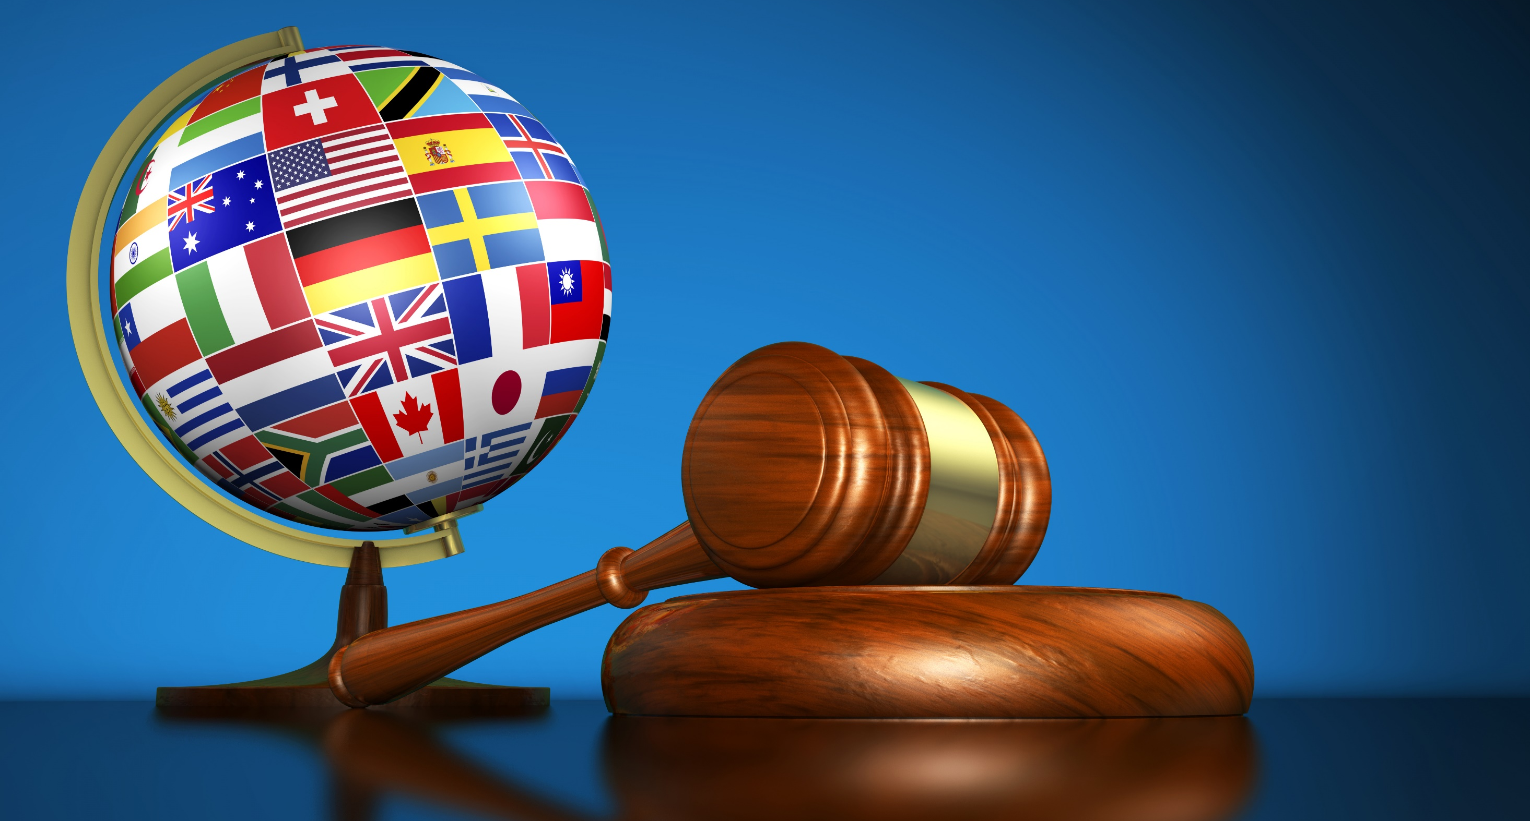
Cyber Law in Different Countries (Cont’d)
Country Name | Laws/Acts | Website
Italy | Penal Code Article 615 ter | https://www.cybercrimelaw.net
Japan | The Trademark Law (Law No. 127 of 1957), Copyright Management Business Law (4.2.2.3 of 2000) | https://www.iip.or.jp
Canada | Copyright Act (R.S.C., 1985, c. C-42), Trademark Law, Canadian Criminal Code Section 342.1 | https://laws-lois.justice.gc.ca
Singapore | Computer Misuse Act | https://sso.agc.gov.sg
South Africa | Trademarks Act 194 of 1993 | http://www.cipc.co.za
 | Copyright Act of 1978 | https://www.nlsa.ac.za
South Korea | Copyright Law Act No. 3916 | https://www.copyright.or.kr
 | Industrial Design Protection Act | https://www.kipo.go.kr
Belgium | Copyright Law, 30/06/1994 | https://www.wipo.int
 | Computer Hacking | https://www.cybercrimelaw.net
Brazil | Unauthorized modification or alteration of the information system | https://www.domstol.no
Hong Kong | Article 139 of the Basic Law | https://www.basiclaw.gov.hk

Slide 26
Module Flow
1
Discuss Various Regulatory Frameworks, Laws, and Acts
2
Learn to Design and Develop Security Policies
3
Learn to Conduct Different Types of Security and Awareness Training

Slide 27
What is Security Policy?
A security policy is a well-documented set of plans, processes, procedures, standards, and guidelines required to establish an ideal information security status of an organization
Security policies are used to inform people on how to work in a safe and secure manner; they define and guide employee actions on how to deal with organization sensitive operation, data, or resources
The security policy is an integral part of an information security management program for any organization

Slide 28
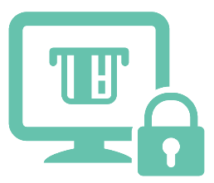
Need for a Security Policy
Provide consistent application of security principles throughout the organization
Provide legal protection
Quickly respond to security incidents
Ensure information security standards compliance
Limit the organization’s exposure to external information threats
Reduce the impact of a security incident
Outline senior management’s commitment in maintaining a secure environment
Minimize the risk of a data breach

Slide 29
Advantages of Security Policies
Enhanced Data and Network Security
Better Network Performance
Quick Response to Issues and Lower Downtime
Risk Mitigation
Monitored and Controlled Device Usage and Data Transfers
Reduction in Management Stress Levels

Slide 30

Characteristics of a Good Security Policy
Economically Feasible
Concise and Clear
Usable
Understandable
Realistic
Consistent
Procedurally Tolerable
Based on Standards and Regulations
Legal Compliance

Slide 31
Key Elements of Security Policy
Brief and Clear Information
Enforceable by Law
Sufficient Guidance
Clear Communication
Defined Scope and Applicability
Recognizes Areas of Responsibility

Slide 32
Contents of a Security Policy
This features the requirements of a system when implementing security policies that include discipline security, safeguard security, procedural security, and assurance security
High-level security requirements
Policy description based on
requirement
Focuses on the security disciplines, safeguards, procedures, continuity of operations, and documentation
Security concept of operation
Defines the roles, responsibilities, and functions of a security policy
Allocation of security enforcement to architecture elements
Provides a computer system architecture allocation to each system in the program

Slide 33
Typical Policy Document Content
Document Control
Definitions
Document Location
Roles and Responsibilities
Revision History
Target Audience
Approvals
Policy Statements
Distribution
Sanctions and Violations
Document History
Related Standards, Policies, and Processes
Overview
Contact Information
Purpose
Where to Find More Information
Scope
Glossary/ Acronyms

Slide 34
Types of Information Security Policies
Enterprise Information
Security Policy (EISP)
Issue Specific Security Policy (ISSP)
System Specific
Security Policy (SSSP)
EISP drives an organization’s scope and provides direction to their security policies
ISSP directs the audience on the usage of technology-based systems with the help of guidelines
SSSP directs users while configuring or maintaining a system
Examples of EISP:
Examples of ISSP:
Examples of SSSP:
  Application policy
  Network and network device security policy
  Back up and restore policy
  System security policy
  Remote access and wireless policies
  Incident response plan
  Password policies
  Policies for personal devices
  DMZ policy
  Encryption policy
  Policies for Intrusion detection and prevention
  Access control policy

Slide 35
Internet Access Policies
Promiscuous Policy
Permissive Policy
No restrictions on Internet/remote access
Nothing is blocked
Known dangerous services/ attacks blocked
Policy begins with no restrictions
Known holes plugged; known dangers stopped
Paranoid Policy
Prudent Policy
Everything is forbidden
No Internet connection, or severely limited Internet usage
Users find ways around overly severe restrictions
Provides maximum security while allowing known, but necessary, dangers
All services are blocked
Safe/necessary services are enabled individually

Slide 36
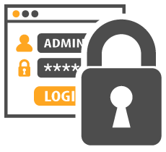
Password Policy
Password policy provides guidelines for using strong passwords for an organization’s resources
Design Considerations
05
Common password practice
04
03
Password duration
02
Password blacklists
Complexity of password
01
Password length and formation

Slide 37
Module Flow
1
Discuss Various Regulatory Frameworks, Laws, and Acts
2
Learn to Design and Develop Security Policies
3
Learn to Conduct Different Types of Security and Awareness Training

Slide 38
Employee Awareness and Training
An organization need to provide formal security awareness training for its employees when they join and periodically thereafter, so employees
  Know how to defend themselves and the organization against threats
  Follow security policies and procedures for working with IT
  Know whom to contact if they discover a security threat
  Can identify the nature of the data based on data classification
  Protect physical and informational assets of that organization
  Security awareness website
  Classroom style training
Different methods to train employees are:
  Providing hints
  Online training
  Making short films
  Round table discussions
  Conducting seminars

Slide 39

Employee Awareness and Training: Security Policy
Security policy training teaches employees how to perform their duties and to comply with the security policy
Organizations should train new employees before granting them access to the network or provide limited access until the completion of their training
Advantages
  Effective implementation of a security policy
  Policies are followed and not just enforced
  Creates awareness on compliance issues
  Helps an organization enhance its network security

Slide 40


Employee Awareness and Training: Physical Security
Proper training should be given to educate employees on physical security
Training increases the knowledge and awareness about physical security
Training should educate employees about how to:
  Minimize breaches
  Identify the elements that are more prone to hardware theft
  Assess the risks handling sensitive data
  Ensure physical security at the workplace

Slide 41

Employee Awareness and Training: Social Engineering
Train employee on possible social engineering techniques and how to combat these techniques
But I must explain to you how all this mistaken idea of denouncing pleasure and praising pain was born account of the system, some advantage from it?
Areas of Risk | Attack Techniques | Train employee/Help Desk on:
Phone | Impersonation | Not providing any confidential information, if this has occurred
Dumpsters | Dumpster Diving | Not throwing sensitive documents in the trash Shredding document before putting into the trash Erasing magnetic data before putting into the trash
Email | Phishing, malicious attachment | Differentiating between legitimate email and a targeted phishing email Not downloading malicious attachment

Slide 42


Employee Training and Awareness: Data Classification
Organization should train employees on how to tell if information is confidential
Areas of Risk | Attack Techniques | Train employee/Help Desk on
Office | Stealing sensitive information | How to classify and mark document-based classification levels and keep sensitive document in secured place
Typical Information classification levels:
Top Secret (TS)
Secret
Confidential
Restricted
Unclassified
Security labels are used to mark the security level requirements for the information assets and controls access to it
Organizations use security labels to manage access clearance to their information assets

Slide 43
Module Summary
This module has discussed various regulatory frameworks, laws, and acts
It has discussed the importance and need for a security policy along with its characteristics and advantages
It also discussed various types of security policies
Finally, this module ended with an overview on different types of security and awareness training
In the next module, we will discuss on physical network security controls in detail

