Slide 1
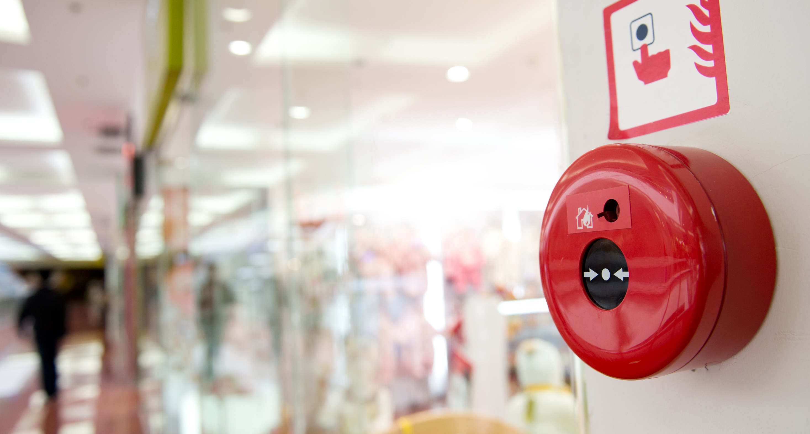
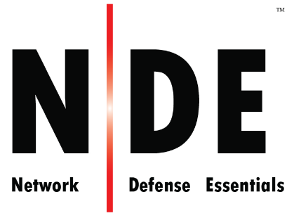
Module 04
Network Security Controls - Physical Controls
Notes:
140464306

Slide 2
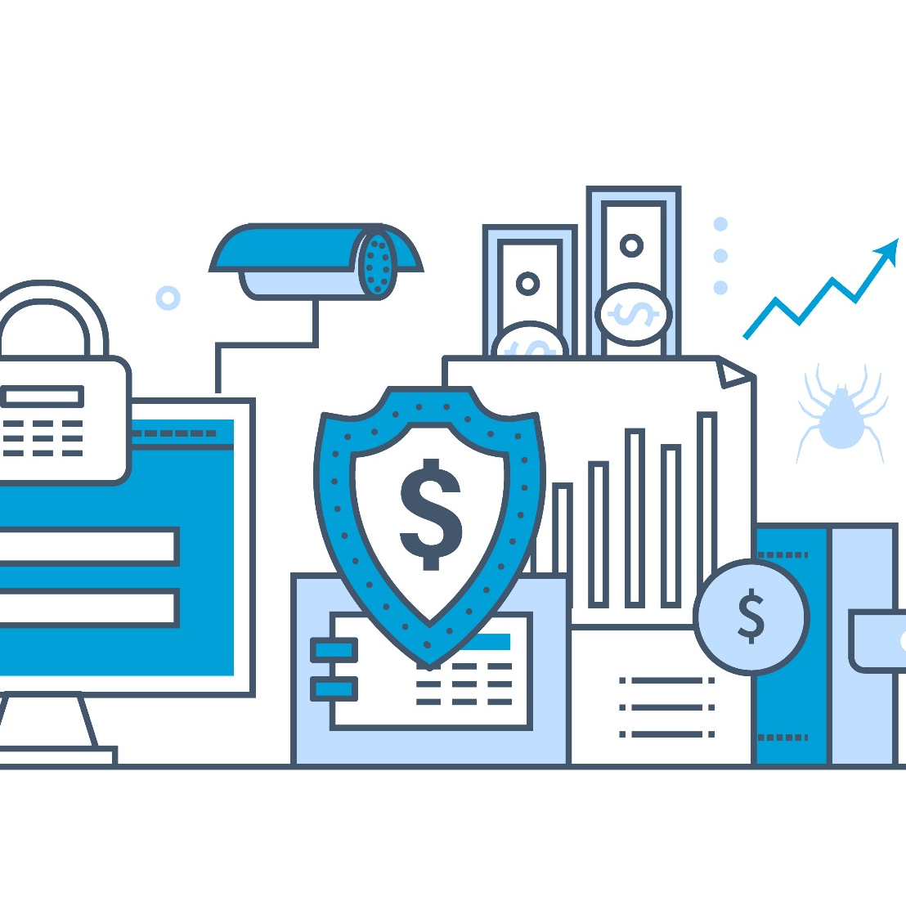
Module Objectives
1
Understanding the Importance of Physical Security
2
Understanding the Physical Security Attack Vectors
3
Understanding the Various Types of Physical Security Controls
4
Understanding the Importance of Workplace Security
5
Overview of Physical Security Policy
6
Understanding the Various Environmental Controls

Slide 3
Module Flow
1
Understand the Importance of Physical Security
3
Describe Workplace Security
2
Discuss Various Physical Security Controls
4
Describe Various Environmental Controls

Slide 4

Need for Physical Security
The physical layer of your network is not protected by traditional firewalls
A successful unauthorized physical access may lead to theft, damage, or modification of the information systems
Application Layer 7
Presentation Layer 6
Session Layer 5
A physical security breach can directly impact confidentiality, integrity, and availability of information and systems
Traditional Firewall
Transport Layer 4
Network Layer 3
Physical security is the basis of any information security program in an organization. It deals with restricting unauthorized physical access to the infrastructure, office premises, workstations, and employees of the organization
Data Link Layer 2
Physical Layer 1
The 7 Layers of OSI

Slide 5

Physical Security Attack Vectors
Natural/Environmental Threats
Man-made Threats
    Floods
    Fires
    Earthquakes
    Lightning and thunder
    Temperature and humidity
    Vandalism
    Device loss
    Damage of physical devices
    Theft
    Terrorism
    Social engineering
    Unauthorized access to systems

Slide 6
Module Flow
1
Understand the Importance of Physical Security
3
Describe Workplace Security
2
Discuss Various Physical Security Controls
4
Describe Various Environmental Controls

Slide 7
Types of Physical Security Controls
Preventive
Controls
Prevent security violations and enforce various access control mechanisms
Examples include door lock, security guard, and other measures
Detective
Controls
Detect security violations and record any intrusion attempts
Examples include motion detectors, alarm systems and sensors, video surveillance, and other methods
Deterrent
Controls
Used to discourage attackers and send warning messages to the attackers to discourage intrusion attempts
Examples include various types of warning signs
Recovery
Controls
Used to recover from security violation and restore information and systems to a persistent state
Examples include disaster recovery, business continuity plans, backup systems, and other processes
Compensating
Controls
Used as an alternative control when the intended controls failed or cannot be used
Examples include hot sites, backup power systems, and other means

Slide 8

Location Considerations
1
Visibility of assets
2
Neighboring buildings
3
Local considerations
4
Impact of catastrophic events
5
Joint tenancy risks

Slide 9

Site Architecture Considerations
  Identify what are the critical infrastructures
  Have a separate location for the server and storage room
  Identify what safety measures are required for these systems
  Have emergency exits
  Make plans to manage environment hazards
  Define who will be responsible for managing these systems
  Establish procedures explaining how they should be protected
  Use a proper sanitation system such as manholes, sewers etc.
  Keep parking away from the main building

Slide 10
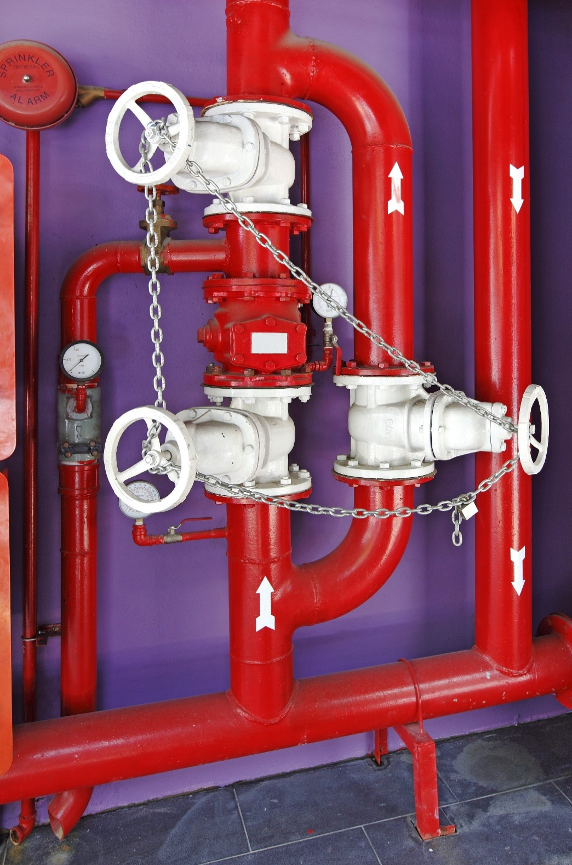
Fire Fighting Systems
Types of Fire Fighting Systems
Active fire protection (manual or automatic) | Passive fire protection (structural consideration)
Fire detection Smoke, flame and heat detectors Fire suppression Fire extinguisher Standpipe system Sprinkler systems | Use of fire-resistant construction materials Compartmentalization of the overall building Emergency exits Minimizing inflammable sources Maintenance of fire fighting systems Emergency procedures Educating the occupants
Fire Class | Fire Source | Suppressant
 |  | Water | Foam | Dry Chemical | Wet Chemical | Clean Agents and CO₂ | Special Chemicals
A | Ordinary solid combustibles | Y | Y | Y | Y
B | Flammable liquids & gases |  | Y | Y |  | Y
C | Electrical equipment |  |  | Y |  | Y
D | Combustible metals |  | Y |  |  |  | Y
K | Oils and fats |  | Y |  | Y
Name Here
Name Here

Slide 11
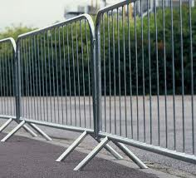
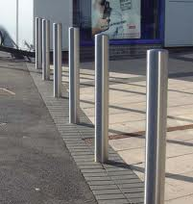
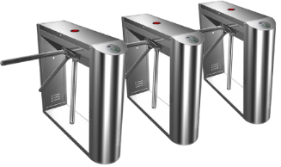
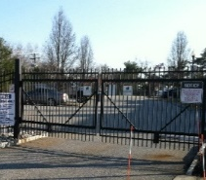
Physical Barriers
Physical barriers restrict unauthorized people from entering the building; always use a combination of barriers to deter unauthorized entry
Fences/Electric fences/Metal Rails
Other Physical barriers
Bollards
Turnstiles
First line of defense to stop trespassers
It is used to control vehicular and pedestrian traffic
It facilitates entry and access controls
Include doors, windows, grills, glass, curtains, etc.

Slide 12

Security Personnel
01
Efficient and well trained security personnel are critical to implement, monitor, and maintain the physical security of organization
02
People involved in physical security include guards, safety officer, plant’s security officer/supervisor, etc.
Security personnel should be aware of:
Physical security policies and procedures | Handling emergency situations | Patrolling procedures
First aid and medical assistance | Fire prevention | Trespassers and crowd management

Slide 13
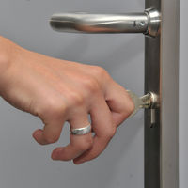
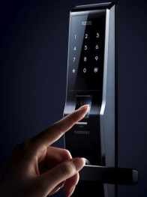
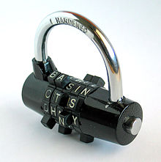
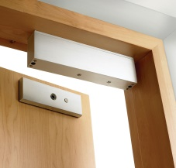
Physical Locks
Mechanical locks:
Uses a combination of springs, tumblers, levers, and latches, and operates by means of physical keys
Digital locks:
Requires a fingerprint, smart card or PIN authentication to unlock
Types of Locks
Electronic /Electric /Electromagnetic locks:
Uses magnets, solenoids and motors to operate by supplying or removing power
Combination locks:
Requires a sequence of numbers or symbols to unlock

Slide 14
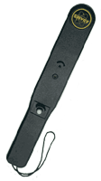
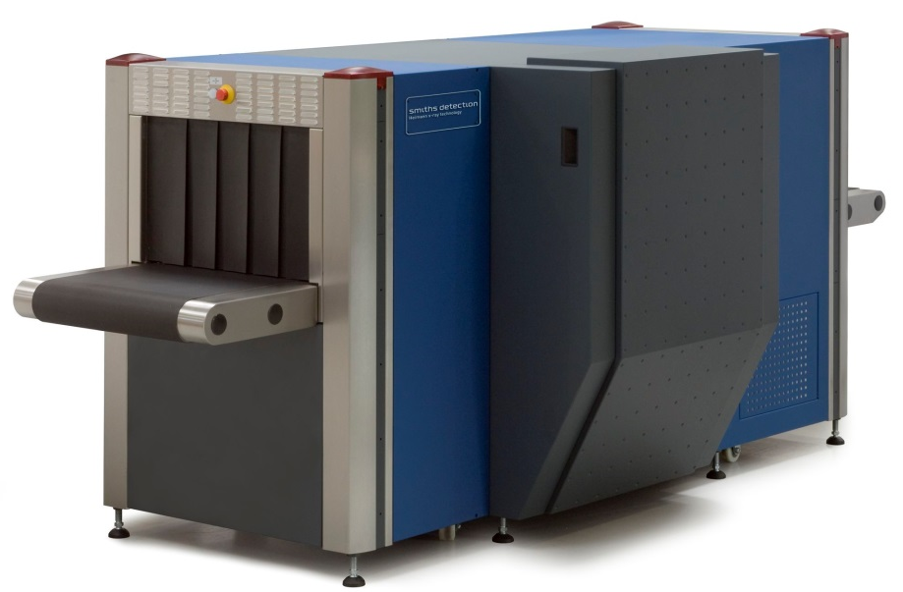
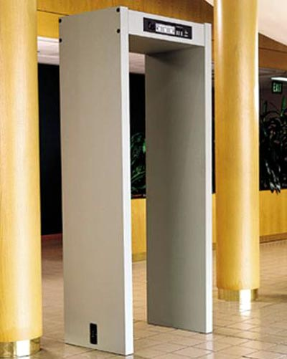
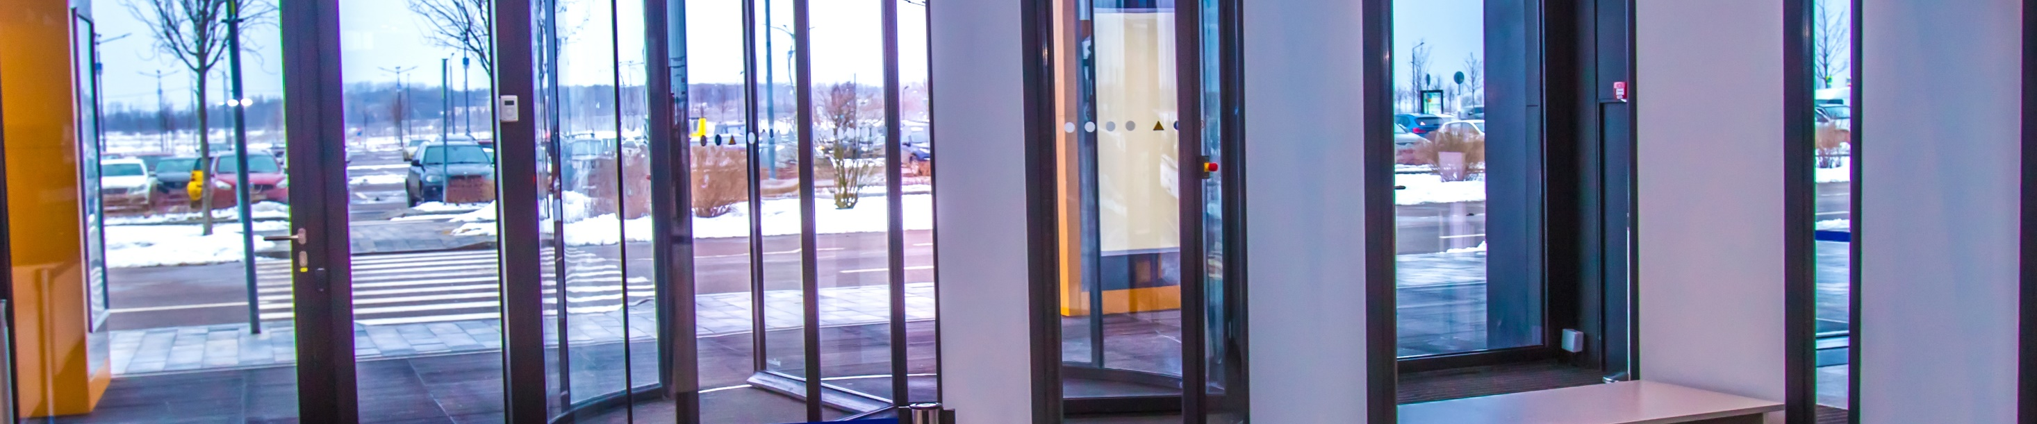
Concealed Weapon/Contraband Detection Devices
Contraband includes materials that are banned from entering the environment such as explosives, bombs, weapons, etc.
Use different tools such as handheld metal detectors, walkthrough metal detectors, X-ray inspection systems, etc. to detect contraband materials
Metal detectors
X-ray inspection systems
Walkthrough metal detectors

Slide 15
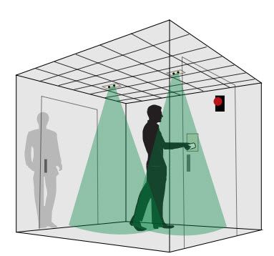
Mantrap
It is a security system having an entry and exit door on opposite sides, separating non-secure area from secure area
It allows only one door to be opened at a time, people enter the mantrap, request access and if granted they are permitted to exit. If access is not granted they are held inside until security personnel unlocks the mantrap
Passing these doors is allowed only through access control mechanisms such as access cards, password, voice recognition, biometrics, etc.

Slide 16
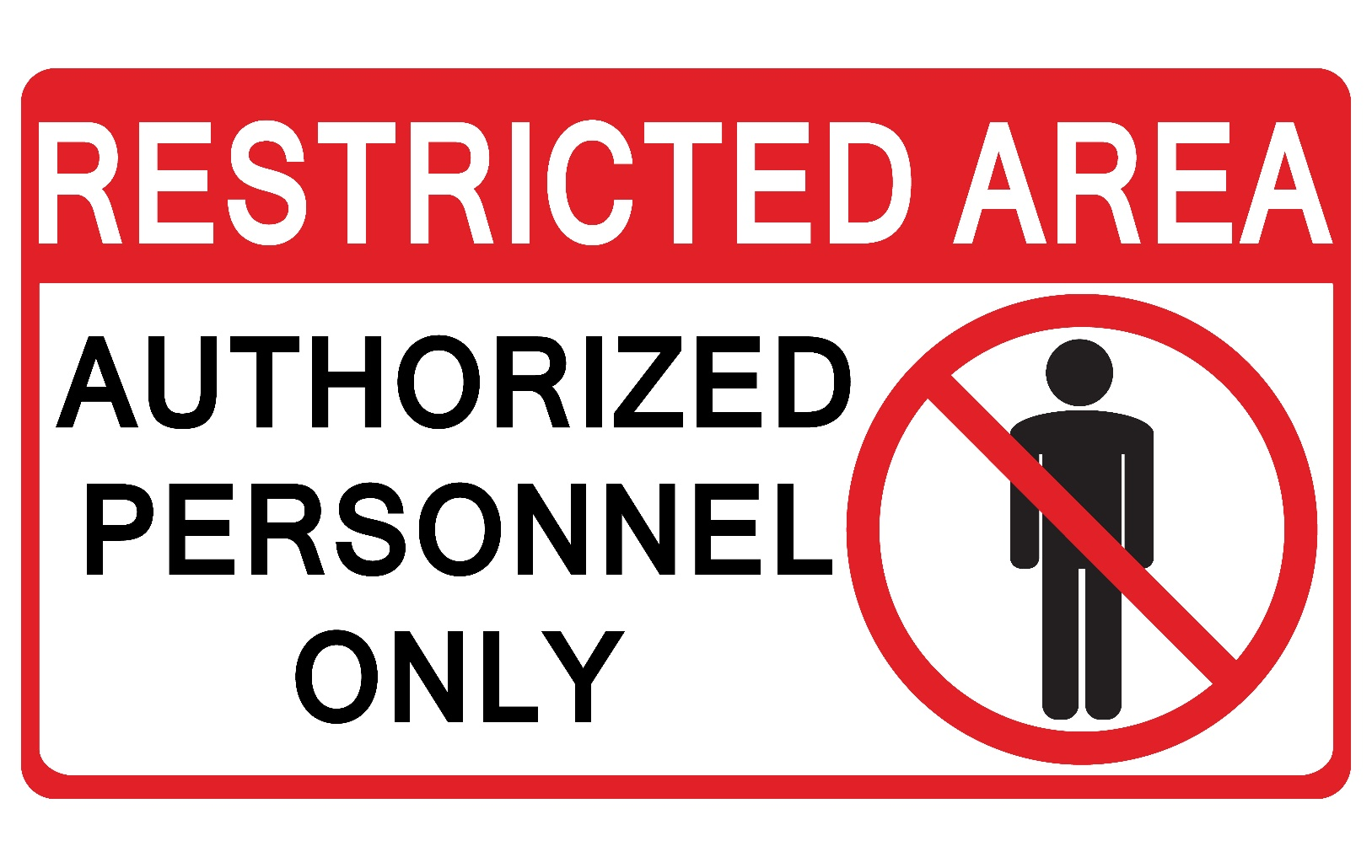
Warning Signs
      Warning signs are used to ensure someone does not inadvertently intrude in any restricted areas
      Appropriate warning signs should be placed at each access control point

Slide 17
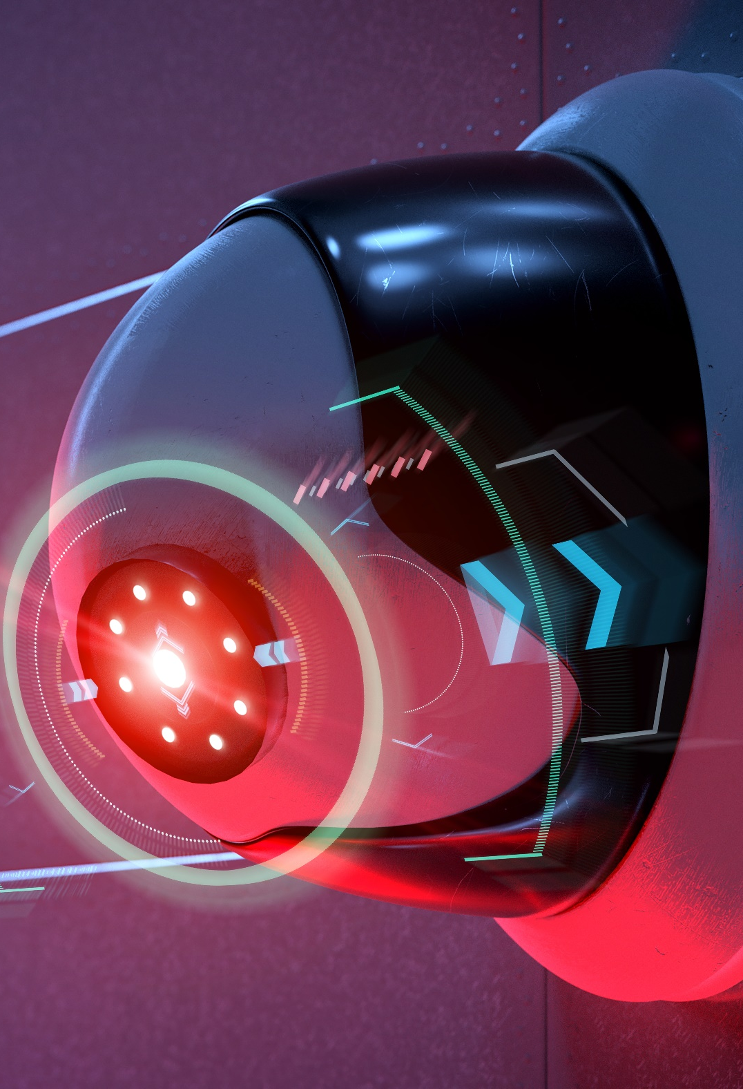
Alarm System
Proper alarm systems should be installed inside and at the entrance to report intrusions, suspicious activity, and emergencies
It can be turned on either automatically or manually by smoke detectors, heat detectors, security personnel, etc.
It should be audible to everyone in the building and set at intervals of 5 minutes such as the first alert, second alert and then the final alert to evacuate

Slide 18
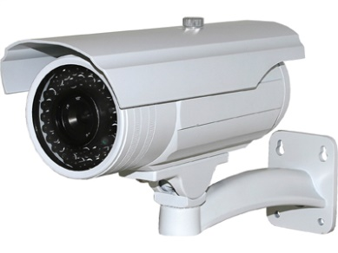
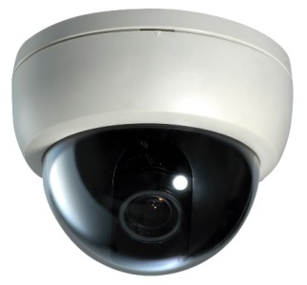
Video Surveillance
1
Video surveillance refers to monitoring activities in and around the premises using CCTV (Close Circuit Television) systems
2
CCTV systems can be programmed to capture motion and trigger alarms if an intrusion or movement is detected
Surveillance systems should be installed at strategic locations in and around the premises such as parking lots, reception, lobby, work area, server rooms, and areas having output devices such as printers, scanners, fax machine, etc.
3
Bullet-type CCTV Camera
Basic Types of
CCTV Camera
Dome-type CCTV Camera

Slide 19
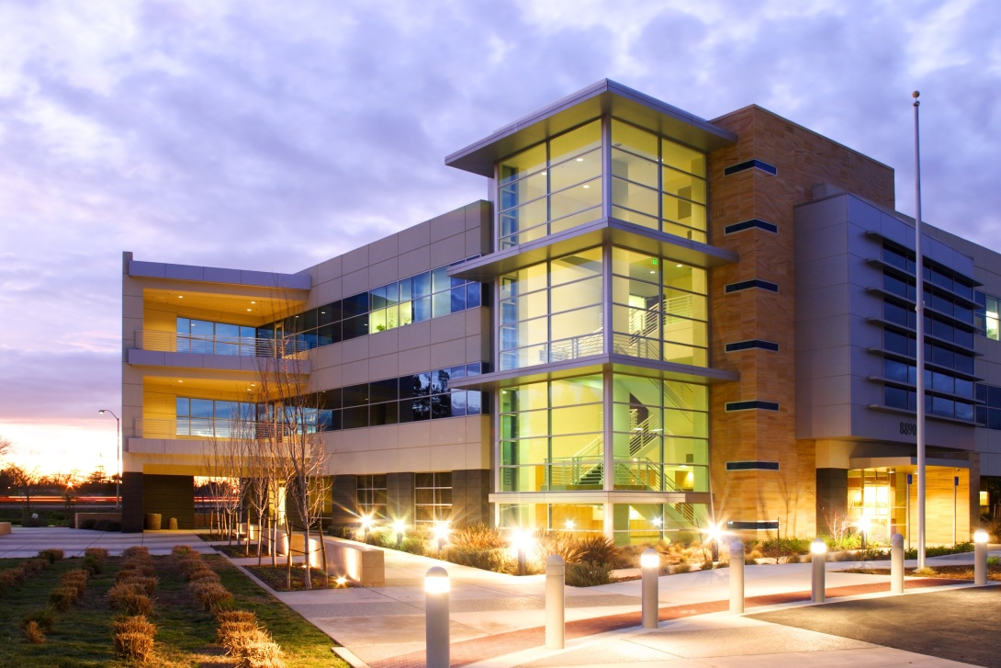
Lighting System
Adequate lighting should be provided inside, outside, and at the entrance of the building which helps in seeing long distances during security patrols
Adequate lighting will discourage intruders from entering the premises and concealing behind stones, bushes, trees, etc.
Types of lighting systems:
  Continuous
  Standby
  Movable
  Emergency

Slide 20
Power Supply
Use UPS (Uninterruptible Power Supply) systems to manage unexpected power disruptions or fluctuations in primary electric supply that may lead to equipment failure, business disruption or data loss
Different types of UPS systems (UPS Topologies):
Standby on-line hybrid
Standby
Line Interactive
Most commonly used for personal computers
Most commonly used for small business, web, and departmental servers
Most commonly used for server rooms
Double Conversion On-Line
Delta Conversion On-Line
Standby-Ferro
No longer commonly used because it becomes unstable when operating a modern computer power supply load
Generally used in environments where electrical isolation is necessary
Can be useful where complete isolation and/or direct connectivity is required

Slide 21
Module Flow
1
Understand the Importance of Physical Security
3
Describe Workplace Security
2
Discuss Various Physical Security Controls
4
Describe Various Environmental Controls

Slide 22
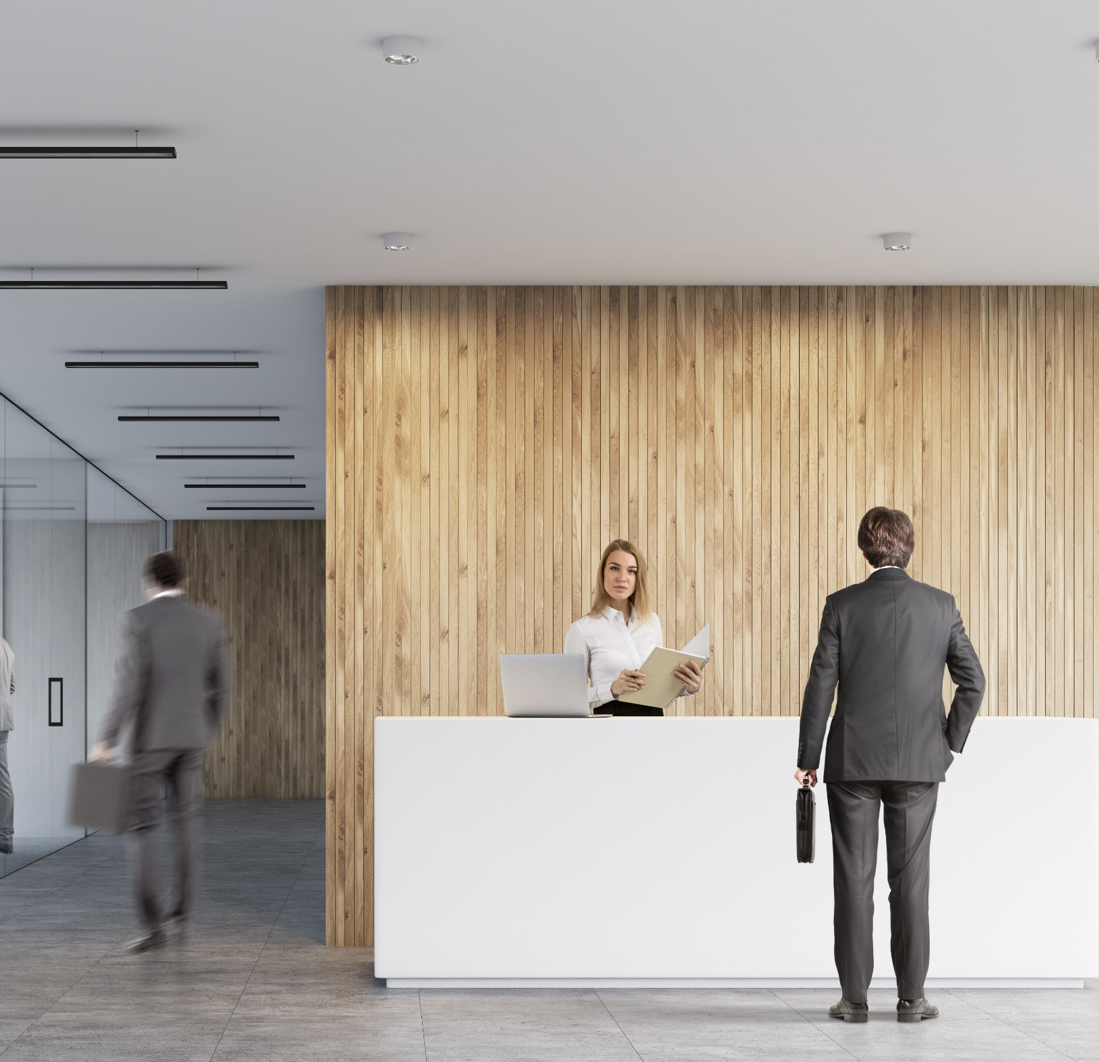
Reception Area
The reception area should be spacious and offer a proper scope to control building access, visitor traffic and assess visitor’s behavior
Important files and documents or devices should not be kept on the reception desk
The design and placement of reception desks should help in discouraging inappropriate access to the administrative area
Computers at a reception desk should be positioned so the screens are not visible to visitors
Computers at the reception desk must always be locked when the receptionist personnel is away from the desk

Slide 23
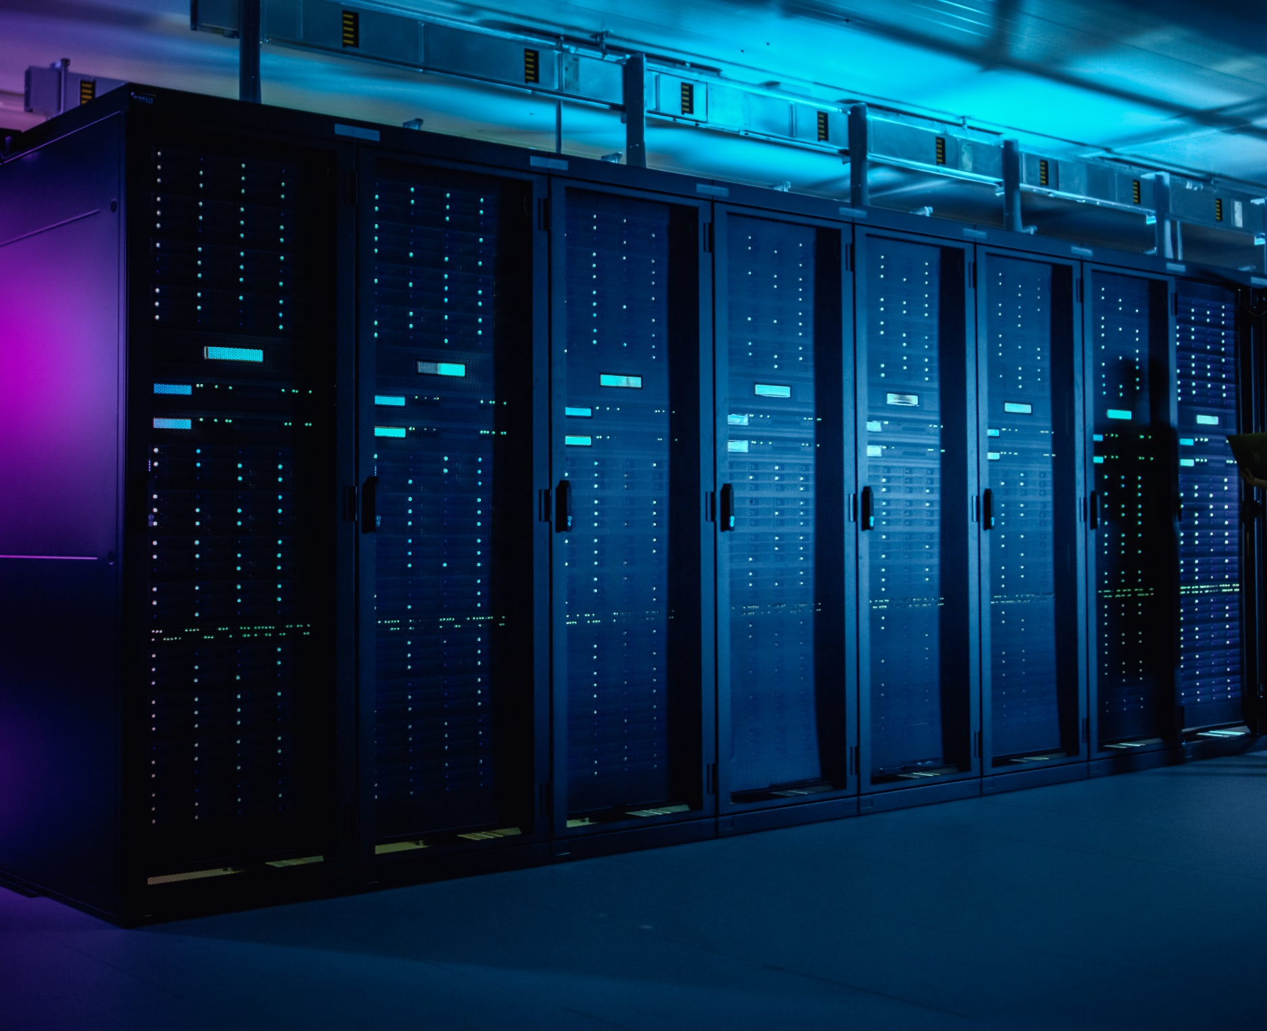
Server/Backup Device Security
01
Keep critical network assets, such as servers and backup devices, in a separate room
02
Protect the server room and backup devices with an appropriate access control
Keep the server room and backup devices under video surveillance
03

Slide 24

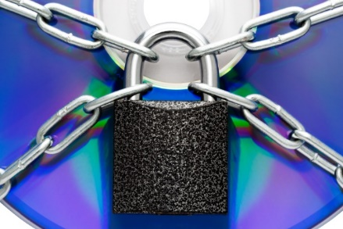
Critical Assets and Removable Devices
Keep your network devices and computer equipment in locked cabinets
Some cabinets comes with biometric locks and climate control features
Restrict the use of removable devices such as DVDs, USB pen drives, SD cards, mobile phones, cameras, etc.
Design and implement acceptable-use policies to manage the use of removable device
Implement a regular inventory review of removable devices
Consider using corporate-controlled locked-down devices instead of implementing a bring-your-own-device (BYOD) policy

Slide 25
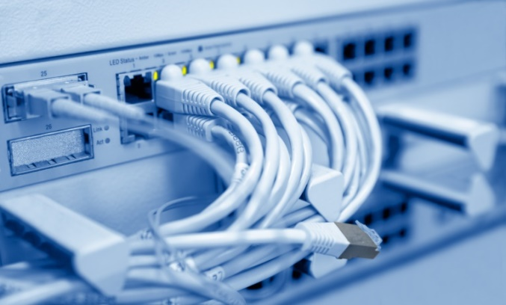
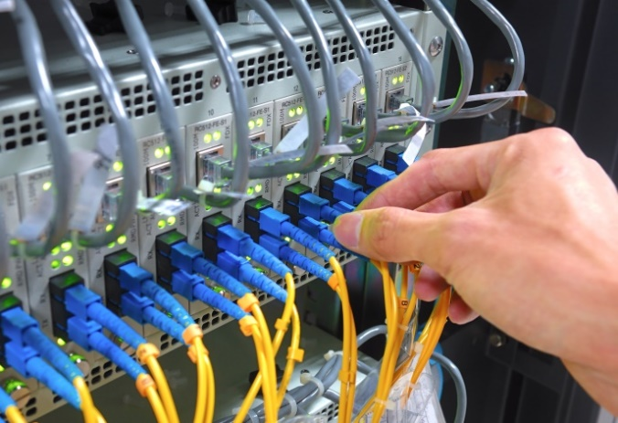
Securing Network Cables
01
Lay network wiring separate from all other wiring for easy maintenance, monitoring, and to prevent electronic interference
02
Consider installing armored cable if there is a threat of rodents, termites, etc.
03
Use transparent conduits for cabling in high sensitive areas which allow easy identification of any damage or interference
04
All network and communication cables should be hidden and protected appropriately
05
Undergrounding cables will prevent physical access to the cables
06
Do not lay cables above false ceiling to avoid fire risks
07
Document the entire cable infrastructure

Slide 26

Securing Portable Mobile Devices
  Use cables and locks to safeguard laptops
  Encrypt hard drives to make it impossible to access files when it’s lost or stolen
Install anti-theft software that can remotely lock and track devices using a data connection
Install device tracking software that can assist in recovering stolen/lost devices
Enable or install a remote wipe feature to erase data stored in devices
Do not lend your device to third parties
Do not leave your device unattended in public places
Label the device or attach a sticker with the name and contact details so the device can be returned if lost

Slide 27

Physical Security Policy
Physical security policy defines guidelines to ensure that adequate physical security measures are in place
Design Considerations
1
  Is the building protection deficiency reviewed regularly?
2
  Is there a process to identify outsiders such as visitors, contractors, and vendors before giving them access to the premises?
3
  Are there adequate lighting systems in place?
4
  Are each of the entry points properly blocked?
5
  Are the badges, locks, keys, and authentication controls audited regularly?
6
  Is video surveillance footage monitored regularly?
7
  Is a proper inventory of an organization’s assets maintained regularly?

Slide 28
Module Flow
1
Understand the Importance of Physical Security
3
Describe Workplace Security
2
Discuss Various Physical Security Controls
4
Describe Various Environmental Controls

Slide 29
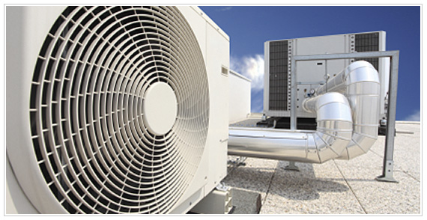
Heating, Ventilation and Air Conditioning
Continuous power consumption/supply makes data centers, hardware, and equipment become hot very quickly
Improper equipment placement can increase the risk of fire
HVAC (Heating, Ventilation, and Air Conditioning) systems control the surrounding environment in a room or building especially humidity, temperature, and air flow
HVAC ensures the information system components are less prone to damage due to environmental changes
Consider various factors and components such as hardware, cabling, fire protection, and power supply, etc. before installing the HVAC equipment
Maintain baseline temperature and humidity levels to keep equipment working reliably

Slide 30


Electromagnetic Interference (EMI) Shielding
  EMI occurs when electronic device’s performance is interrupted or degraded due to electromagnetic radiation or conduction
  High levels of disturbance can cause severe damage such as shaky monitors, system failures, unexplained shutdowns, etc.
  EMI shielding is a coating on electronic equipment kept in metal boxes which block emissions and radiation

Slide 31

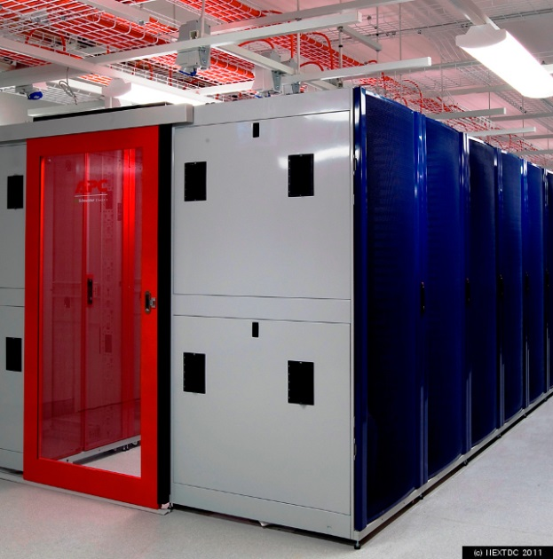
Hot and Cold Aisles
A hot and cold aisle is an arrangement of server racks and networking equipment to manage cold and hot air flow
This arrangement isolates the cold and hot aisles from each other, by placing them in opposite directions
Cold aisles typically face air conditioner output ducts and hot aisles should face air conditioner input ducts
It saves the hardware from humidity and heat, increases hardware performance and maintains consistent room temperature

Slide 32
Physical Security Checklists
Ensure that proper access control methods are implemented to prevent unauthorized access
Ensure that sensitive areas are monitored with proper lighting
1
2
Ensure an alarm system is installed for all types of threats such as fire, smoke, electricity, water, etc. and is working properly
Ensure an appropriate door lock system is implemented and is working properly
3
4
Ensure an adequate number of security guards is hired to monitor the physical security of the campus
5
6
Ensure the security personnel is given proper training

Slide 33
Module Summary
1
This module has discussed the importance of physical security, and its role in the organization’s information security program
2
This module introduced you to the various physical security controls and security measures that organizations should consider while implementing physical security
3
This module also explained in detail on the importance of workplace security
4
Finally, this module ended with an overview on various environmental controls
5
In the next module, we will discuss on technical network security controls in detail

