Slide 1

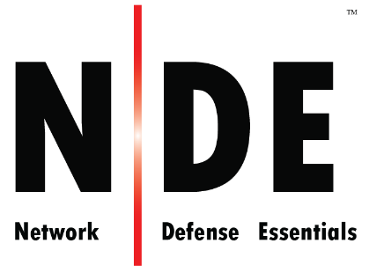
Module 06
Virtualization and Cloud Computing
Notes:
203618407

Slide 2

Module Objectives
01
Understanding Virtualization, its Components, and Virtualization Enablers
02
Understanding OS Virtualization Security and Concerns
03
Understanding the Best Practices for OS Virtualization Security
04
Understanding Cloud Computing and its Benefits
05
Overview of Different Types of Cloud Computing Services
06
Overview of Cloud Deployment Models
08
Understanding Importance of Cloud Security and its Best Practices

Slide 3
Module Flow
Understand Virtualization Essential Concepts and OS Virtualization Security
1
2
Understand Cloud Computing Fundamentals
Discuss the Insights of Cloud Security and Best Practices
3

Slide 4
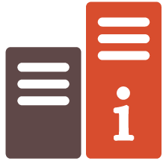

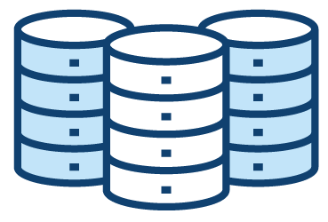
Virtualization refers to a software-based virtual representation of
an IT infrastructure that includes network, devices, applications,
storage, etc.
The virtualization framework divides the physical resources
which are traditionally bound to hardware, into multiple
individual simulated environments
Virtualization
Virtual Architecture
Traditional Architecture
Application
Application
Application
Application
Applications
Operating System
Operating System
Operating System
Operating System
Operating System
Virtual Infrastructure
HARDWARE
Network
Network
Server
Storage
Server
Storage

Slide 5
Virtualization (Cont’d)
Virtualization Approaches
Levels of Virtualization
Types of Virtualization
Full Virtualization
OS assisted Virtualization or Para Virtualization
Hardware assisted Virtualization
Hybrid Virtualization
Storage Device Virtualization
File System Virtualization
Server Virtualization
Fabric Virtualization
Operating System Virtualization
Network Virtualization
Server Virtualization
Desktop Virtualization

Slide 6
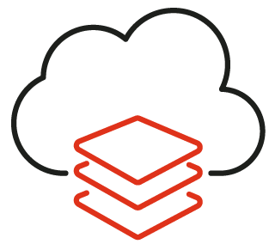
Virtualization Components
01
Hypervisor / Virtual Machine Monitor
An application or firmware that enables multiple guest operating systems to share a host’s hardware resources
Virtual Machine
Virtual Machine
02
Guest Machine / Virtual Machine
Virtual H/W
Virtual H/W
Independent instance of an operating system created by virtual machine monitor
Virtual Storage
OS
Management Console
OS
Management Server
03
Apps
Apps
Host Machine / Physical Machine
Real physical machine that provides computing resources to support virtual machines
Virtual Network
Virtual Machine Monitor (VMM)
04
Management Server
Virtualization platform components used to directly manage the virtual machines
Hypervisor
Physical Machine or Host
05
Management Console
Interface used to access, configure, and manage the virtualization product

Slide 7

Virtualization Enablers
Software
Defined
Network
(SDN)
Network Function Virtualization (NFV)
Network Virtualization (NV)

Slide 8

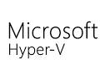
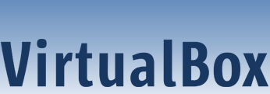
Common Virtualization Vendors
VMware ESXi (https://www.vmware.com)
Citrix Hypervisor (https://www.citrix.com)
Virtual Iron (https://www.oracle.com)
Microsoft Hyper-V Server (https://www.microsoft.com)
VirtualBox (https://www.virtualbox.org)

Slide 9

OS Virtualization Security and Concerns

Slide 10
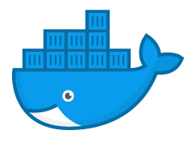
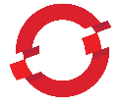
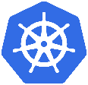
Container
Virtualization based on an operating system, in which the kernel’s operating system functionality is replicated on multiple instances of isolated user space, called containers, software containers or virtualization engines
Containers as a service (CaaS) includes the virtualization of containers and container management through orchestrators
Using CaaS, subscribers can develop rich, scalable containerized applications through the cloud or on-site data centers
Container Orchestration Software
Container Engine
Container Orchestration
Managed environment for deploying containerized applications
An automated process of managing the lifecycles of software containers and their dynamic environment
Docker Swarm
OPENSHIFT
Kubernetes

Slide 11


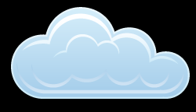





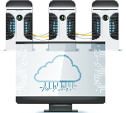
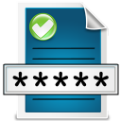
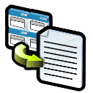
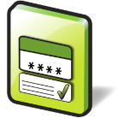
Container Technology Architecture
Host with Containers
Admin
Admin
Developer
Host with Containers
Developer
Internal Registry
Testing and Accreditation Systems
Host with Containers
External Registry
Orchestrator
Developer
Image Creation, Testing and Accreditation
Storage and Retrieval of Image
Deployment and Management of Container

Slide 12
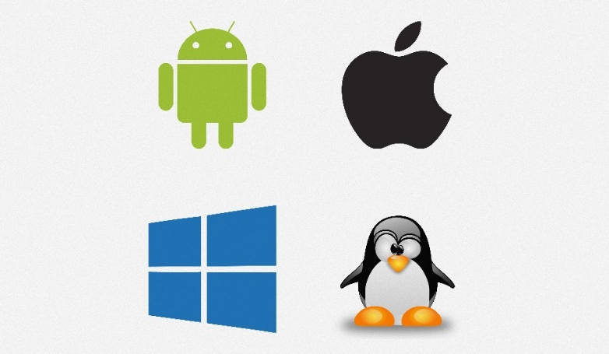
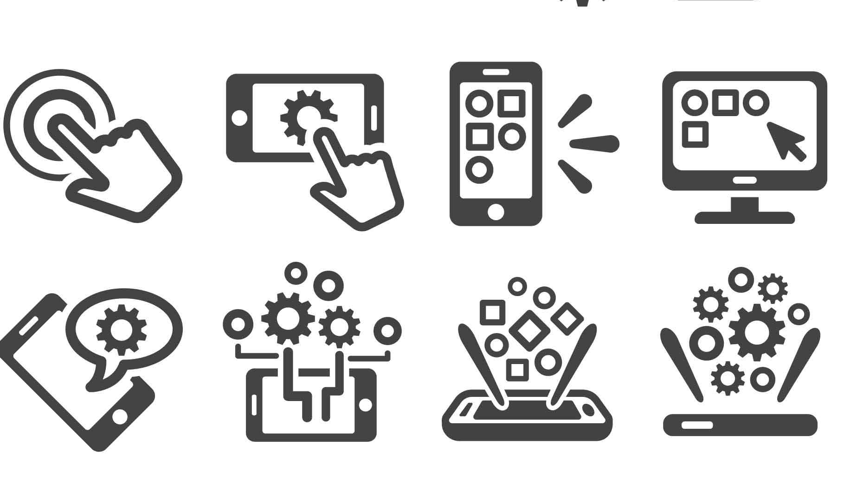
Types of Containers
OS Containers
Application Containers
Containers used as an operating system and run multiple services
Examples: LXC, OpenVZ, Linux Vserver, BDS Jails, Solaris Zones
  Containers used to run a single application
  A container contains the application, its dependencies, and hardware requirements file
  Examples: Docker, Rocket

Slide 13

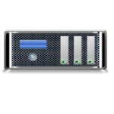



Containers v/s Virtual Machine
Container | Virtual Machine
Provides OS-level virtualization | Provides hardware-level virtualization
Lightweight | Heavyweight
All containers share the host OS | Each virtual machine runs in its own OS
Requires less memory space | Allocates required memory
Fully isolated (more secure) | Process-level isolation (less secure)
Example: LXC, LXD, CGManager, Docker | Example: VMWare, Hyper-V, vSphere, Virtual Box
Virtual Machines
App1
App2
App3
Bins/Libs
Bins/Libs
Bins/Libs
Guest OS
Guest OS
Guest OS
Hypervisor
Host Operating System
Infrastructure
Containers
App1
App2
App3
Bins/Libs
Bins/Libs
Bins/Libs
Container Engine (Docker)
Host Operating System
Infrastructure

Slide 14
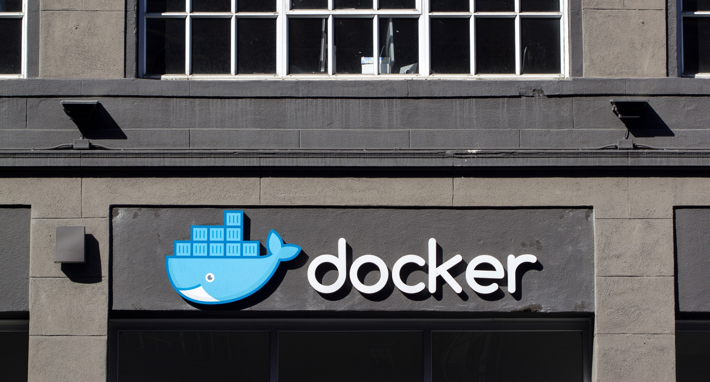
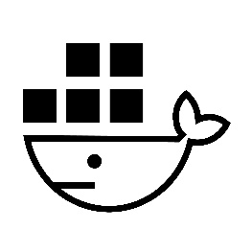

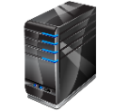
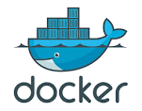






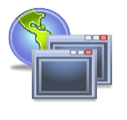




Docker
Docker is an open source technology used for developing, packaging, and running applications and all its dependencies in the form of containers, to ensure that the application works in a seamless environment
Docker provides a Platform-as-a-Service (PaaS) through OS-level virtualization and delivers containerized software packages
Docker Engine
Docker Architecture
Client Docker CLI
Manages
Manages
Client
Docker Host
Registry
Containers
Rest API
Images
DAEMON
Docker Build
Server Docker daemon
Manages
Docker Pull
Network
Manages
Data Volumes
Docker Run
Build
Pull
Containers
Images
Run

Slide 15





Docker Networking
Docker connects multiple containers and services or other
non-Docker workloads together
The Docker networking architecture is developed on a set of interfaces known as the Container Network Model (CNM)
The CNM provides application portability across heterogeneous infrastructures
Network Sandbox
Network Sandbox
Network Sandbox
Container
Container
Container
Endpoint
Endpoint
Endpoint
Endpoint
Network
Network
Docker Engine
Network Driver
IPAM Driver
Network Infrastructure

Slide 16
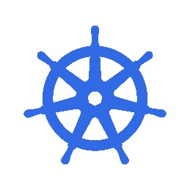

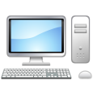
Kubernetes
Kubernetes, also known as K8s, is an open-source, portable, extensible, orchestration platform developed by Google for managing containerized applications and microservices
Kubernetes provides a resilient framework for managing distributed containers, generating deployment patterns, and performing failover and redundancy for the applications
Kubernetes Cluster Architecture
Kubernetes Master
kube-controller-manager
cloud-controller- manager
Cloud
kube-apiserver
kubelet
kubelet
kubelet
kube-proxy
kube-proxy
kube-proxy
Kube-scheduler
etcd
Kubernetes Nodes

Slide 17
Container Security Challenges
1
2
3
4
5
Inflow of vulnerable source code
Large attack surface
Lack of visibility
Compromising secrets
DevOps speed
6
7
8
9
10
Noisy neighboring containers
Container breakout to the host
Network-based attacks
Bypassing isolation
Ecosystem complexity

Slide 18

Container Security Threats
Image Threats
Registry Threats
Container Threats
  Image vulnerabilities
  Image configuration defects
  Embedded malware
  Embedded clear text secrets
  Use of untrusted images
  Insecure connections to registries
  Stale images in registries
  Insufficient authentication and authorization restrictions
  Vulnerabilities within the runtime software
  Unbounded network access from containers
  Insecure container runtime configurations
  App vulnerabilities
  Rogue containers

Slide 19

Container Security Threats (Cont’d)
Orchestrator Threats
  Unbounded administrative access
  Unauthorized access
  Poorly separated inter-container network traffic
  Mixing of workload sensitivity levels
  Orchestrator node trust
Host OS Threats
  Large attack surface
  Shared kernel
  Host OS component vulnerabilities
  Improper user access rights
  Host OS file system tampering

Slide 20

Docker Security Threats
Escaping
Gaining of root access on the host server by user with access to a container
Gaining access to a container and utilizing it to attack other containers of the same host or within the local network.
Examples: DDoS Attacks, malicious (remote) access, unpatched exploits
Cross-Container Attacks
Inter-Container Attacks
Gaining unauthorized access to a single container
Docker Registry Attacks
Gaining access to the docker registry

Slide 21
Kubernetes Security Challenges and Threats
01
02
03
04
Explosion of east-west traffic
Increased attack surface
Automating security to keep pace
Too many containers
05
06
07
08
Communication between containers
Default configuration settings
Runtime security challenges
Compliance issues
Notes:
https://www.stackrox.com/post/2020/05/kubernetes-security-101/
https://techbeacon.com/enterprise-it/4-kubernetes-security-challenges-how-address-them
https://informationsecuritybuzz.com/articles/what-are-the-top-5-kubernetes-security-challenges-and-risks/

Slide 22
OS Virtualization Security Best Practices

Slide 23
Best Practices for Container Security
1
2
3
Regularly monitor the CVEs of the container runtime and remediate, if any vulnerabilities are detected
Employ app-aware tools to monitor container network interfaces, network traffic, and network anomalies
Configure applications to run as normal users to prevent privilege escalation
4
5
6
Configure the host's root file system in read-only mode to restrict the write access
Employ application security scanning tools to protect containers from malicious software
Perform regular scanning of the images in the repository to identify vulnerabilities or misconfigurations

Slide 24
Best Practices for Docker Security
Enable read-only mode on file systems and volumes by setting --read-only flag
Limit the capabilities by allowing access only to the features required by the container
Always use trusted Docker images only
02
04
06
01
03
05
Avoid exposing the Docker daemon socket
Regularly patch the host OS and Docker with the latest security updates
Use Linux security modules such as seccomp, AppArmor, and SELinux to gain fine-grained control over the processes

Slide 25
Ensure proper validation of file contents and their path at every stage of processing
Implement the configuration method for the credential paths
01
02
Best Practices for Kubernetes Security
Use common parsing functions such as ParsePort across the codebase to increase code readability
Raise errors explicitly after each step of a compound operation
06
03
Never use compound shell commands without proper validations
Use the well-tested JSON library and type structures for constructing JSON objects
05
04

Slide 26
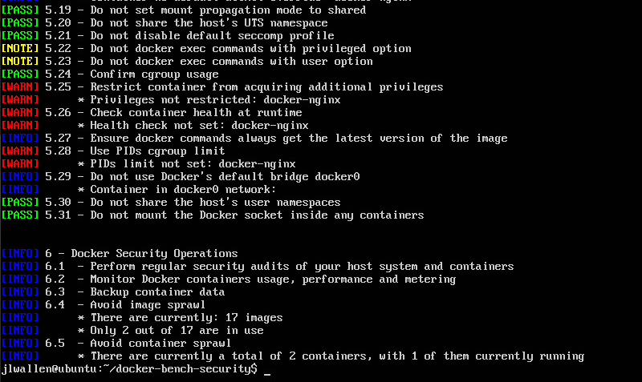
Docker Security Tools
A script that enables checking:
Host Configuration
Docker Daemon Configuration
Docker Daemon Configuration Files
Container Images and Build Files
Container Runtime
Docker Bench for Security
Twistlock
https://github.com
Aqua
https://www.aquasec.com
Anchore
https://anchore.com
NeuVector
https://neuvector.com
CloudPassage Halo
https://www.cloudpassage.com
https://github.com

Slide 27
Module Flow
Understand Virtualization Essential Concepts and OS Virtualization Security
1
2
Understand Cloud Computing Fundamentals
Discuss the Insights of Cloud Security and Best Practices
3

Slide 28
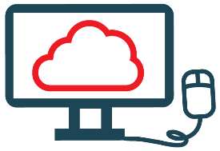

Introduction to Cloud Computing
Cloud computing is an on-demand delivery of IT capabilities where IT infrastructure and applications are provided to subscribers as a metered service over a network
Characteristics of Cloud Computing
On-demand self-service
Broad network access
Distributed storage
Resource pooling
Rapid elasticity
Virtualization technology

Slide 29
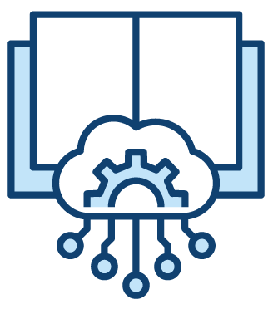
Cloud Computing Benefits
Economic
Operational
Business agility
Less maintenance costs
Acquire economies of scale
Less capital expense
Huge storage facilities for organizations
Flexibility and efficiency
Resilience and redundancy
Scale as required
Less operational problems
Deploy applications quickly
Staffing
Security
Streamline processes
Efficient usage of resources
Less personnel training
Less IT Staff
Multiple users can utilize cloud resources
Less investment in security controls
Efficient, effective, and swift response to security breaches
Standardized open interface for managed security services (MSS)
Effective patch management and implementation of security updates
Better disaster recovery preparedness

Slide 30
Types of Cloud Computing Services
SYS ADMINS
DEVELOPERS
END CUSTOMERS
END CUSTOMERS
Infrastructure-as-a-Service (IaaS)
Platform-as-a-Service (PaaS)
Software-as-a-Service (SaaS)
Identity-as-a-Service (IDaaS)
Provides virtual machines and other abstracted hardware and operating systems which may be controlled through
a service API
E.g., Amazon EC2, GoGrid, Microsoft OneDrive, or Rackspace
Offers development tools, configuration management, and deployment platforms on-demand that can be used by subscribers to develop custom applications
E.g., Google App Engine, Salesforce, or Microsoft Azure
Offers software to subscribers on-demand over the Internet
E.g., web-based office applications like Google Docs or Calendar, Salesforce CRM, or Freshbooks
Offers IAM services including SSO, MFA, IGA, and intelligence collection
E.g., OneLogin, Centrify Identity Service, Microsoft Azure Active Directory, or Okta

Slide 31
Types of Cloud Computing Services (Cont’d)
Security-as-a-Service (SECaaS)
Function-as-a-Service (FaaS)
Provides penetration testing, authentication, intrusion detection, anti-malware, security incident, and event management services
E.g., eSentire MDR, Switchfast Technologies, OneNeck IT Solutions, or McAfee Managed Security Services
Provides a platform for developing, running, and managing application functionalities for microservices
E.g., AWS Lambda, Google Cloud Functions, Microsoft Azure Functions, or Oracle Cloud Fn
END
CUSTOMERS
END
CUSTOMERS
Container-as-a-Service (CaaS)
Anything-as-a-Service (XaaS)
Offers virtualization of container engines, and management of containers, applications, and clusters, through a web portal or API
E.g., Amazon AWS EC2, or Google Kubernetes Engine (GKE)
Offers anything as a service over the Internet based on the user’s demand like digital products, food, transportation, medical consultations, etc.
E.g., Salesforce, AWS, Google Compute Engine, Azure, O365 and G Suite, JumpCloud
END
CUSTOMERS
END
CUSTOMERS
Notes:
XaaS
https://timesofcloud.com/cloud-tutorial/xaas/
https://www.sam-solutions.com/blog/everything-as-a-service-xaas-definition-and-examples/
https://www.webopedia.com/definitions/anything-as-a-service-xaas/
https://www.netapp.com/knowledge-center/what-is-anything-as-a-service-xaas/#:~:text=%E2%80%9CAnything%20as%20a%20service%E2%80%9D%20(,a%20service%20over%20the%20internet
https://jumpcloud.com/blog/xaas
https://www.eglobaltech.com/post/everything-as-a-service-have-federal-cios-found-their-holy-grail

Slide 32
Customer vs. CSP Shared Responsibilities in IaaS, PaaS, and SaaS
Cloud Computing
On-Premise
Infrastructure
(as a Service)
Platform
(as a Service)
Software
(as a Service)
Data
Data
Data
Data
Interfaces
Interfaces
Interfaces
Interfaces
Applications
Applications
Applications
Applications
Middleware
Middleware
Middleware
Middleware
Operating Systems
Operating Systems
Operating Systems
Operating Systems
Virtual Machines
Virtual Machines
Virtual Machines
Virtual Machines
Resource Owners
Virtual Network
Virtual Network
Virtual Network
Virtual Network
Hypervisors
Hypervisors
Hypervisors
Hypervisors
Processing & Memory
Processing & Memory
Processing & Memory
Processing & Memory
Data Storage
Data Storage
Data Storage
Data Storage
Network Interfaces
Network Interfaces
Network Interfaces
Network Interfaces
Facilities & Data Centers
Facilities & Data Centers
Facilities & Data Centers
Facilities & Data Centers
Subscribers/Tenants/Customers
Service Provider

Slide 33
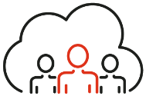





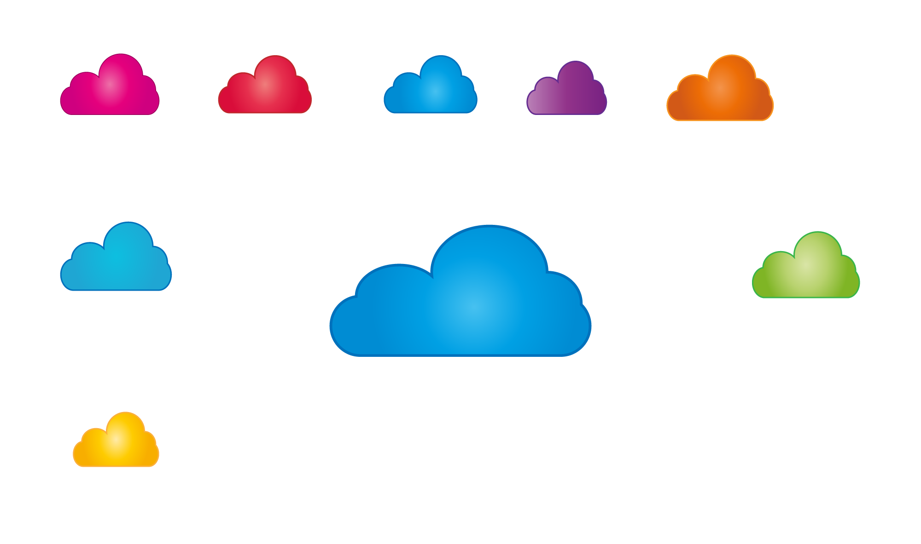



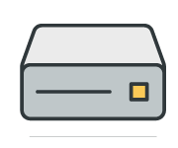
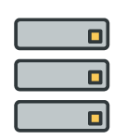







Cloud Deployment Models
Public Cloud
Private Cloud
Services are rendered over a network that is open for public use
Cloud infrastructure is operated for a single organization only
Users terminating the access
Legitimate access path
Users initiating access
Public users accessing the cloud via network
Boundary Controller
Subscriber controlled security perimeter
Computers in a network providing access
Cloud provider
Inside
Private cloud
Boundary Controller
Outside
Optional subscriber-controlled security perimeter
Blocked
access
New
hardware
Users that access the cloud within the security perimeter
Old
hardware
Users accessing cloud from within the perimeter
Outside subscriber’s facility

Slide 34

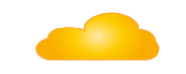



Cloud Deployment Models (Cont’d)
Community Cloud
Hybrid Cloud
Shared infrastructure between several organizations from a specific community with common concerns (security, compliance, jurisdiction, etc.)
Combination of two or more clouds (private, community, or public) that remain unique entities but are bound together, thereby offering the benefits of multiple deployment models
Security perimeters
Organization A
Organization A
Organization B
Organization B
On-site private cloud
Outsourced private cloud
Organization C
Organization C
Inside
Inside
On-site community cloud
Outsourced community cloud
Outside
Outside
Users accessing local cloud resources
User that access the cloud from within their perimeters
Users accessing remote cloud resources
Community companies that provide and consume cloud resources
Community companies that consume resources
Public cloud

Slide 35

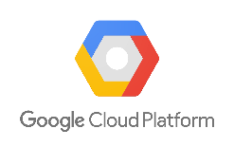
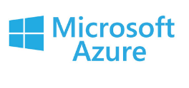
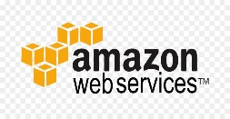
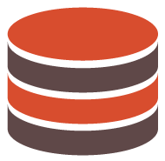

Cloud Deployment Models (Cont’d)
Dynamic heterogeneous environment that combines workloads across multiple cloud vendors, managed via one proprietary interface to achieve long term business goals
Multi Cloud
Application Data
Application Data
Public cloud
Public cloud
Application Data
Application Data
Public cloud
Private cloud
Companies/users consuming cloud resources

Slide 36

On-premises vs. Hosted vs. Cloud
Parameters | On-premises | Cloud | Hosted
Ownership | The organization establishes the infrastructure and runs all the business operations | A third party owns the infrastructure and runs the business operations for the organization | A third party owns the platform; the enterprise uses the resources based on the requirement
Deployment | The software or application is installed on internal physical servers | The cloud provider installs the software or application on virtual servers | A third party sets up the entire cloud hosting center or data center
Performance | Depends on the skills of internal employees | Depends on the Internet speed | Performance can be optimized by working with the service provider
Cost | Physical infrastructure and initial setup are expensive | Virtual infrastructure is paid for as per usage | Rented private infrastructure is relatively expensive for the organization
Connectivity | Systems can work without the Internet | Active Internet service is mandatory | The platform can perform communication with both a private internal network and the Internet
Security | Depends on the skills of the administration team | Less secure than other options as it is completely operated off-site | Security is under the organization’s control; all systems must be up to date and patched constantly
Maintenance | Maintained by an internal team | Maintained by the cloud provider | Maintained by a third-party hosting agency
Scalability | Offers limited scalability | Easily and highly scalable | Scalability depends on the availability of applications on the cloud
Notes:
https://www.leveragetech.com.au/blog/on-premise-vs-cloud-vs-hosted/
https://searchitchannel.techtarget.com/definition/hosted-services
https://www.bigcommerce.com/blog/on-prem-vs-hosted-vs-saas/#pros-and-cons-of-on-prem-hosted-and-saas

Slide 37

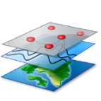




NIST Cloud Deployment Reference Architecture
NIST cloud computing reference architecture defines five major actors:
Cloud Consumer
A person or organization that uses cloud computing services
Cloud Provider
Cloud Provider
Service Layer
Cloud Service Management
A person or organization providing services to interested parties
Cloud Consumer
SaaS
Cloud Broker
Cloud Auditor
PaaS
Business Support
Service Intermediation
Cloud Carrier
Security audit
IaaS
An intermediary for providing connectivity and transport services between cloud consumers and providers
Provisioning/
Configuration
Privacy
Security
Service Aggregation
Privacy Impact Audit
Resource Abstraction and Control Layer
Performance Audit
Physical Resource Layer
Portability/
Interoperability
Service Arbitrage
Cloud Auditor
A party for making independent assessments of cloud service controls and taking an opinion thereon
Hardware
Facility
Cloud Broker
An entity that manages cloud services in terms of use, performance, and delivery, and maintains the relationship between cloud providers and consumers
Cloud Carrier

Slide 38
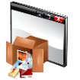


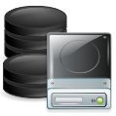
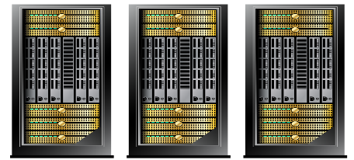
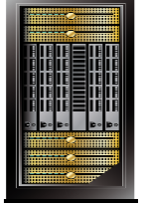
Cloud Storage Architecture
Cloud storage is a data storage medium used to store digital data in logical pools using a network
High Level Cloud Storage Architecture
Front-End
Public APIs for Data and Management
The cloud storage architecture consists of three main layers namely, front-end, middleware, and back-end
Virtual Computer Servers
Virtual Computer Servers
The Front-end layer is accessed by the end user where it provides APIs for the management of data storage
Object Storage
Middleware
Block, File or Object Storage
The Middleware layer performs several functions such as data de-duplication and replication of data
Logical Storage Pools
Physical Storage Servers
Physical Storage Servers
Back-End
The Back-end layer is where the hardware is implemented
Cloud Service Location 1
Location n

Slide 39
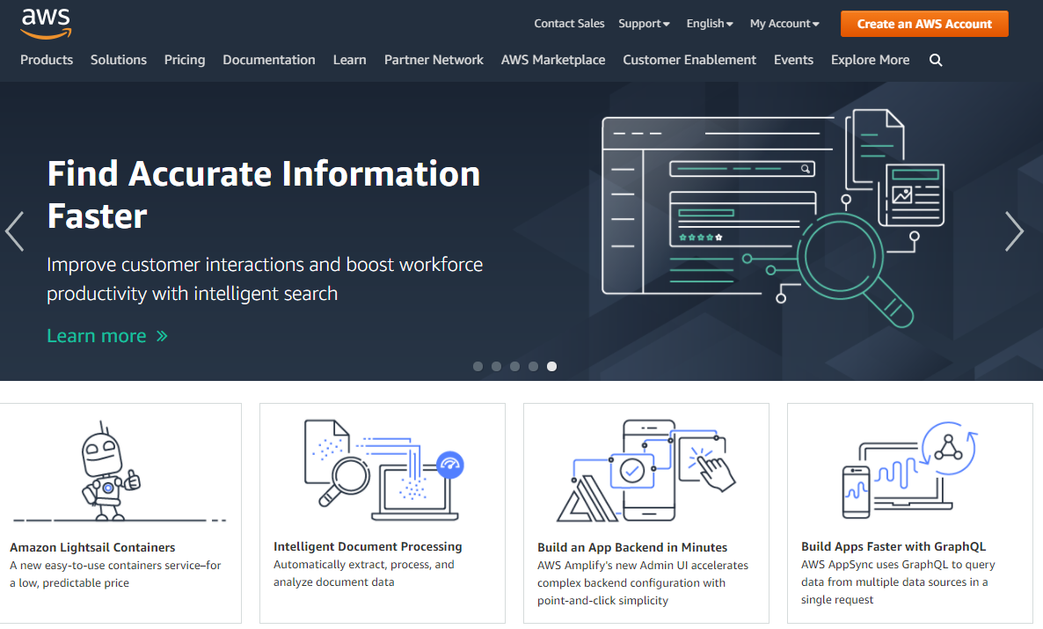
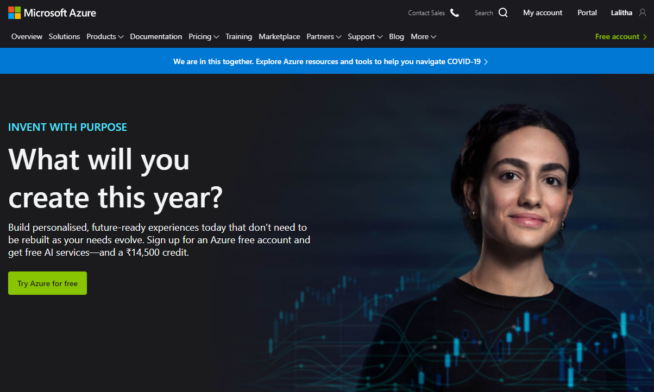
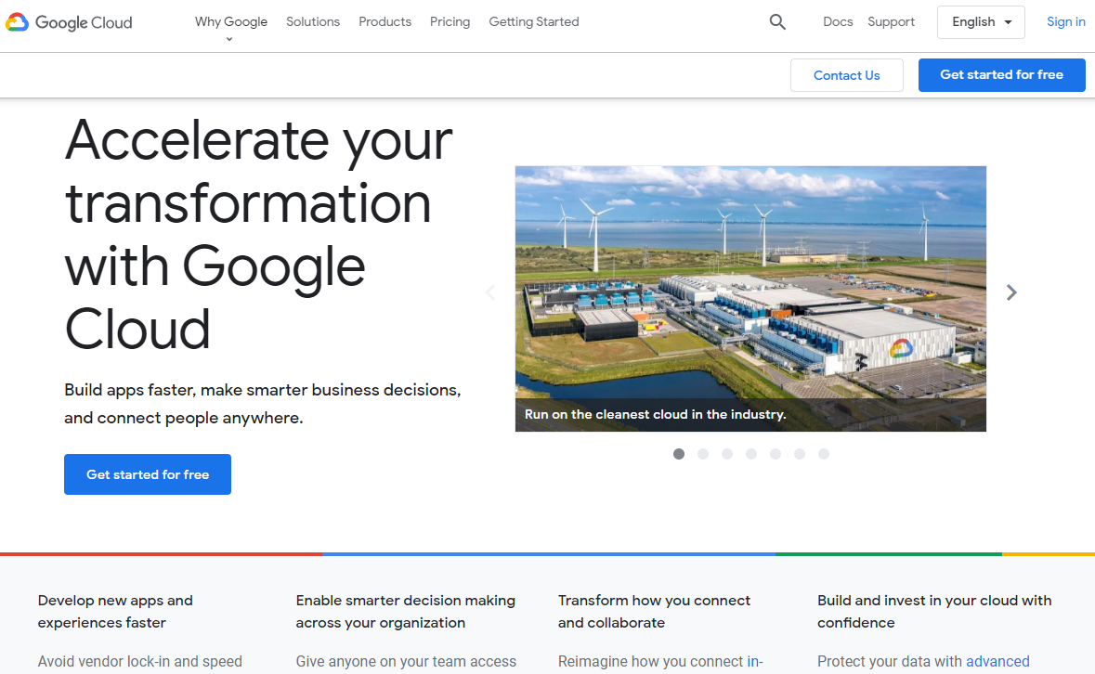
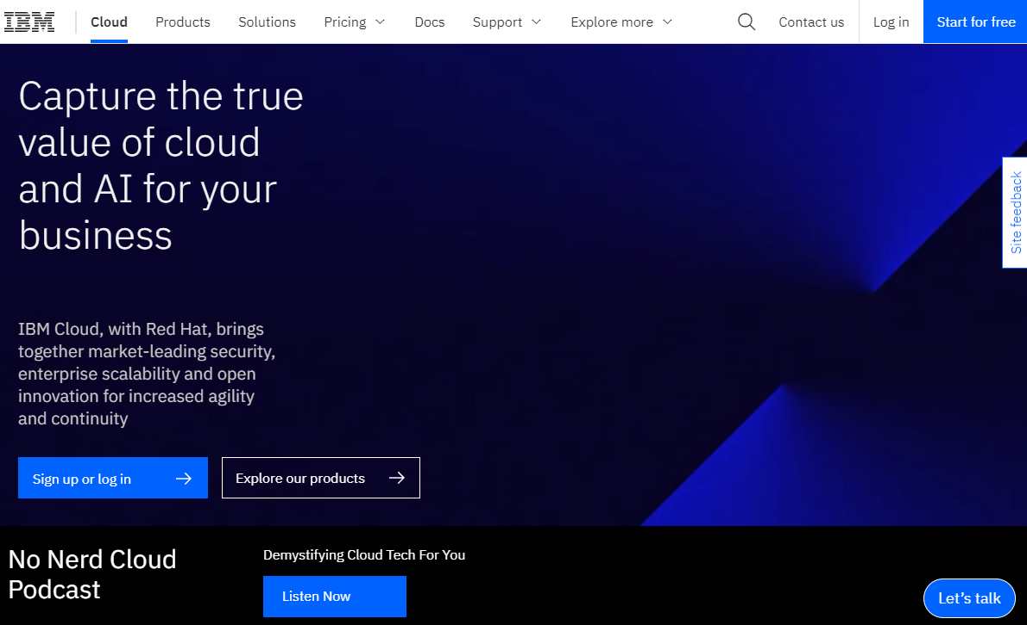
Cloud Service Providers
https://aws.amazon.com
https://azure.microsoft.com
https://cloud.google.com
https://www.ibm.com

Slide 40
Module Flow
Understand Virtualization Essential Concepts and OS Virtualization Security
1
2
Understand Cloud Computing Fundamentals
Discuss the Insights of Cloud Security and Best Practices
3

Slide 41
Cloud Security: Shared Responsibility
1
Cloud security and compliance are the shared responsibility of the cloud provider and consumer
Cloud Security
2
According to the selected cloud module, security responsibilities are divided based on the shared responsibility model
Cloud Provider
Cloud Customer
3
If the consumers do not secure their functions, the entire cloud security model will fail

Slide 42

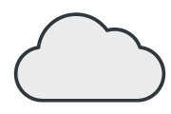
Cloud Security: Shared Responsibility (Cont’d)
Shared Responsibility Model for Security in the Cloud
Responsibility | On-Premises (for reference) | IaaS (Infrastructure-as-a-service) | PaaS (Platform-as-a-serve=ice) | SaaS (Software-as-a-service)
User Access
Data
Applications
Operating System
Network Traffic
Infrastructure
Physical
Customer Responsibility
Cloud Provider Responsibility

Slide 43
Elements of Cloud Security
Cloud Service Consumers
User Security and Monitoring
Identity services (AuthN/Z, federation, delegation, provisioning)
Cloud service consumers are responsible for:
User security and monitoring (identity and access management (IAM)
Information security–data (encryption and key management)
Application-level security
Data storage security
Monitoring, logging, and compliance
Supporting services (Auditing, Super user privilege management)
Information Security - Data
Customer’s responsibility
Encryption (transit, rest, processing), Key management, ACL, Logging
Application-level Security
Application stack, Service connectors, Database, Storage
Cloud Service Providers
Platform and Infrastructure Security
Cloud service providers are responsible for securing the shared infrastructure, including routers, switches, load balancers, firewalls, hypervisors, storage networks, management consoles, DNS, directory services, and cloud API
PaaS– NoSQL, API, Message Queues, Storage
PaaS
Guest OS-level (Firewall, Hardening, Security monitoring)
Cloud provider’s responsibility
Hypervisor/Host-level (Firewalls, Security monitoring)
IaaS
Network-level (BGP, Load balancers, Firewalls, Security monitoring)

Slide 44
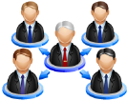







Elements of Cloud Security (Cont’d)
Identity and Access Management (IAM)
User life cycle
Approve user authorizations based on roles/rules
Authentication Management
User Management
Authorization Management
  IAM is the management of the digital identities of users and their rights to access cloud resources
  It includes creating, managing, and removing digital identities, as well as the authorization of users
Employees, Suppliers, Partner, Customers, etc.
User Management Services
Authorization Model
Authoritative Sources
Desired State
Contract
Data Management and Provisioning
Authentication Management Services
Usage
Provisioning Services, Data Management Services (Manual/Automated)
Monitoring Services
Auditing Services
Reporting Services
Access Management Services
Actual State
Federation
Access Management
Monitoring and Audit
Systems and Applications

Slide 45
Elements of Cloud Security (Cont’d)
Compliance
A clear idea about the regulation standards that an organization wants to comply with along with its associated requirements allows organizations benefit from the business agility and growth
Compliance considerations for the organizations to integrate their compliance programs with their cloud providers:
Know the requirements that impact an organization to know about the jurisdictions of an organization, industry, or activities employed by the organization to conduct business
Conduct regular compliance risk assessments to help the organizations to adopt the updated and revised risk assessment processes regularly
Monitoring and auditing the organization compliance program before a crisis hits helps organizations to determine the gaps and improving their compliance position

Slide 46

Elements of Cloud Security (Cont’d)
Data Storage Security
In a cloud, data are stored on internet-connected servers in data centers and it is the responsibility of data centers to secure the data
The data storage security techniques includes local data encryption, key management, strong password management, periodic security assessment of data security controls, cloud data backup, etc.
Monitoring
Monitoring is required to manage cloud-based services, applications, and infrastructure
Activity monitoring should observe the activities like data replication, data file name changes, data file classification changes, data ownership changes to monitor unauthorized data access, etc.

Slide 47
Elements of Cloud Security (Cont’d)
Logging
Security logs are used for threat detection, data analysis, and compliance audits to enhance cloud security
Efficient security log management for cloud includes aggregating all logs, capturing appropriate data, controlling log collection and distribution frequency, ensuring system scalability, etc.
Network Security
Main challenge in cloud network security includes the lack of network visibility in monitoring and managing suspicious activities by the consumer
Cloud network security requires the following additional security features like, encrypt data-in-transit, provide multi-factor authentication, install firewalls, enable data loss prevention, etc.

Slide 48


AWS Identity and Access Management
IAM enables users to securely control the access to AWS services and resources
AWS IAM allows to establish access rules and permissions for specific users and applications
Account
Group: Admins
Group: Developers
Group: Test
Harry
Oliver
George
Mike
Jack
Jacob
DevApp1
TestApp1

Slide 49

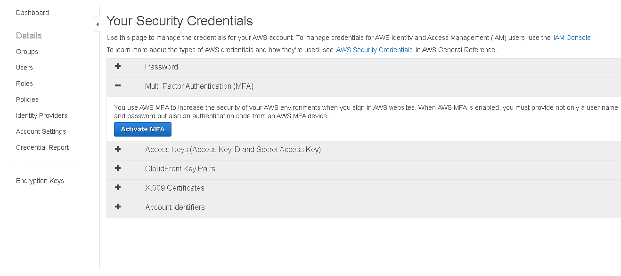
AWS IAM: Lock Your AWS Account Root User Access Keys
The access key (an access key ID and secret access key) is used to make programmatic requests to AWS
The access key of AWS root user account gives full access to all AWS resources
Enabling AWS MFA on AWS root user account
To protect root user access key:
  Do not create AWS root user account access keys unless required
  Change the AWS root user account access key regularly
  Never share the AWS root user account password or access keys
  Use strong passwords for logging into the AWS Management Console
  Enable AWS MFA on AWS root user account

Slide 50
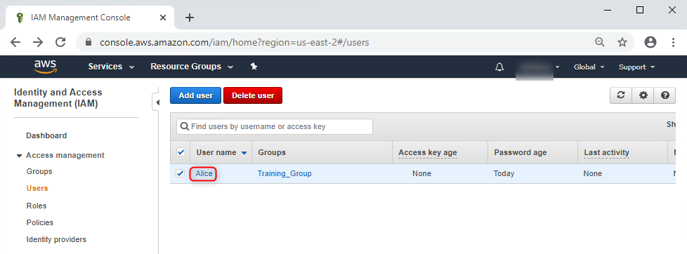

AWS IAM: Create Individual IAM Users
1
2
3
Do not allow a user to use the root user account; instead, create individual user accounts for accessing AWS services
Provide a unique set of security credentials and appropriate permissions to the IAM users
This will help in changing or revoking the permissions of IAM users as required

Slide 51
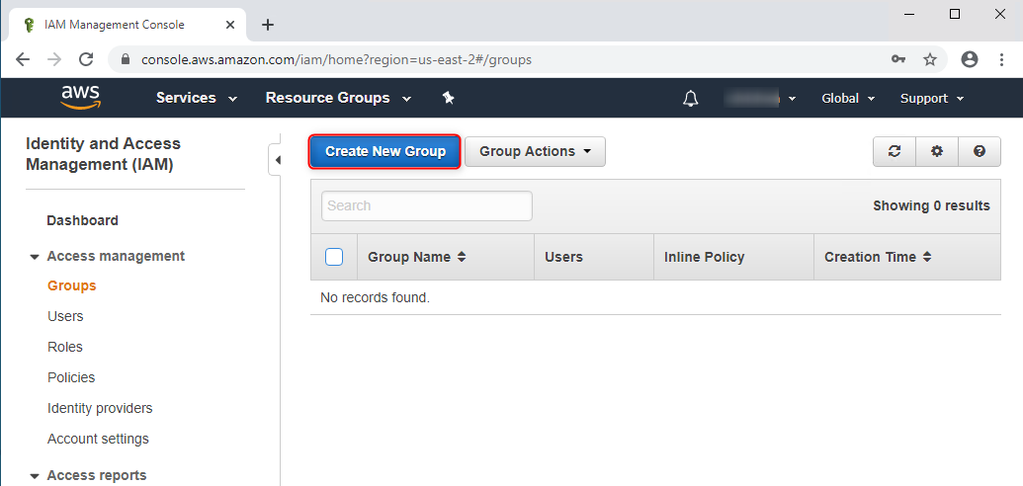

AWS IAM: Use Groups to Assign Permissions to IAM Users
Create groups and assign appropriate permissions to reduce access management complexity for organizations with large number of users
Create groups with similar job functions
Advantages:
Assigning and reassigning rights to groups is easy and less time consuming
Reduces accidental assignment of greater privileges to users

Slide 52



AWS IAM: Grant Least Privilege
To implement more granular access control, begin with minimum permissions and gradually add permissions as required
Implement conditional access to restrict privileged access
Use the Access Advisor tab to regularly monitor user access
Implement resource-based policies to restrict access to specific resources

Slide 53








AWS IAM: Use AWS-managed Policies
AWS Managed Policies
AWS
AWS Account1
AWS Account2
Group Admins
Oliver
AWS managed policies are standalone policies that are created and administered by AWS
AWS-managed policies are designed to provide permissions for common use cases
Use AWS-managed policies while designing and creating access policies
Policy AdministratorAccess
Harry
Mike
George
Susan
Policy PowerUserAccess
Role EC2 - App
Role ThirdPartyAccess
Policy AWSCloudTrailReadOnlyAccess

Slide 54
Best Practices for Securing the Cloud
01
Enforce data protection, backup, and retention mechanisms
Enforce legal contracts in employee behavior policy
05
02
Enforce SLAs for patching and vulnerability remediation
Prohibit user credentials sharing among users, applications, and services
06
03
Vendors should regularly undergo AICPA SAS 70 Type II audits
Implement strong authentication, authorization and auditing controls
07
04
Verify one’s own cloud in public domain blacklists
Check for data protection at both the design stage and at runtime
08

Slide 55

NIST Recommendations for Cloud Security
01
Assess the risk posed to the client’s data, software and infrastructure
02
Select an appropriate deployment model according to the needs
03
Ensure audit procedures are in place for data protection and software isolation
04
Renew SLAs in case of security gaps found between the organization’s security requirements and the cloud provider’s standards
05
Establish appropriate incident detection and reporting mechanisms
06
Analyze what are the security objectives of the organization
07
Enquire about who is responsible for data privacy and security issues in the cloud

Slide 56

Organization/Provider Cloud Security Compliance Checklist
Management | Organization | Provider
Is everyone aware of his or her cloud security responsibilities?
Is there a mechanism for assessing the security of a cloud service?
Does the business governance mitigate the security risks that can result from cloud-based “shadow IT”?
Does the organization know within which jurisdictions its data can reside?
Is there a mechanism for managing cloud-related risks?
Does the organization understand the data architecture needed to operate with appropriate security at all levels?
Can the organization be confident of end-to-end service continuity across several cloud service providers?
Does the provider comply with all relevant industry standards (e.g. the UK’s Data Protection Act)?
Does the compliance function understand the specific regulatory issues pertaining to the organization's adoption of cloud services?

Slide 57

Cloud Security Tools
An end-to-end IT security solution that provides a continuous, always-on assessment of the global security and compliance posture, with visibility across all IT assets irrespective of where they reside
Qualys Cloud Platform
CloudPassage Halo
https://www.cloudpassage.com
McAfee MVISION Cloud
https://www.mcafee.com
CipherCloud
https://www.ciphercloud.com
Netskope Security Cloud
https://www.netskope.com
Prisma Cloud
https://www.paloaltonetworks.com
https://www.qualys.com

Slide 58

Module Summary
This module has discussed virtualization, its components,
and virtualization enablers
It has discussed OS virtualization security and concerns
It has also discussed the best practices for OS virtualization
security
This module has discussed cloud computing and its benefits
It has discussed different types of cloud computing services
and cloud deployment models
Finally, this module ended with a brief discussion on the importance of cloud security and its best practices
In the next module, we will discuss on wireless network security
in detail

