Slide 1


Module 07
Wireless Network Security
Notes:
1549496762

Slide 2

Module Objectives
1
Understanding the Wireless Terminology, Wireless Networks, and Wireless Standards
2
Understanding the Wireless Network Topologies and Classification of Wireless Networks
3
Understanding the Components of a Wireless Network
4
Overview of Wireless Network Encryption Mechanisms
5
Understanding the Different Types of Wireless Network Authentication Methods
6
Understanding Wireless Network Security Measures and Wireless Security Tools

Slide 3
Module Flow
Discuss Different Types of Wireless Network Authentication Methods
Understand Wireless Network Encryption Mechanisms
02
03
Discuss and Implement Wireless Network Security Measures
Understand Wireless Network Fundamentals
01
04

Slide 4
Wireless Terminologies
Describes the amount of information that may be broadcast over a connection
The MAC address of an AP that has set up a Basic Service Set (BSS)
A place where a wireless network is available for public use
Bandwidth
BSSID
Hotspot
GSM
Access point (AP)
ISM band
A universal system used for mobile transportation for wireless networks worldwide
Used to connect wireless devices to a wireless/wired network
A set of frequencies
for the international industrial, scientific, and medical communities

Slide 5
Wireless Terminologies (Cont’d)
Association
The process of connecting a wireless device to an AP
Service Set Identifier (SSID)
A unique identifier of 32 alphanumeric characters given to a wireless local area network (WLAN)
Orthogonal Frequency-division Multiplexing (OFDM)
Method of encoding digital data on multiple carrier frequencies
Multiple input, multiple output orthogonal frequency-division multiplexing (MIMO-OFDM)
An air interface for 4G and 5G broadband wireless communications
Direct-sequence Spread Spectrum (DSSS)
An original data signal multiplied with a pseudo-random noise spreading the code
Frequency-hopping Spread Spectrum (FHSS)
A method of transmitting radio signals by rapidly switching a carrier among many frequency channels

Slide 6

Wireless Networks
Wireless networks use radio frequency (RF) signals to connect wireless-enabled devices in a network
The wireless fidelity (Wi-Fi) technology uses the Institute of Electrical and Electronics Engineers (IEEE) standard of 802.11 and uses radio waves for communication
Advantages
Installation is easy and eliminates wiring
Access to the network can be from anywhere within the range of an access point (AP)
Public places such as airports, schools, etc., can offer a constant internet connection using WLAN

Slide 7

Wireless Technologies
In a wireless network, data transmission occurs by means of electromagnetic waves that carry signals over the communication path
Types of Wireless Technologies
Wi-Fi
Bluetooth
RFID
WiMAX
It uses radio waves or microwaves to allow electronic devices to exchange data or connect to the Internet
Using Bluetooth technology, data is transmitted between cell phones, computers, and other networking devices over short distances
It uses radio frequency (RF) electromagnetic waves to transfer data for automatic identification and for tracking tags attached to objects
It uses long distance wireless networking and high-speed Internet and belongs to the IEEE 802.16 family of wireless networking standards

Slide 8

Wired vs. Wireless Networks
Wired Networks | Wireless Networks
High bandwidth | Low bandwidth
Low bandwidth variation | High bandwidth variation
Low error rates | High error rates
More secure | Less secure
Less equipment dependent | More equipment dependent
Symmetric connectivity | Possible asymmetric connectivity
High-power machines | Low-power machines
High-resource machines | Low-resource machines
Low delay | High delay
Connected operation | Disconnected operation

Slide 9

Wireless Standards
Protocol | Frequency (GHz) | Bandwidth (MHz) | Stream data rate (Mbits/s) | Modulation | Range (m)
 |  |  |  |  | Indoor | Outdoor
802.11 (Wi-Fi) | 2.4 | 22 | 1, 2 | DSSS, FHSS | 20 | 100
802.11a | 5 | 20 | 6, 9, 12, 18, 24, 36, 48, 54 | OFDM | 35 | 120
 | 3.7
 |  |  |  |  | — | 5000
802.11b | 2.4 | 22 | 1, 2, 5.5, 11 | DSSS | 35 | 140
802.11d | It is an enhanced version of 802.11a and 802.11b that enables global portability by allowing variation in frequencies, power levels, and bandwidth
802.11e | It provides guidance for prioritization of data, voice, and video transmissions by enabling quality of service (QoS)
802.11g | 2.4 | 20 | 6, 9, 12, 18, 24, 36, 48, 54 | OFDM

Slide 10

Wireless Standards (Cont’d)
Protocol | Frequency (GHz) | Bandwidth (MHz) | Stream data rate (Mbits/s) | Modulation | Range (m)
 |  |  |  |  | Indoor | Outdoor
802.11i | This is a standard for WLANs that provides improved encryption for networks that use the 802.11a, 802.11b, and 802.11g standards
802.11n | 5 | 20 | 7.2, 14.4, 21.7, 28.9, 43.3, 57.8, 65, 72.2 | MIMO-OFDM | 70 | 150
 | 2.4 | 40 | 15, 30, 45, 60, 90, 120, 135, 150 |  | 70 | 150
802.11ac | 5 | 20 | 7.2, 14.4, 21.7, 28.9, 43.3, 57.8, 65, 72.2, 86.7, 96.3 | MIMO-OFDM | 35
 |  | 40 | 15, 30, 45, 60, 90, 120, 135, 150, 180, 200 |  | 35
 |  | 80 | 32.5, 65, 97.5, 130, 195, 260, 292.5, 325, 390, 433.3 |  | 35
 |  | 160 | 65, 130, 195, 260, 390, 520, 585, 650, 780, 866.7 |  | 35
802.11ax | 2.4/5/6 | 40 | Up to 2294^{[F]} | MIMO-OFDM | 30 | 120
 |  | 80 | Up to 4803^{[F]}
 |  | 80+80 | Up to 10530

Slide 11

Wireless Standards (Cont’d)
Protocol | Frequency (GHz) | Bandwidth (MHz) | Stream data rate (Mbits/s) | Modulation | Range (m)
 |  |  |  |  | Indoor | Outdoor
802.11ad | 60 | 2160 | 6.75 Gbit/s | OFDM, single carrier, low-power single carrier | 60 | 100
802.12 | This standard defines the demand priority and media access control protocol for increasing the Ethernet data rate to 100 Mbps
802.15 | This standard defines the communication specifications for wireless personal area networks (WPANs)
802.15.1 (Bluetooth) | 2.4 |  | 1-3 Mbps |  | 10
802.15.4 (Zigbee) | 2.4 | 868, 900
802.15.5 | A standard for mesh networks with enhanced reliability via route redundancy
802.16 | A group of broadband wireless communication standards for metropolitan area networks (MANs)

Slide 12








Wireless Network Topologies
Devices exchange information with each other similar to
that in a peer-to-peer communication mode without the
need of an AP for communication
To setup this mode properly, first configure the wireless adapter for all the devices. They should all have the same channel
name and SSID in order to activate the connections
  Ad-hoc Standalone Network Architecture (Independent Basic Service Set (IBSS))
Devices in the wireless network are connected through an AP
An AP connects to the internet via a modem
Installed in large organizations
  Infrastructure Network Topology (Centrally Coordinated Architecture/ Basic Service Set (BSS))

Slide 13














































Classification of Wireless Networks
  Wireless Networks Based on the Connection
  Extension to a Wired Network
Access Point
  Multiple Access Points
Users
Broadband Router
Access Point
Access Point
Users
Users
Extension Point
Internet
Broadband Router
Users
Internet
Internet
LAN 1
LAN 2
  LAN-to-LAN Wireless Network
3G/4G USB
  4G Hotspot
Broadband Router
Broadband Router
Users
3G Hotspot
3G Connection
Cell Tower

Slide 14
Classification of Wireless Networks (Cont’d)
  Wireless Network Based on the Geographic Area Coverage
WLAN
WPAN
  It connects users in a local area with a network. The area may range from a single room to an entire campus
It interconnects devices positioned around an individual, in which the connections are wireless. It has a very short range
WWAN
WMAN
WWAN covers an area larger than the WLAN. It can cover a particular region, nation, or even the entire globe
It accesses broadband area networks by using an exterior antenna. It is a good alternative for a fixed-line network

Slide 15

Components of a Wireless Network
Access Point (AP)
  It is a hardware device that allows wireless communication devices to connect to a wireless network via wireless standards such as Bluetooth, Wi-Fi, etc.
Wireless Cards (NIC)
  Systems connected to the wireless network require a network interface cards (NIC) to establish a standard Ethernet connection
Wireless Modem
It is a device that receives and transmits network signals to other units without requiring physical cabling
Wireless Bridge
It connects multiple LANs at the medium access control (MAC) layer and is separated either logically or physically. It is used for increasing the coverage area of the wireless network

Slide 16
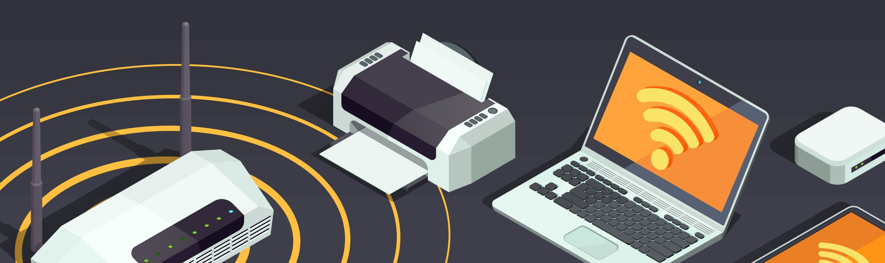
Components of a Wireless Network (Cont’d)
Wireless Repeater
Wireless Router
Wireless Gateways
Wireless USB Adapter
  Retransmits the existing signal captured from a wireless router or AP to create a new network
  Performs the functions of a router as well as a wireless AP and provides Internet access to various devices
  Routes data packets and functions as a wireless AP. An Internet connection can be shared between multiple stations
Connects different devices to a wireless network in order to access the Internet without a computer, router, or any other network device

Slide 17
Components of a Wireless Network (Cont’d)
Antenna
  Converts electrical impulses into radio waves and vice versa
  Types of Antenna
Directional Antenna
Parabolic Grid Antenna
Dipole Antenna
Used for broadcasting and obtaining radio waves from a single direction
It is based on the principle of a satellite dish and can pick up Wi-Fi signals from a distance of 16 km or more.
Bidirectional antenna, used for supporting client connections rather than site-to-site applications
Omnidirectional Antenna
Yagi Antenna
Reflector Antennas
It provides a 360° horizontal radiation pattern. It is used in wireless base stations.
A unidirectional antenna commonly used in communications in the frequency band from 10 MHz to very high frequency (VHF) and ultra high frequency (UHF)
These are used for concentrating electromagnetic energy that is radiated or received at a focal point

Slide 18
Module Flow
Discuss Different Types of Wireless Network Authentication Methods
Understand Wireless Network Encryption Mechanisms
02
03
Discuss and Implement Wireless Network Security Measures
Understand Wireless Network Fundamentals
01
04

Slide 19

Types of Wireless Encryption
An IEEE amendment that specifies security mechanisms for 802.11 wireless networks
802.11i
WEP
An encryption algorithm for IEEE 802.11 wireless networks
Supports multiple authentication methods, such as token cards, Kerberos, and certificates
EAP
LEAP
A proprietary version of EAP developed by Cisco
WPA
An advanced wireless encryption protocol using TKIP and MIC to provide stronger encryption and authentication
TKIP
A security protocol used in WPA as a replacement for WEP

Slide 20

Types of Wireless Encryption (Cont’d)
WPA2
An upgrade to WPA using AES and CCMP for wireless data encryption
AES
A symmetric-key encryption, used in WPA2 as a replacement for TKIP
CCMP
An encryption protocol used in WPA2 for stronger encryption and authentication
WPA2 Enterprise
Integrates EAP standards with WPA2 encryption
RADIUS
A centralized authentication and authorization management system
PEAP
A protocol that encapsulates the EAP within an encrypted and authenticated transport layer security (TLS) tunnel
WPA3
A third-generation Wi-Fi security protocol that uses GCMP-256 for encryption and HMAC-SHA-384 for authentication

Slide 21



Wired Equivalent Privacy (WEP) Encryption
WEP is a security protocol defined by the 802.11b standard; it was designed to provide a wireless LAN with a level of security and privacy comparable to that of a wired LAN
WEP uses a 24-bit initialization vector (IV) to form stream cipher RC4 for confidentiality and the CRC-32 checksum for integrity of wireless transmissions
It has significant vulnerabilities and design flaws and can therefore be easily cracked
WEP Key Store
(K1, K2, K3, K4)
CRC-32 Checksum
Data
ICV
RC4 Cipher
-
How WEP Works
WEP Seed
-
XOR Algorithm
X
WEP Key
IV
Keystream
IV
PAD
KID
Ciphertext
WEP-encrypted Packet (Frame body of MAC Frame)

Slide 22



Wi-Fi Protected Access (WPA) Encryption
WPA is a security protocol defined by 802.11i standards; it uses a Temporal Key Integrity Protocol (TKIP) that utilizes the RC4 stream cipher encryption with 128-bit keys and 64-bit MIC integrity check to provide stronger encryption and authentication
WPA uses TKIP to eliminate the weaknesses of WEP by including per-packet mixing functions, message integrity checks, extended initialization vectors, and re-keying mechanisms
Data to Transmit
Temporal Encryption Key
MSDU
Michael Algorithm
Key Mixing
MSDU + MIC
Transmit Address
MIC key
TSC (IV + EIV)
Fragmen-tation
How WPA Works
CRC-32
Check
sum
WEP seed
MPDU
ICV
XOR Algorithm
X
RC4
Cipher
Keystream
Mac Header
IV
KID
EIV
Ciphertext
Packet to transmit

Slide 23

WPA2 Encryption
WPA2 is an upgrade to WPA, and it includes mandatory support for counter mode with cipher block chaining message authentication code protocol (CCMP),
an AES-based encryption mode with strong security
How WPA2 Works
Priority destination address
MAC Header
PN
Temporal Key
Plaintext Data
Modes of Operation
WPA2-Personal
WPA2-Enterprise
Build AAD
Build Nonce
  It uses a set-up password (pre-shared Key, PSK) to protect unauthorized network accesses
  In PSK mode, each wireless network device encrypts the network traffic using a 128-bit key, which is derived from a passphrase of 8 to 63 ASCII characters
  It includes EAP or RADIUS for centralized client authentication using multiple authentication methods, such as token cards, and Kerberos
  Users are assigned login credentials by a centralized server, which they must present when connecting to the network
Nonce
AES CCMP
AAD
Build CCMP header
MAC Header
CCMP Header
Encrypted Data
Encrypted MIC
WPA2 MAC Frame

Slide 24

WPA3 Encryption
WPA3 is an advanced implementation of WPA2 providing trailblazing protocols and uses the AES-GCMP 256 encryption algorithm
Modes of Operation
  WPA3 - Personal
WPA3 - Enterprise
  It is mainly used to deliver password-based authentication using the SAE protocol, also known as Dragonfly Key Exchange
  It is resistant to offline dictionary attacks and key recovery attacks
It protects sensitive data using many cryptographic algorithms
It provides authenticated encryption using GCMP-256
It uses HMAC-SHA-384 to generate cryptographic keys
It uses ECDSA-384 for exchanging keys

Slide 25



Comparison of WEP, WPA, WPA2, and WPA3
Encryption | Attributes
 | Encryption Algorithm | IV Size | Encryption Key Length | Key Management | Integrity Check Mechanism
WEP | RC4 | 24-bits | 40/104-bits | None | CRC-32
WPA | RC4, TKIP | 48-bits | 128-bits | 4-way handshake | Michael algorithm and CRC-32
WPA2 | AES-CCMP | 48-bits | 128-bits | 4-way handshake | CBC-MAC
WPA3 | AES-GCMP 256 | Arbitrary length 1 - 2⁶⁴ | 192-bits | ECDH and ECDSA | BIP-GMAC-256
WEP, WPA | Should be replaced with more secure WPA and WPA2
WPA2 | Incorporates protection against forgery and replay attacks
WPA3 | Provides enhanced password protection and secured IoT connections; encompasses stronger encryption techniques

Slide 26
Issues in WEP, WPA, and WPA2
Issues in WEP
Issues in WPA
Issues in WPA2
  CRC-32 does not ensure complete cryptographic integrity
  IVs are 24 bits and sent in cleartext
  Vulnerable to known plaintext attacks
  Prone to password cracking attacks
  Lack of centralized key management
  Pre-shared key is vulnerable to eavesdropping and dictionary attacks
  Lack of forward secrecy
  WPA-TKIP is vulnerable to packet spoofing and decryption attacks
  Insecure random number generator (RNG) in WPA allows the discover of GTK generated by AP
  Vulnerabilities in TKIP allow attackers to guess the IP address of the subnet
  Pre-shared key is vulnerable to eavesdropping and dictionary attacks
  Lack of forward secrecy
  Hole96 vulnerability makes WPA2 vulnerable to MITM and DoS attacks
  Insecure random number generator (RNG) in WPA2 allow attackers to discover GTK generated by AP
  KRACK vulnerabilities make WPA2 vulnerable to packet sniffing, connection hijacking, malware injection, and decryption attacks

Slide 27
Module Flow
Discuss Different Types of Wireless Network Authentication Methods
Understand Wireless Network Encryption Mechanisms
02
03
Discuss and Implement Wireless Network Security Measures
Understand Wireless Network Fundamentals
01
04

Slide 28














Wi-Fi Authentication Methods: Open System Authentication
Any wireless device can be authenticated with the AP, thus allowing the device to transmit data only when its WEP key matches to that of the AP
Probe request
Probe response (security parameters)
Open system authentication request
Open system authentication response
Association request (security parameters)
Access Point (AP)
Switch or Cable Modem
Client attempting to connect
Association response
Internet

Slide 29




Wi-Fi Authentication Methods: Shared Key Authentication
The station and AP use the same WEP key to provide authentication, which means that this key should be enabled and configured manually on both the AP and client
Authentication request sent to AP
AP sends challenge text
Client encrypts challenge text and sends it back to AP
AP decrypts challenge text, and if correct, authenticates client
Access Point (AP)
Switch or Cable Modem
Client attempting to connect
Client connects to network
Internet

Slide 30














Wi-Fi Authentication Process Using a Centralized Authentication Server
Client
Client requests connection
Access Point
RADIUS Server
AP sends an EAP-Request to determine identity
Forwards the identity to the RADIUS server using the uncontrolled port
EAP-Response with identity
Sends a request to the wireless client via the AP specifying the authentication mechanism to be used
The wireless client responds to the RADIUS server with its credentials via the AP
Sends a multicast/global authentication key encrypted with a per-station unicast session key
Sends an encrypted authentication key to the AP if the credentials are acceptable

Slide 31
Module Flow
Discuss Different Types of Wireless Network Authentication Methods
Understand Wireless Network Encryption Mechanisms
02
03
Discuss and Implement Wireless Network Security Measures
Understand Wireless Network Fundamentals
01
04

Slide 32
Wireless Network Security Measures
  Wireless Network Security Techniques
Create an inventory of wireless devices
01
05
Defend against WPA cracking
Placement of the wireless AP and antenna
02
06
Detect rogue APs
Disable SSID broadcasting
03
07
Locate rogue APs
Select a strong wireless encryption mode
04
08
Configure the security on wireless routers

Slide 33
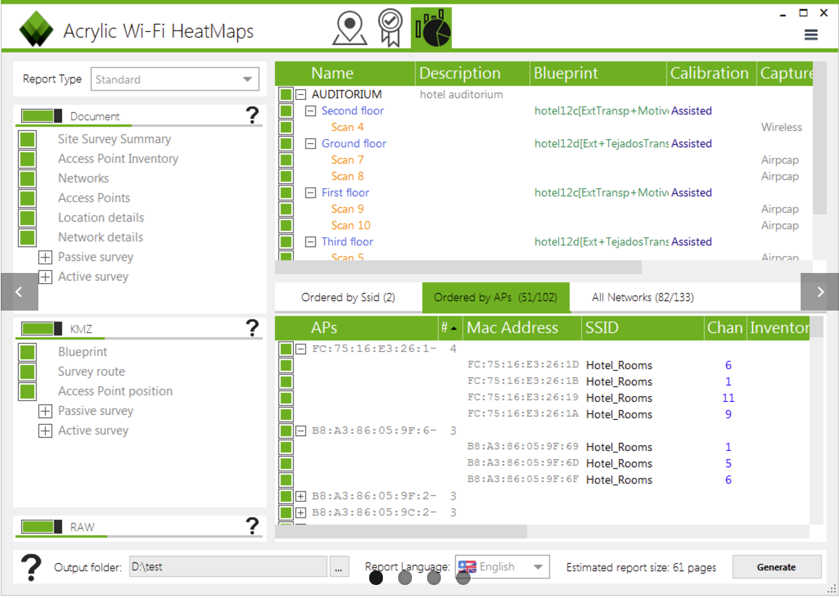
Creating an Inventory of Wireless Devices
Identify and document all the client devices according to the make/models/applications, encryption, firmware, wireless channel, etc.
This helps the network defenders to manage and monitor the wireless devices in the network
# | Make | Model | Operating System | Strongest Authentication Mode | Best Firmware Level | 802.11 Radio Type | Maximum Output Power
A | Intermec | CK31 | Win CE .NET | WPA2/802.1x | 4.20 | b/g | 17 dBm
B | Symbol | 9090G | Windows Mobile | WPA2/802.1x | 5.1.70 | a/b/g | 20 dBm
C | Vocollect | Talkman T5 | Proprietary Voice | WPA-PSK | 4.20 | b only | 12 dBm
D | Symbol | 6846 | MS-DOS | WEP | - | b only | 20 dBm
E | XybernautAtigo | S310LX | Windows XP | WPA2/802.1x | 5.0 | a/b/g | 20 dBm
https://www.acrylicwifi.com

Slide 34
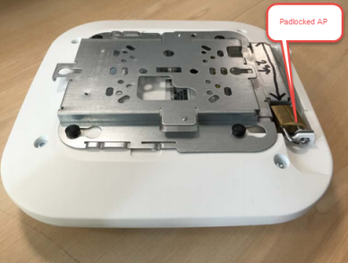
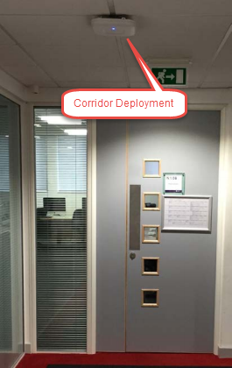
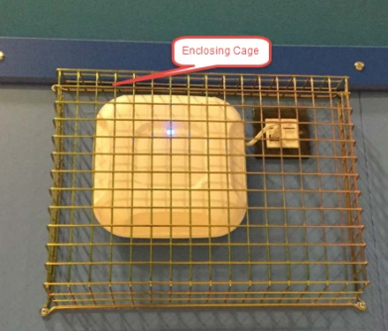
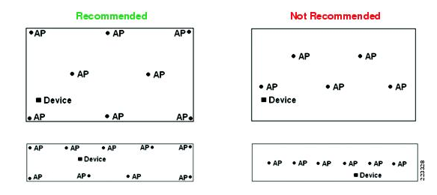
Placement of a Wireless AP
Guidelines for AP mounting:
  Place APs in central locations
  Install an AP on the ceiling
  Avoid placing APs too high on ceilings
  Avoid mounting an AP on a wall as it may restricts its 360° coverage
  Avoid installing APs in corridors
  Avoid installing APs above suspended ceilings
  Use locks and a plastic sarel enclosure to secure the AP from theft
  Avoid enclosing the AP in a metal cage
  Keep the AP away from metal objects

Slide 35

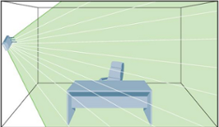
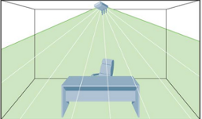
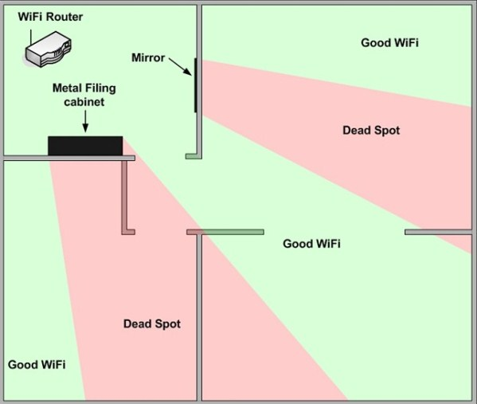
Placement of a Wireless Antenna
  Guidelines for antenna placement:
    Use the trial-and-error method to select an appropriate location and direction
    Place the AP antenna in a perpendicular direction
  Avoid keeping the antenna at an angle of 45°
  Point the antenna gain towards users
  Know the antenna radiation patterns
  Do not place obstructions or objects that interfere with the function of the antenna
  The use of external antennas as integrated antennas has a limitation

Slide 36
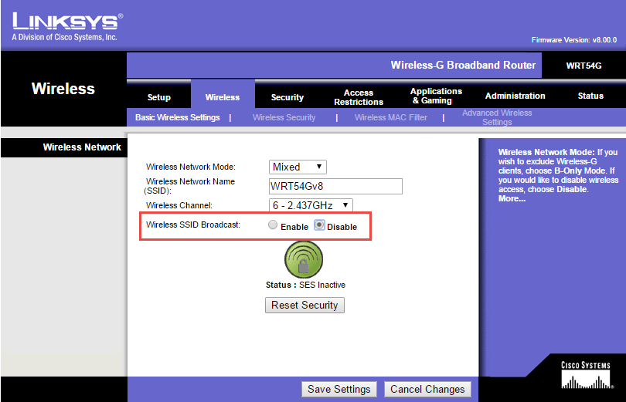
Disable SSID Broadcasting
If the SSID is broadcast, the AP will announce its presence and name, allowing everyone to attempt to authenticate and connect to the wireless network
The SSID broadcast should be disabled. In this scenario, an AP will only broadcast its presence, but not its name.
This discourages unauthorized association requests to the network and permits connections from legitimate users to the wireless network who have the correct SSID

Slide 37

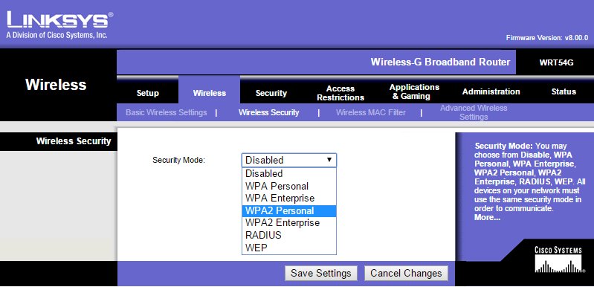
Selecting a Strong Wireless Encryption Mode
Order of preference for choosing an encryption mode:
A strong wireless encryption mode should be selected for the wireless network
01
WPA3
02
  WPA2 Enterprise with RADIUS
03
  WPA2 Enterprise
04
  WPA2 PSK
05
  WPA Enterprise
06
  WPA
07
  WEP

Slide 38
Defending Against WPA Cracking
Select a random passphrase that is not made up of dictionary words
Select a complex passphrase which contains a minimum of 20 characters and change the passphrase at regular intervals
Use WPA3 /WAP2 encryption only
Set the client settings properly (e.g., validate the server, specify the server address, do not prompt for new servers, etc.)
Use a virtual private network (VPN) such as a remote access VPN, Extranet VPN, Intranet VPN, etc.
Implement a network access control (NAC) or network access protection (NAP) solution for additional control over end-user connectivity

Slide 39


Detecting Rogue Access Points
Wireless Scanning
Wired Network Scanning
Simple Network Management Protocol (SNMP) Polling
Performs a wireless network scanning to detect the presence of wireless APs in the vicinity
  Discovery of an AP not listed in the wireless device inventory indicates the presence of a rogue AP
  Use wireless discovery tools such as inSSIDer, NetSurveyor, NetStumbler, Vistumbler, Kismet, etc., to detect wireless networks
Use network scanners such as Nmap to identify APs on the network. This will help in locating rogue devices on the wired network
Use the SNMP to identify the IP devices attached to the wired network
Use the SNMP detection utilities such as SolarWinds SNMP scanner, Lansweeper SNMP scanner, etc., to identify the SNMP-enabled devices on the network
Note: To use SNMP polling, the SNMP service on all IP devices in the network should be enabled.

Slide 40
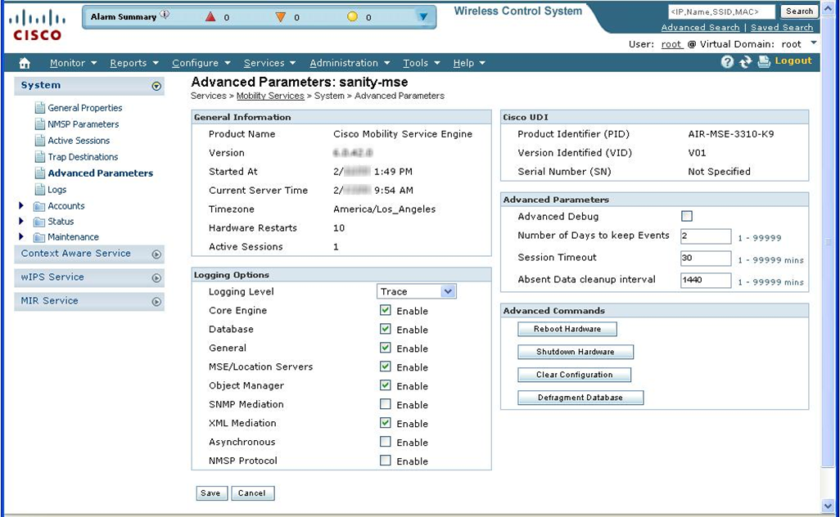
Wireless Security Tools
Cisco Adaptive Wireless IPS
It provides wireless-network threat detection and mitigation against malicious attacks and security vulnerabilities
AirMagnet WiFi Analyzer PRO
https://www.netally.com
RFProtect
https://www.arubanetworks.com
Fern Wifi Cracker
https://github.com
OSWA-Assistant
http://securitystartshere.org
BoopSuite
https://github.com
https://sourceforge.net
https://www.cisco.com

Slide 41
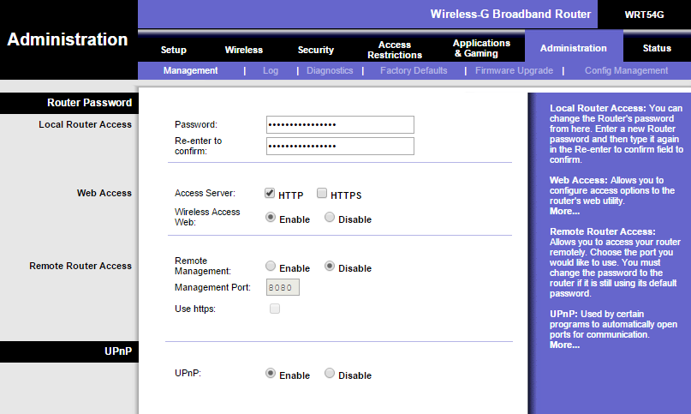
Configuring the Administrative Security on Wireless Routers
Change the default password on the wireless router
Assign a strong and complex password to the router
Choose the HTTPS for secure communication
Disable remote router access
Enable logging

Slide 42
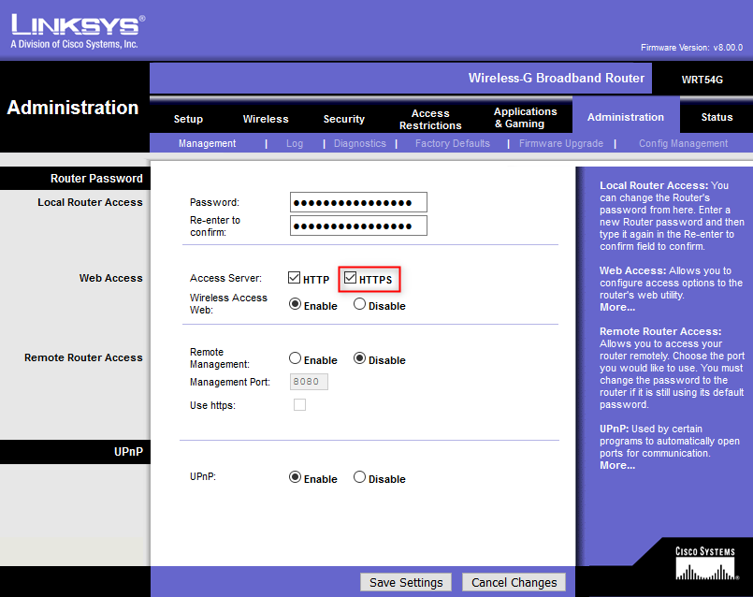
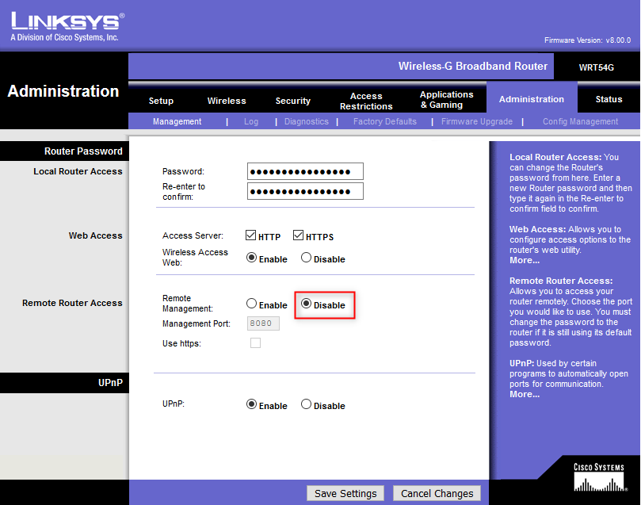
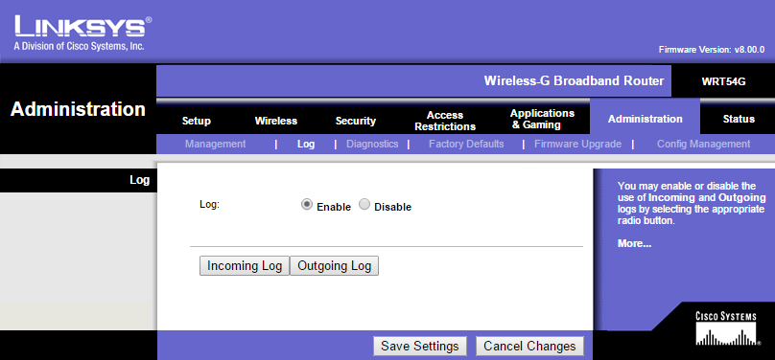
Configuring the Administrative Security on Wireless Routers (Cont’d)

Slide 43

Module Summary
1
This module has discussed the wireless terminology, wireless networks, and wireless standards
2
It also discussed the wireless network topologies and classification of wireless networks
3
This module has discussed the components of a wireless network and wireless network encryption mechanisms
4
It has discussed the different types of wireless network authentication methods
5
Finally, this module ended with an overview on various wireless network security measures and wireless security tools
6
In the next module, we will discuss on mobile device security in detail

