Slide 1


Module 08
Mobile Device Security
Notes:
662108080

Slide 2

Module Objectives
1
Understanding the Various Mobile Device Connection Methods
2
Understanding the Concepts of Mobile Device Management
3
Understanding the Common Mobile Use Approaches in Enterprises
4
Understand the Security Risk and Guidelines Associated with Enterprises Mobile Usage Policies
5
Understanding Enterprise-level Mobile Security Management Solutions
6
Understanding the General Security Guidelines and Best Practices for Mobile Platforms

Slide 3

Module Flow
Understand Various Mobile Device Connection Methods
Discuss Security Risks and Guidelines Associated with Enterprises Mobile Usage Policies
1
4
Discuss Mobile Device Management Concepts
Discuss and Implement Enterprise-level Mobile Security Management Solutions
2
5
Discuss Common Mobile Usage Policies in Enterprises
Discuss and Implement General Security Guidelines and Best Practices on Mobile Platforms
3
Mobile Security
6

Slide 4

Mobile Device Connection Methods
Near-field Communication (NFC)
It employs electromagnetic induction to enable communication between the devices connected within 10 cm
Satellite Communication (Satcom)
It is an artificial geostationary satellite that provides services across the globe, but it is much slower and more expensive than other technologies
Cellular Communication
It is based on a single network tower that serves devices located within a specific radius
Notes:
https://www.lynda.com/Security-tutorials/Mobile-connection-methods/601805/667337-4.html
SATCOM, ANT, WiFi, Infrared
https://www.professormesser.com/security-plus/sy0-501/mobile-device-connection-methods/
Cellular
https://www.slideshare.net/AnkitAnand126/cellular-wireless-network-security#:~:text=Conclusion%20Cellular%20Networks%20are%20open,authentication%2C%20confidentiality%2C%20integrity%20etc.
Point to point and Multi point
https://en.wikipedia.org/wiki/Point-to-point_(telecommunications)#:~:text=In%20telecommunications%2C%20a%20point%2Dto,be%20heard%20by%20the%20other.
https://www.geeksforgeeks.org/differences-between-point-to-point-and-multi-point-communication/
https://www.cablefree.net/wireless-technology/difference-point-point-point-multipoint/
GPS
https://www.androidcentral.com/how-does-gps-work-my-phone
RFID
https://www.atlasrfidstore.com/rfid-insider/7-types-security-attacks-rfid-systems
5G
https://www.raconteur.net/technology/5g/5g-security/

Slide 5
Mobile Device Connection Methods (Cont’d)
ANT
It is a wireless sensor protocol that enables communication between sensors and their controllers
GPS
Universal Serial Bus (USB)
It enables wired communication for devices. It can be used for power supply and serial data transmission between devices
Global Positioning System (GPS)
It is a radio navigation and positioning system based on satellite communication. It provides information related to geolocation and timing irrespective of weather conditions on the Earth
Infrared (IR)
It is a wireless technology for transferring data between two devices in the digital form within a short range of up to 5 m

Slide 6

Mobile Device Connection Methods (Cont’d)
5G Cellular (Mobile) Communication
Wi-Fi
Bluetooth
It is a common wireless technology used in homes and office buildings to connect local devices
It is a short-range, high-speed, and low-power wireless technology that enables communication between devices connected within the Bluetooth range
It is a broadband cellular network that operates at high bandwidth with low latency and provides high-speed data downloads

Slide 7

Mobile Device Connection Methods (Cont’d)
Point-to-point (P2P) Connection
It enables secure communication between two mobile devices without data encryption because they are connected through fixed paths without the interference of other devices
Point-to-multipoint Connection
It allows one-to-many connections by providing multiple paths from a single location to several other locations
Radio-frequency Identification (RFID)
It works on radio-frequency technology, which identifies a person or object using their tags (unique labels)

Slide 8
Module Flow
Understand Various Mobile Device Connection Methods
Discuss Security Risks and Guidelines Associated with Enterprises Mobile Usage Policies
1
4
Discuss Mobile Device Management Concepts
Discuss and Implement Enterprise-level Mobile Security Management Solutions
2
5
Discuss Common Mobile Usage Policies in Enterprises
Discuss and Implement General Security Guidelines and Best Practices on Mobile Platforms
3
Mobile Security
6

Slide 9

Mobile Device Management (MDM)
MDM provides platforms for over-the-air or wired distribution of applications, data and configuration settings for all types of mobile devices, including mobile phones, smartphones, tablet computers, etc.
Mobile Application Management
Mobile Content Management
Context-aware Authentication
A software that is mostly used by IT admins to control and secure organizational data. It offers features such as the remote activation or deactivation of devices, remote wiping in case of theft or loss, etc.
A software that offers solutions to safeguard the content or data on the mobile devices. It provides features to store and deliver data, offer the required services, and permit employees to access the organizational data remotely
It uses the contextual information of a user such as geolocation, identity, and behavior for enhancing data security decisions
Notes:
https://searchmobilecomputing.techtarget.com/definition/mobile-device-management
https://www.webopedia.com/definitions/mobile-device-management/
https://www.apriorit.com/dev-blog/473-how-to-build-an-mdm-system
https://www.bmc.com/blogs/mdm-mobile-device-management/
https://searchmobilecomputing.techtarget.com/definition/mobile-application-management-MAM
https://www.quora.com/What-is-mobile-application-management`
https://www.contentful.com/r/knowledgebase/mobile-cms/
https://www.manageengine.com/mobile-device-management/mobile-content-management.html
https://docs.vmware.com/en/VMware-Workspace-ONE-UEM/services/MCM/GUID-AWT-MCM-INTRO.html
https://www.webopedia.com/definitions/mcm-mobile-content-management/
https://en.wikipedia.org/wiki/Mobile_content_management_system
https://insights.samsung.com/2020/05/28/3-things-you-should-know-about-remote-wipe-2/
https://www.accellion.com/blog/remote-wipe-must-for-mobile-security/
https://clearbridgemobile.com/a-beginners-guide-to-geofencing-for-mobile-apps/
https://www.appypie.com/geofencing-app-marketing
https://www.promaticsindia.com/blog/understanding-geolocation-in-mobile-apps-how-location-based-services-in-apps-enhance-their-appeal/
https://en.wikipedia.org/wiki/Lock_screen
https://www.welivesecurity.com/2020/06/05/how-secure-is-your-phone-lock-screen/
https://thetool.io/2020/top-push-notifications-tools-services#:~:text=A%20Push%20Notification%20(also%20called,a%20request%20from%20the%20user.&text=They%20are%20the%20opposite%20side,Notifications%20originate%20from%20a%20server.
https://buildfire.com/what-is-a-push-notification/
https://www.twilio.com/docs/glossary/what-is-push-notification
https://www.allclearid.com/2020/01/15/pins-vs-passwords-whats-difference/
https://www.paypal.com/us/webapps/mpp/security/secure-passwords
https://www.m2sys.com/blog/guest-blog-posts/biometrics-mobile-app-security/
https://www.sciencedirect.com/science/article/pii/S1877050918301479
https://www.computerworld.com/article/3105866/forget-two-factor-authentication-here-comes-context-aware-authentication.html
https://searchsecurity.techtarget.com/definition/context-aware-security
https://www.manageengine.com/mobile-device-management/mdm-containerization.html
https://www.hexnode.com/blogs/what-is-containerization-and-why-is-it-important-for-your-business/
https://resources.infosecinstitute.com/certification/security-mobile-security-concepts-technology-sy0-401/
https://source.android.com/security/encryption/full-disk

Slide 10

Mobile Device Management (MDM) (Cont’d)
Mobile Email Management
Mobile Security Management
  It offers secure access to organizational email infrastructure and data on an employee’s mobile devices
It involves actions and precautionary steps for securing the organizational data and mobile devices used by employees
Enterprise Mobility Management
Remote Wipe
  It consists of tools and technologies used in an organization to secure the data in employees’ personal (BYOD) and organizational devices
It is a technique used for securing and protecting data from miscreants if a mobile device used by an employee was lost. This feature allows the administrator to send a command that can erase all the device data
Notes:
https://searchmobilecomputing.techtarget.com/definition/mobile-device-management
https://www.webopedia.com/definitions/mobile-device-management/
https://www.apriorit.com/dev-blog/473-how-to-build-an-mdm-system
https://www.bmc.com/blogs/mdm-mobile-device-management/
https://searchmobilecomputing.techtarget.com/definition/mobile-application-management-MAM
https://www.quora.com/What-is-mobile-application-management`
https://www.contentful.com/r/knowledgebase/mobile-cms/
https://www.manageengine.com/mobile-device-management/mobile-content-management.html
https://docs.vmware.com/en/VMware-Workspace-ONE-UEM/services/MCM/GUID-AWT-MCM-INTRO.html
https://www.webopedia.com/definitions/mcm-mobile-content-management/
https://en.wikipedia.org/wiki/Mobile_content_management_system
https://insights.samsung.com/2020/05/28/3-things-you-should-know-about-remote-wipe-2/
https://www.accellion.com/blog/remote-wipe-must-for-mobile-security/
https://clearbridgemobile.com/a-beginners-guide-to-geofencing-for-mobile-apps/
https://www.appypie.com/geofencing-app-marketing
https://www.promaticsindia.com/blog/understanding-geolocation-in-mobile-apps-how-location-based-services-in-apps-enhance-their-appeal/
https://en.wikipedia.org/wiki/Lock_screen
https://www.welivesecurity.com/2020/06/05/how-secure-is-your-phone-lock-screen/
https://thetool.io/2020/top-push-notifications-tools-services#:~:text=A%20Push%20Notification%20(also%20called,a%20request%20from%20the%20user.&text=They%20are%20the%20opposite%20side,Notifications%20originate%20from%20a%20server.
https://buildfire.com/what-is-a-push-notification/
https://www.twilio.com/docs/glossary/what-is-push-notification
https://www.allclearid.com/2020/01/15/pins-vs-passwords-whats-difference/
https://www.paypal.com/us/webapps/mpp/security/secure-passwords
https://www.m2sys.com/blog/guest-blog-posts/biometrics-mobile-app-security/
https://www.sciencedirect.com/science/article/pii/S1877050918301479
https://www.computerworld.com/article/3105866/forget-two-factor-authentication-here-comes-context-aware-authentication.html
https://searchsecurity.techtarget.com/definition/context-aware-security
https://www.manageengine.com/mobile-device-management/mdm-containerization.html
https://www.hexnode.com/blogs/what-is-containerization-and-why-is-it-important-for-your-business/
https://resources.infosecinstitute.com/certification/security-mobile-security-concepts-technology-sy0-401/
https://source.android.com/security/encryption/full-disk

Slide 11

Mobile Device Management (MDM) (Cont’d)
Screen Lock
It is a feature in mobile devices that is used to secure data and prevent illegal access by perpetrators
Passwords and PINs
It protects private data of the employee and confidential information of the organization stored on a mobile device
It is an advanced and unique security technology that utilizes an individual’s physical attributes such as fingerprint, iris, face, voice, and behavior for verifying their identity
Biometrics
It is a messaging feature that originates from a server and enables the delivery of data or a message from an application to a mobile device without any explicit request from the user
Push Notification Services

Slide 12
Mobile Device Management (MDM) (Cont’d)
Geolocation
Full Device Encryption
It is a technology that can identify the real-world geographical location of users or devices when connected to the Internet
It is a security feature that can encrypt all the information stored on any storage medium within a mobile device
Geofencing
Containerization
A geofence is a virtual fence that is positioned at a location and interacts with mobile users whenever they cross the fence.
This helps marketers gather sensitive data and know about users’ offline activities from the location data
It is a technique in which all personal and organizational data are segregated on an employee’s mobile device. It helps in improving the security of organizational data

Slide 13
Module Flow
Understand Various Mobile Device Connection Methods
Discuss Security Risks and Guidelines Associated with Enterprises Mobile Usage Policies
1
4
Discuss Mobile Device Management Concepts
Discuss and Implement Enterprise-level Mobile Security Management Solutions
2
5
Discuss Common Mobile Usage Policies in Enterprises
Discuss and Implement General Security Guidelines and Best Practices on Mobile Platforms
3
Mobile Security
6

Slide 14

Mobile Use Approaches in Enterprise
Organizations follow four types of approaches to grant permissions to employees to use mobile devices for business purposes.
1
2
BYOD (Bring Your Own Device)
COPE (Company Owned, Personally Enabled)
3
4
COBO (Company Owned, Business Only)
CYOD (Choose Your Own Device)

Slide 15


Bring Your Own Device (BYOD)
Bring your own device (BYOD) refers to a policy that allows employees to bring their personal devices such as laptops, smartphones, and tablets to the workplace and use them for accessing the organizational resources based on their access privileges
The BYOD policy allows employees to use the devices that they are comfortable with and best fits their preferences and work purposes
BYOD Benefits
1
Increased productivity
3
Work flexibility
2
Employee satisfaction
4
Lower costs

Slide 16

BYOD Policy Implementation
Define the requirements
1
Decide how to manage the employee devices and their data access
2
3
Develop policies
Support
5
4
Security

Slide 17

Choose Your Own Device (CYOD)
Choose Your Own Device (CYOD) refers to a policy that allows employees to select devices such as laptops, smartphones, and tablets from the list of devices approved by the company. The company purchases the selected device, and the employees use it for accessing the organizational resources according to their access privileges
CYOD Benefits
1
Devices compatible with the company security policy
3
Streamline device options
2
Employee satisfaction with company’s control
4
Lower cost compared to COPE

Slide 18
CYOD Policy Implementation
1
Define approved set of devices
2
Allow employees to select a device from the approved set of devices and build a technology portfolio
3
Develop policies
4
Security
5
Support

Slide 19

Corporate Owned, Personally Enabled (COPE)
Corporate Owned, Personally Enabled (COPE) refers to a policy that allows employees to use and manage the devices purchased by the organization
COPE Benefits
1
2
3
4
Greater control and authority to the organization
Retains ownership of the devices
Less expensive than BOYD
Prevents employee from carrying multiple devices (phones)

Slide 20
COPE Policy Implementation
1
2
3
Purchase computing resources and devices
Allow employees to work with the company-owned device (including personal work) and build a technology portfolio
Develop policies
4
5
Security
Support

Slide 21


Company Owned, Business Only (COBO)
Company Owned, Business Only (COBO) refers to a policy that allows employees to use and manage the devices purchased by the organization but restrict their usage for business purposes only
COBO Benefits
1
2
Full control and authority to the organization
Prevents data leakage

Slide 22
COBO Policy Implementation
Prohibit personal use of devices
01
Allow employees to work with a device running a single application and build a technology portfolio
02
Develop policies
03
Security
04
Support
05

Slide 23
Module Flow
Discuss Security Risks and Guidelines Associated with Enterprises Mobile Usage Policies
1
Understand Various Mobile Device Connection Methods
4
Discuss Mobile Device Management Concepts
Discuss and Implement Enterprise-level Mobile Security Management Solutions
2
5
Discuss Common Mobile Usage Policies in Enterprises
Discuss and Implement General Security Guidelines and Best Practices on Mobile Platforms
3
Mobile Security
6

Slide 24

Enterprise Mobile Device Security Risks and Challenges
Security Risks
Security Challenges
The use of mobile devices in a work environment has changed the approach of organizational security. Mobile usage in enterprises has created a new set of security risks and challenges
Hence, enterprise mobile device security encounters additional security challenges besides the mobile device-level security risks that include weak security systems and insufficient configuration of mobile devices and platforms
Mobile devices are moving targets that can be used outside an organization and its security system, thereby defeating the purpose of preventing security attacks when organizations allows mobile devices at the workplace
  Mobile devices are harder to track and secure
  Mobile device are portable enough that they can be easily lost or stolen
  It is difficult to ensure that mobile software patches and security settings are updated

Slide 25
Risk Associated with BYOD, CYOD, COPE, and COBO
1
Sharing confidential data on unsecured networks
Lost or stolen devices
6
OPTION 01
2
Data leakage and endpoint security issues
Lack of awareness
7
OPTION 01
3
Ability to bypass the network policy rules of the organization
8
Improperly disposing of devices
OPTION 01
4
Supporting various devices
Infrastructure issues
9
OPTION 01
5
Mixing personal and private data
Disgruntled employees
10
OPTION 01

Slide 26
Security Guidelines for BYOD, CYOD, COPE, and COBO
For Security Professional
For Employee
Secure organizational data centers with multi-layered protection systems
Educate employees about the COPE policy
Clarify who owns which apps and data
Use encrypted channels for data transfer
Clarify which apps are allowed or banned
Control access on a need-to-know basis
Ensure that the employees completely understand and sign-off on the policies
Use the encryption mechanism to store data
Maintain a clear separation between business and personal data
Register devices with a remote locate and wipe facility if the company policy permits
Regularly update the device with the latest OS and patches
Use anti-virus and data loss prevention (DLP) solutions
Set a strong passcode for the device and change it often
Set passwords for apps to restrict others from accessing them

Slide 27
Module Flow
Understand Various Mobile Device Connection Methods
Discuss Security Risks and Guidelines Associated with Enterprises Mobile Usage Policies
1
4
Discuss and Implement Enterprise-level Mobile Security Management Solutions
2
Discuss Mobile Device Management Concepts
5
Discuss Common Mobile Usage Policies in Enterprises
Discuss and Implement General Security Guidelines and Best Practices on Mobile Platforms
3
Mobile Security
6

Slide 28






Mobile Device Management Solutions
MDM Solution Deployment
Mobile device management (MDM) solutions are used to deploy, secure, monitor, and manage company and employee-owned devices
MDM server's management console
MDM Agent
On Premise
Security professionals use the MDM server management console to remotely configure the MDM agents installed on the devices
Network Defender
MDM Agent
On Cloud /SaaS
MDM Agent

Slide 29
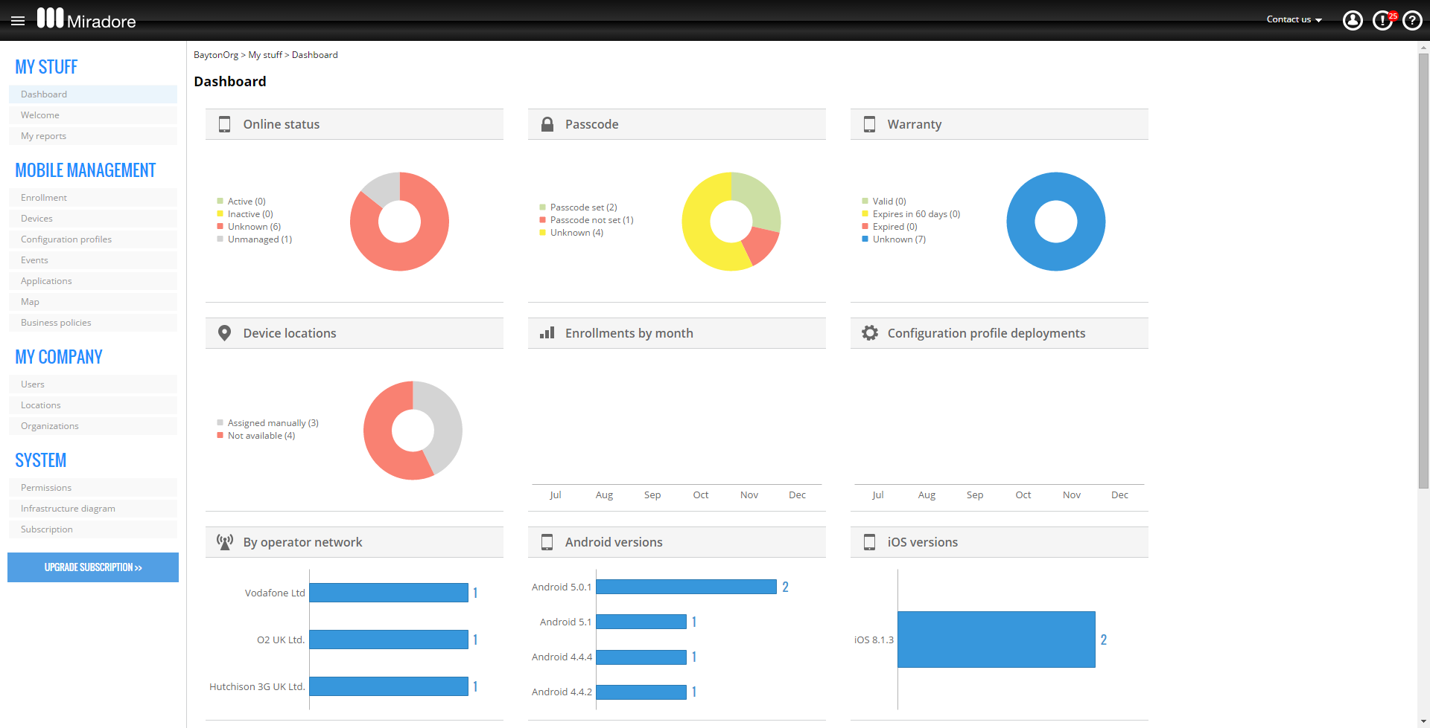
Mobile Device Management Solutions (Cont’d)
Miradore
AirWatch
https://www.vmware.com
Miradore helps ensure device and data security as well as data compliance across an organization
Microsoft Intune
https://www.microsoft.com
IBM MaaS360
https://www.ibm.com
XenMobile
https://www.citrix.com
Absolute Manage MDM
http://www.absolute.com
https://www.miradore.com
Notes:
Screenshot: https://bayton.org/2015/03/miradore-online-mdm-review-a-second-look/

Slide 30





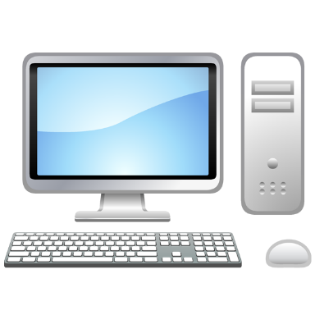







Mobile Application Management Solutions
Mobile application management (MAM) is a software or service that enables network defenders to secure, manage, and distribute enterprise applications on employee mobile devices
Restrict application access
Organizational data
License management
MAM admin console
Personal data
IT Admin
Employee
Install/Uninstall application remotely

Slide 31


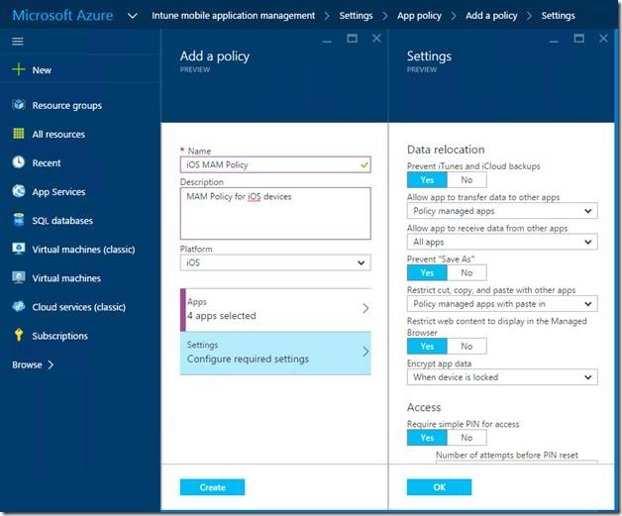
Mobile Application Management Solutions (Cont’d)
Microsoft Intune
Intune MAM is a suite of Intune management features that lets users publish, push, configure, secure, monitor, and update mobile apps
https://www.microsoft.com
AppStation's MAM
https://www.mobileiron.com
Scalefusion Application Management
https://scalefusion.com
ManageEngine Mobile Device Manager Plus
https://www.manageengine.com
Apriorit Enterprise Mobile Device and Application Management
https://www.apriorit.com
Appaloosa
https://www.appaloosa.io

Slide 32



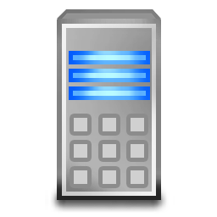


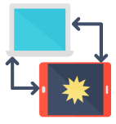



Mobile Content Management Solutions
Mobile content management (MCM) or mobile information management (MIM) solutions provide secure access to corporate data on smartphones, tablets, and other mobile devices
It enables easy and secure sharing of content between devices within an enterprise
File storage and file sharing services are the two main components of MCM solutions
Database
Add
Sync
Content gateway
Organizational file server
IT Admin
Vaultize
https://www.vaultize.com
MobileIron
https://www.mobileiron.com
AppTec360°
https://www.apptec360.com
Deploy content to devices using content locker
Configure Apps
MCM Solutions
Employee
Add

Slide 33
Mobile Threat Defense Solutions
Mobile threat defense (MTD) aims to secure mobile devices against advanced malicious threats, network attacks, and device vulnerabilities
MobileIron Threat Defense (MTD)
https://www.mobileiron.com
Pradeo Security Mobile Threat Defense
https://www.pradeo.com
The agents installed on the devices scan them for various mobile attacks using advanced threat intelligence
Zimperium Mobile Threat Defense (MTD)
https://www.zimperium.com
It uses machine learning and real-time analysis to protect mobile endpoints
Wandera Mobile Threat Defense
https://www.wandera.com
MTD generate alerts for the enterprise mobility management (EMM) solutions to perform appropriate actions (switching mobiles into the quarantine state)
Lookout MTD
https://www.lookout.com

Slide 34
Mobile Email Management Solutions
Mobile email management (MEM) solutions ensures the security of the corporate email infrastructure and data
  Features of MEM solutions
MEM Solutions
  Pre-configures emails on devices remotely
  Ensures that only approved apps and devices can access the emails
  Prevents unauthorized access of email attachments
  Pre-installs the email client to be used for e-mail access
42Gears MEM
https://www.42gears.com
Hexnode Mobile Email Management
https://www.hexnode.com
Mimecast Mobile Email Management
https://www.mimecast.com

Slide 35
Enterprise Mobility Management Solutions
Enterprise mobility management (EMM) is a comprehensive solution for MDM, MAM, MTM, MCM, and MEM
ManageEngine Mobile Device Manager Plus
https://www.manageengine.com
42Gears Enterprise Mobility Management (EMM)
https://www.42gears.com
Mobile Email
Management
(MEM)
Mobile Device Management
(MDM)
Scalefusion EMM
https://scalefusion.com
Enterprise
Mobility
Management
(EMM)
Solution
Mobile Content Management
(MCM)
Mobile Threat
Management
(MTM)
IBM Security MaaS360®
https://www.ibm.com
Mobile Application Management
(MAM)
Zebra Enterprise Mobility Management (EMM) Tool Kit
https://www.zebra.com

Slide 36
Unified Endpoint Management Solutions
Mobileiron UEM
https://www.mobileiron.com
Unified endpoint management (UEM) solutions ensure remote provisioning, managing, controlling, and securing Internet-enabled devices from a single interface
Ivanti Unified Endpoint Manager
https://www.ivanti.com
  Features of UEM
    Remote, manual, or automatic pushing of updates
    Configuration for on-device security policies
    Supporting employee-owned devices
    Erasing the data of lost or stolen devices remotely
    Tracking device usage
    Threat detection and mitigation
    API framework for custom applications
Workspace ONE
https://www.vmware.com
ManageEngine Desktop Central
https://www.manageengine.com
42Gears UEM
https://www.42gears.com

Slide 37
Module Flow
Understand Various Mobile Device Connection Methods
Discuss Security Risks and Guidelines Associated with Enterprises Mobile Usage Policies
1
4
Discuss Mobile Device Management Concepts
Discuss and Implement Enterprise-level Mobile Security Management Solutions
2
5
Discuss and Implement General Security Guidelines and Best Practices on Mobile Platforms
3
Discuss Common Mobile Usage Policies in Enterprises
Mobile Security
6

Slide 38
Mobile Application Security Best Practices
Ensure that the apps do not save passwords
Avoid the use of query string while handling sensitive data
Use code obfuscation and encryption to secure the application source code
Implement two-factor authentication
Use SSL/TLS to send data over secure channels
Avoid caching app data
Perform validation checks on input data
Implement secure session management

Slide 39
Mobile Data Security Best Practices
01
Encrypt the data stored on the device
02
Enable over-the-air encryption using SSL, TLS, VPN, WPA2 etc.
03
Backup the mobile data periodically
04
Do not store extremely sensitive information on mobile devices
05
Do not store passwords or PINs as contacts on your phone
06
Use private data centers to store data and implement device authentication

Slide 40

Mobile Network Security Guidelines
1
Disable interfaces such as Bluetooth, infrared, and Wi-Fi when not in use
2
Set Bluetooth-enabled devices to non-discoverable mode
3
Avoid connecting to unknown Wi-Fi networks and using public Wi-Fi hotspots
4
Connect your device to encrypted Wi-Fi networks only
5
Configure web accounts to use secure connections

Slide 41
General Guidelines for Mobile Platform Security
Do not install too many applications and avoid auto-uploading photos to social networks
Securely wipe or delete the data when disposing of a device
01
05
Perform security assessment on the application architecture
02
06
Do not share any information within GPS-enabled apps unless required
Maintain configuration control and management
03
07
Disable wireless access such as Wi-Fi and Bluetooth if not in use
Install applications from trusted application stores
Never connect two separate networks such as Wi-Fi and Bluetooth simultaneously
04
08

Slide 42

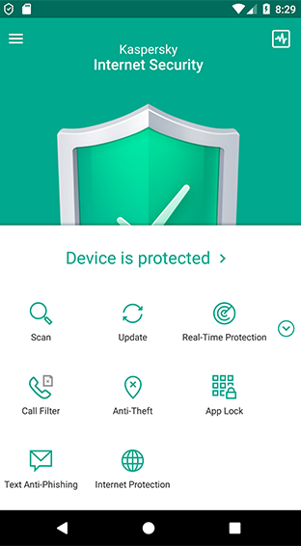
Android Security Tools
Avira Antivirus Security
https://www.avira.com
Kaspersky Internet Security for Android
Avast Mobile Security
https://www.avast.com
Kaspersky Internet Security for Android blocks suspicious apps, websites, and files
McAfee Mobile Security
https://www.mcafeemobilesecurity.com
It allows you to control access to specific apps and stops spyware monitoring calls, texts, and location
Lookout Mobile Security and Antivirus
https://www.lookout.com
It includes anti-theft tools to protect mobiles and data
Sophos Mobile Security
https://www.sophos.com
https://my.kaspersky.com

Slide 43
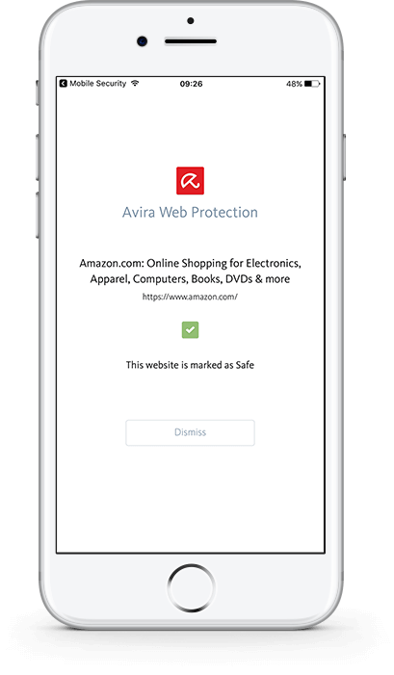
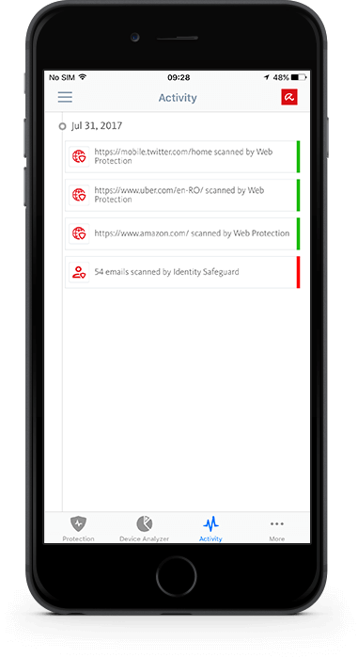
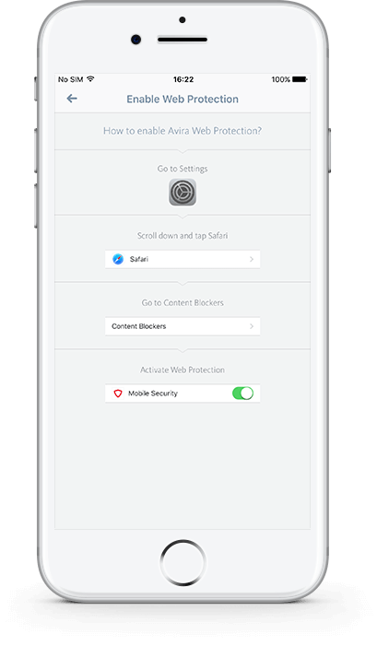
iOS Device Security Tools
This tool provides features such as web protection and identity safeguarding, identifies phishing websites that target you personally, secures emails, tracks your device, identifies suspicious activities, organizes the device memory, and backs up all contacts
Avira Mobile Security
Norton Mobile Security
https://us.norton.com
LastPass Password Manager
https://www.lastpass.com
Lookout Mobile Securit‪y‬
https://www.mylookout.com
SplashID Safe Password Manager
https://www.splashid.com
Webroot Mobile Securit‪y
https://www.webroot.com
https://www.avira.com
Notes:
Need to change screenshots

Slide 44

Module Summary
This module has discussed the various mobile device connection methods
It has discussed the concepts of mobile device management
It has also discussed the common mobile use approaches in enterprises
It has discussed the security risk and guidelines associated with enterprise mobile usage policies
This module also discussed enterprise-level mobile security management solutions
Finally, this module ended with an overview of general security guidelines and best practices for mobile platforms
In the next module, we will discuss on IoT device security in detail

