Slide 1
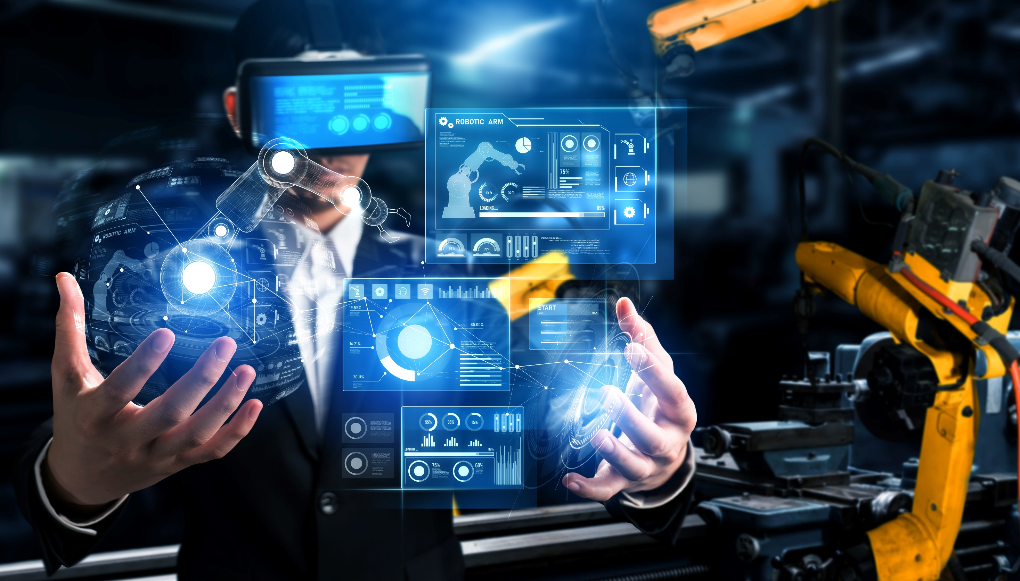

Module 09
IoT Device Security
Notes:
1936177948

Slide 2
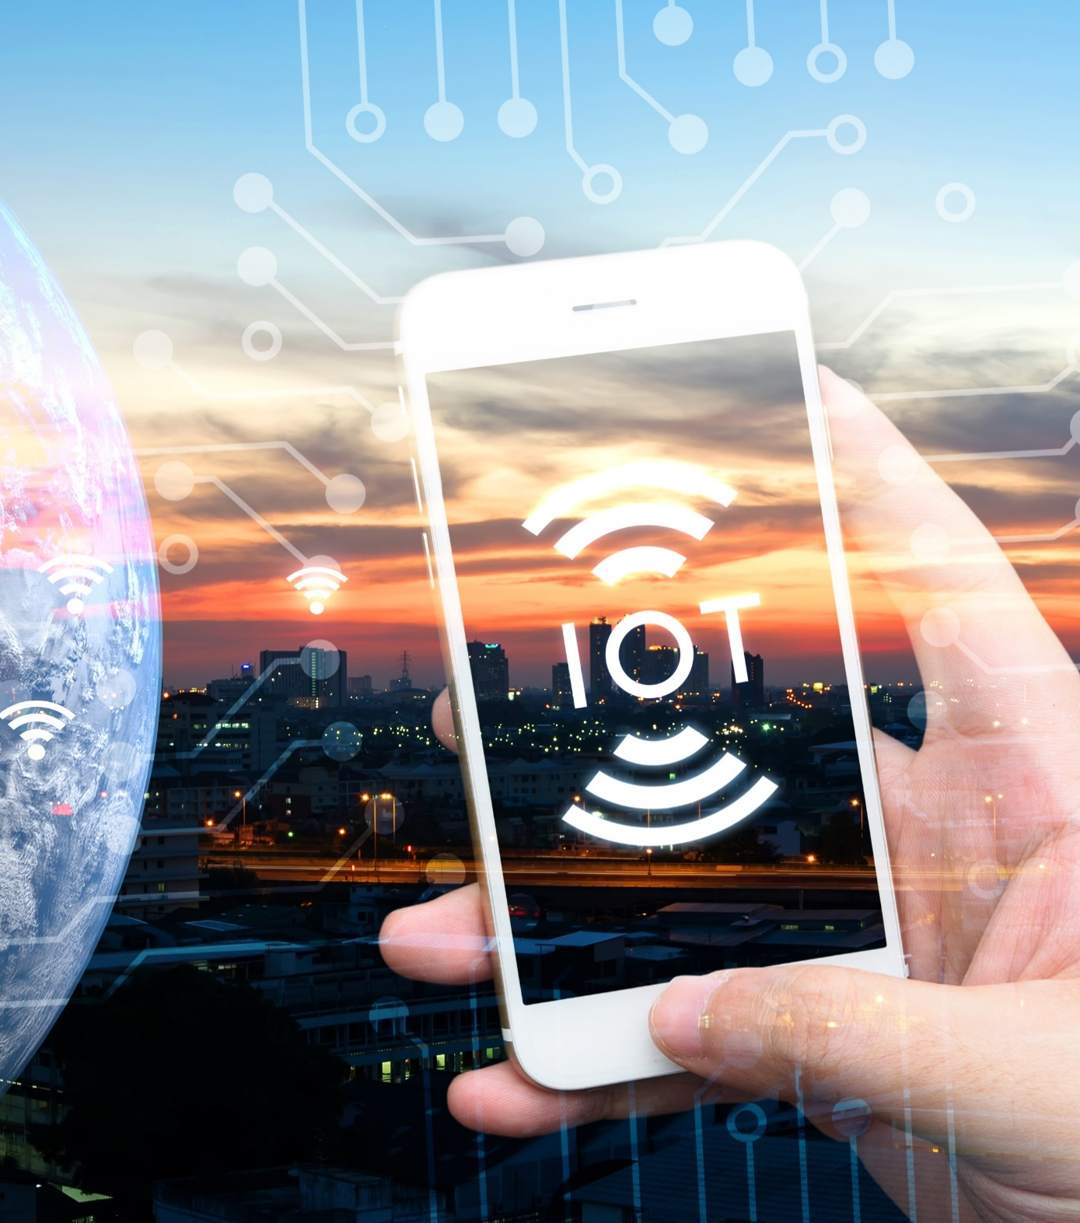
Module Objectives
1
Understanding the IoT and Why Organizations Opt for IoT-enabled Environments
2
Overview of IoT Application Areas and IoT Devices
3
Understanding the IoT Architecture and IoT Communication Models
4
Understanding the Security in IoT-Enabled Environments
5
Understanding the Security Considerations of the IoT Framework
6
Overview of IoT Device Management
7
Understanding the Best Practices and Tools for IoT Security

Slide 3
Module Flow
1
2
Understand IoT Devices, Application Areas, and Communication Models
Discuss the Security in
IoT-enabled Environments

Slide 4

















What is IoT?
Internet of Things (IoT), also known as Internet of Everything (IoE), refers to the network of devices having IP addresses and the capability to sense, collect, and send data using embedded sensors, communication hardware and processors
In IoT, the term thing is used to refer to a device that is implanted on natural, human-made, or machine-made objects and has the functionality of communicating over the network
Industrial Devices
Smart
Watch
Wearable Devices
Tools
Manufacturing
Wearable
Transportation
TVs
IoT
Health
Checkup
Monitoring
Devices
Thermostat
Healthcare Devices
Drugs
Energy
Home Devices

Slide 5

Why Organizations are Opting for IoT-enabled Environments
IoT devices work on a three-dimensional plane, offering connectivity for anyone at anytime, for anything, and from any place
Outdoors and indoors
Daytime
Night
Connect anytime
On the move
Indoor (away from the PC)
Outdoor
At the PC
Between PCs
Human to human (H2H), without using a PC
Human to things (H2T), using generic equipment
Things to things (T2T)
Connect anything
Connect any place

Slide 6

IoT Application Areas and Devices
Service Sectors | Application Groups | Locations | Devices
Buildings | Commercial/Institutional | Office, Education, Retail, Hospitality, Healthcare, Airports, Stadiums | HVAC, Transport, Fire & Safety, Lighting, Security, Access, etc.
 | Industrial | Process, Clean Room, Campus
Energy | Supply/Demand | Power Gen, Trans & Dist, Low Voltage, Power Quality, Energy management | Turbines, Windmills, UPS, Batteries, Generators, Meters, Drills, Fuel Cells, etc.
 | Alternative | Solar Wind, Co-generation, Electrochemical
 | Oil/Gas | Rigs, Derricks, Heads, Pumps, Pipelines
Consumer and Home | Infrastructure | Wiring, Network Access, Energy management | Digital Cameras, Power Systems, MID, e-Readers, Dishwashers, Desktop Computers, Washing Machines/Dryers, Meters, Lights, TVs, MP3 Devices, Games Consoles, Alarms, etc.
 | Awareness & Safety | Security/Alerts, Fire Safety, Elderly, Children, Power Protection
 | Convenience & Entertainment | HVAC/Climate, Lighting, Appliance, Entertainment
Healthcare and Life Science | Care | Hospital, ER, Mobile, POC, Clinic, Labs, Doctor Office | MRI Machines, PDAs, Implants, Surgical Equipment, Pumps, Monitors, Telemedicine, etc.
 | In Vivo/Home | Implants, Home, Monitoring Systems
 | Research | Drug Discovery, Diagnostics, Labs
Transportation | Non-Vehicular | Air, Rail, Marine | Vehicles, Lights, Ships, Planes, Signage, Tolls, etc.
 | Vehicles | Consumer, Commercial, Construction, Off-Highway
 | Trans Systems | Tolls, Traffic mgmt., Navigation

Slide 7

IoT Application Areas and Devices (Cont’d)
Service Sectors | Application Groups | Locations | Devices
Industrial | Resource Automation | Mining, Irrigation, Agricultural, Woodland | Pumps, Valves, Vats, Conveyors, Fabrication, Assembly/Packaging, Vessels/Tanks, etc.
 | Fluid/Processes | Petro-Chem, Hydro, Carbons, Food, Beverage
 | Converting/Discrete | Metals, Papers, Rubber/Plastic, Metalworking electronics, Assembly/Test
 | Distribution | Pipelines, Conveyance
Retail | Specialty | Fuel Stations, Gaming, Bowling, Cinemas, Discos, Special Events | POS Terminals, Tags, Cash Registers, Vending Machines, Signs, etc.
 | Hospitality | Hotels Restaurants, Bars, Cafes, Clubs
 | Stores | Supermarkets, Shopping Centers, Single Site, Distribution, Centers
Security / Public Safety | Surveillance | Radar/Satellite, Environ., Military Security, Unmanned, Fixed | Tanks, Fighter Jets, Battlefields, Jeeps, Cars, Ambulance, Homeland Security, Environment, Monitor, etc.
 | Equipment | Weapons, Vehicles, Ships, Aircraft, Gear
 | Tracking | Human, Animal, Postal, Food, Health, Baggage
 | Public Infrastructure | Water, Treatment, Building, Environ. Equip. & Personnel, Police, Fire, Regulatory
 | Emergency Services | Ambulance, Police, Fire, Homeland Security
IT and Networks | Public | Services, E-Commerce, Data Centers, Mobile Carriers, ISPs | Servers, Storage, PCs, Routers, Switches, PBXs, etc.
 | Private Enterprise | IT/Data Center Office, Privacy Nets
http://www.beechamresearch.com

Slide 8


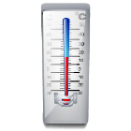
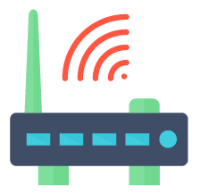





IoT Architecture
Humidity/Moisture
A gateway is responsible for collecting the data from IoT devices and performing the preliminary processing of the data before sending to the cloud
Store Data
Data Storage/ Cloud Server
Send Data Analysis
Temperature
Send Data
The final processing, data storage, and provision of feedback to the edge devices are performed in the cloud
Receive Command
IoT Gateway
Pressure
Get Data Analysis
Internet
Send Command
Sound/Vibration
IoT Devices
Remote Control using Mobile App
Users access the cloud infrastructure using smartphones, tablets, desktops, and laptops

Slide 9













Layers of the
IoT Architecture
Applications
(CRM, ERP, SCM, PLM)
Processes, Practices,
and Policies
User
Device(s)
Gateway
Connection
Cloud
Platform
Analytics
Device Layer
Communication Layer
Cloud Platform Layer
Process Layer

Slide 10




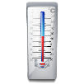


IoT Communication Models
01
Device-To-Device Model
02
Device-To-Cloud Model
Application
Service Provider
HTTP
TLS
TCP
IP
CoAP
DTLS
UDP
IP
Light Bulb from manufacturer A
Wireless Network
Light Switch from manufacturer B
Bluetooth
Z-wave
Zigbee
Device with Temperature
Sensor
Device with Carbon Monoxide Sensor
03
Device-to-Gateway Model
04
Cloud-to-Cloud (Back-End Data-Sharing Model)
Application
Service Provider
CoAP
DTLS
UDP
IPv6
Protocol Stack
HTTP
TLS
TCP
IPv6
CoAP
or
HTTP
Application
Service Provider #2
IPv4/IPv6
Application
Service Provider #1
HTTPS
Oauth 2.0
JSON
Local Gateway
Light
Sensor
Device with Temperature
Sensor
Local 1 Protocol
Device with Carbon Monoxide Sensor
Bluetooth smart
IEEE 802.11 (Wi-Fi)
IEEE 802.15.4 (LR-WPAN)
Application
Service Provider #3

Slide 11
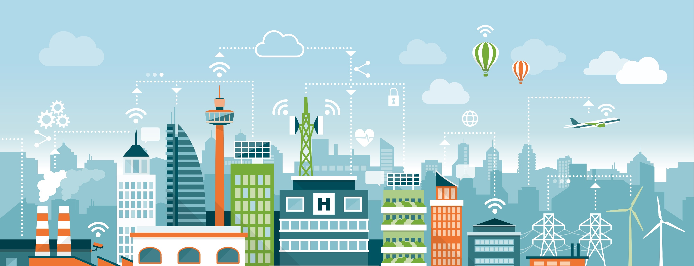

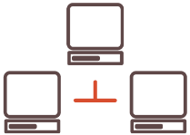







IoT-Enabled IT Environment
IoT Things
Local Network
Cloud-based Computing
LAN
Business Data Analysis
Internet
Gateway
Remote Web Server
Wired/Wireless
User Access and Control

Slide 12

IoT-Enabled IT Environment (Cont’d)
Features of an IoT-Enabled IT Environment
Real-time monitoring involves monitoring IoT assets, processing products, maintaining a flow, helping detect issues, and taking actions immediately
Real-time analytics involves analyzing IoT things and taking steps accordingly
Multi-layer security involves preventing unauthorized access to IoT things by using multi-factor authentication (MFA), Transport Layer Security (TLS), device identity management, etc.
Data collection involves the exchange of data between IoT-enabled organizations using different communication protocols
Communication among multiple devices involves configuring multiple devices to access IoT things even remotely at any time and from anywhere

Slide 13
Module Flow
1
2
Understand IoT Devices, Application Areas, and Communication Models
Discuss the Security in
IoT-enabled Environments

Slide 14

Security in IoT-enabled Environments
With no or inadequate focus on IoT device security by manufacturers, security measures used to harden the IoT device are often insufficient
Therefore, organizations should focus on countering attack scenarios in IoT-enabled environments. Organizations should focus on securing network devices and routers in an IoT-enabled environment. This helps restrict the attacker from accessing other parts of the network and performing targeted attacks
The organization should use multilayered management. An overarching multilayered security plan and constant maintenance are necessary to effectively secure all these disparate IoT devices
Company-wide collaboration and synchronization are required to secure an IoT-enabled environment

Slide 15


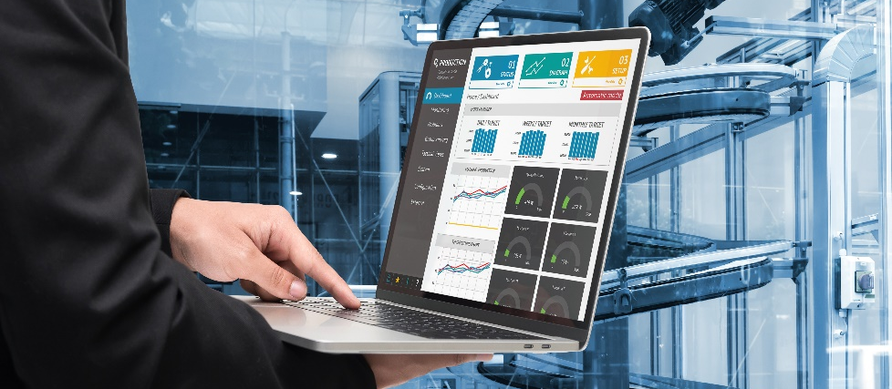
IoT System Management
Device Management
User Management
Security Monitoring
Ensure secure data transmission to facilitate fine interaction between devices and to guarantee the proper functioning of devices in an IoT system
Provide control over the users who have access to an IoT system. User management includes identifying users, setting user roles and access levels, controlling access, etc.
To address security breaches at early stages and to prevent malicious attacks on an IoT system, perform the activities such as log and analyze commands sent by control applications to things, monitor and store all the actions of users, identify the patterns of malicious behavior, etc.

Slide 16
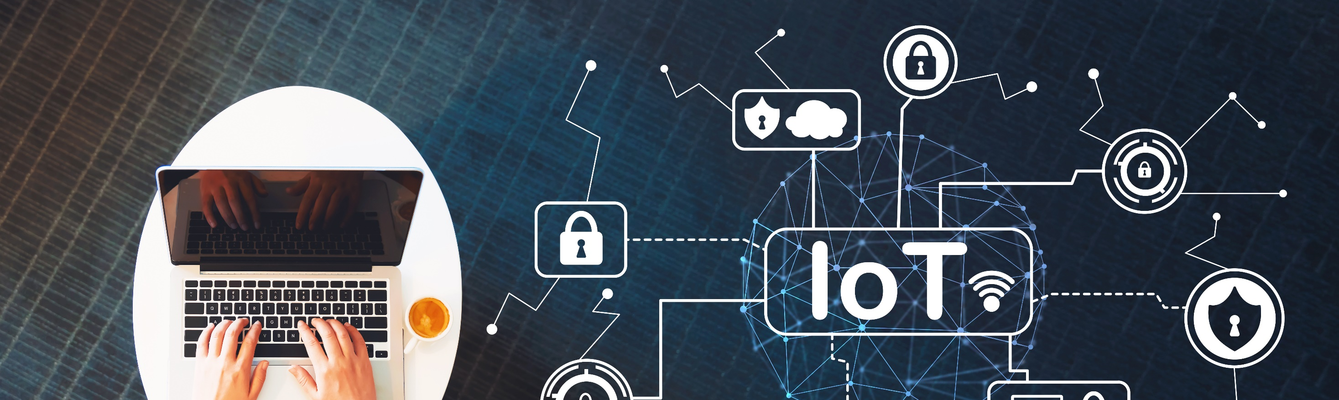

Stack-wise IoT Security Principles
Applications
(CRM, ERP, SCM, PLM)
Processes, Practices,
and Policies
User
Device(s)
Gateway
Connection
Cloud
Platform
Analytics
Secure Device Layer
Secure Communication Layer
Secure Cloud Layer
Secure Process Layer

Slide 17
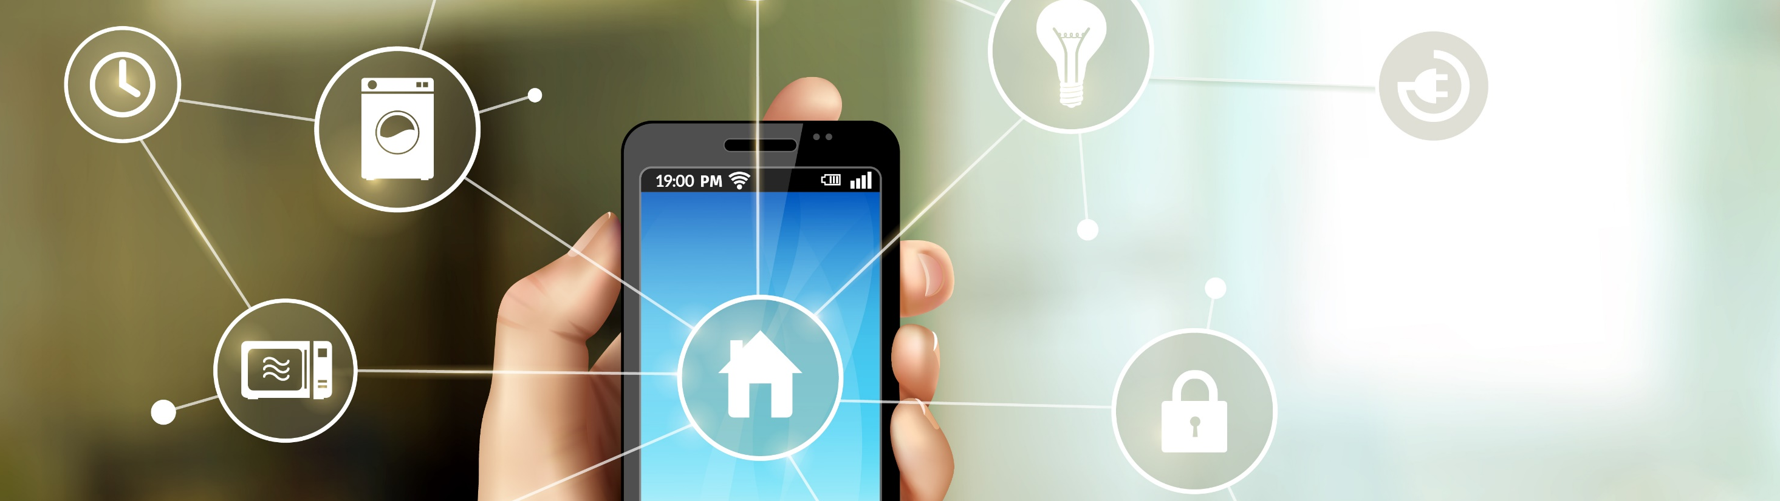




IoT
Framework Security Considerations
EDGE
GATEWAY
CLOUD PLATFORM
MOBILE
Communications encryption
Storage encryption
Update components
No default passwords
Multi-directional encrypted communications
Strong authentication of all the components
Automatic updates
Encrypted communications
Secure web interface
Authentication
Encrypted storage
Automatic updates
Local storage security
Encrypted communications channels
Multi-factor authentication
Account lockout mechanism

Slide 18
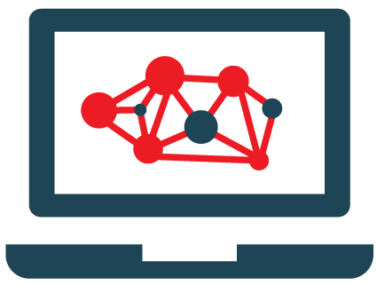
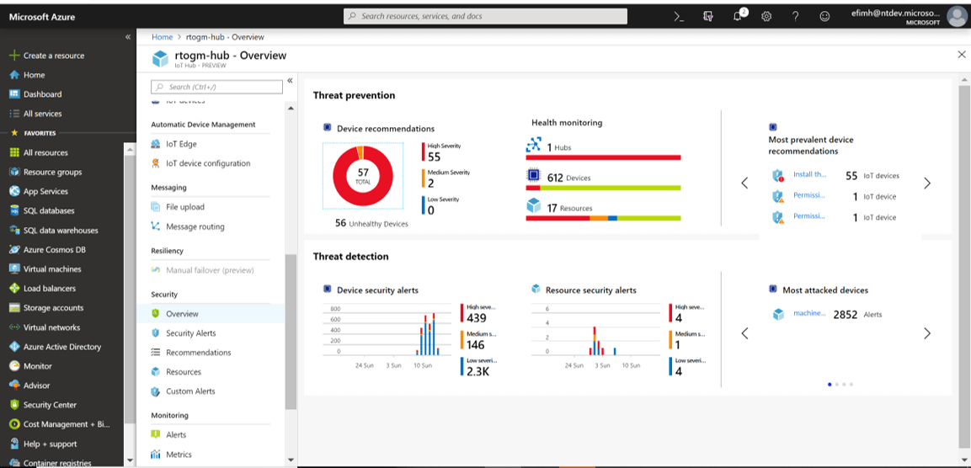
IoT Device Management
IoT device management helps in supporting IoT solutions by using any software tools and processes and helps in onboarding latest devices securely and promptly
Azure IoT Central
IoT Device
Management Solutions
Oracle IoT Asset Monitoring Cloud
https://www.oracle.com
Predix
https://www.ge.com
Cloud IoT Core
https://cloud.google.com
IBM Watson IoT Platform
https://www.ibm.com
AT&T IoT Connectivity Management
https://www.business.att.com
https://azure.microsoft.com
Notes:
Screenshot: https://crozdesk.com/it/testing-software/bevywise-iot-simulator

Slide 19
IoT Security Best Practices
1
2
3
4
Disable the “guest” and “demo” user accounts if enabled
Use the “Lock Out” feature to lock out accounts for excessive invalid login attempts
Implement strong authentication mechanisms
Locate control system networks and devices behind firewalls and isolate them from the business network
5
6
7
8
Implement IPS and IDS in the network
Implement end-to-end encryption and use Public Key Infrastructure (PKI)
Use VPN architecture for secure communication
Deploy security as a unified, integrated system

Slide 20
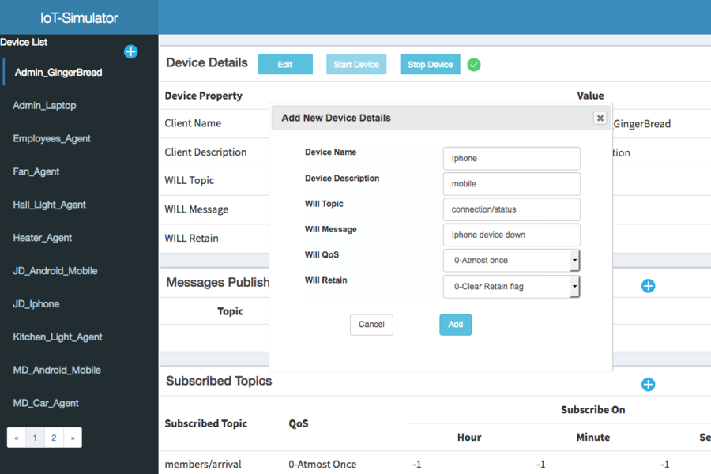
IoT Security Tools
Bevywise IoT Simulator
Bevywise IoT Simulator is an intelligible simulation tool to simulate tens of thousands of MQTT clients in a single box
SeaCat.io
https://teskalabs.com
DigiCert IoT Security Solutions
https://www.digicert.com
FortiNAC
https://www.fortinet.com
Darktrace
https://www.darktrace.com
Cisco IoT Threat Defense
https://www.cisco.com
https://www.bevywise.com
Notes:
Screenshot: https://crozdesk.com/it/testing-software/bevywise-iot-simulator

Slide 21
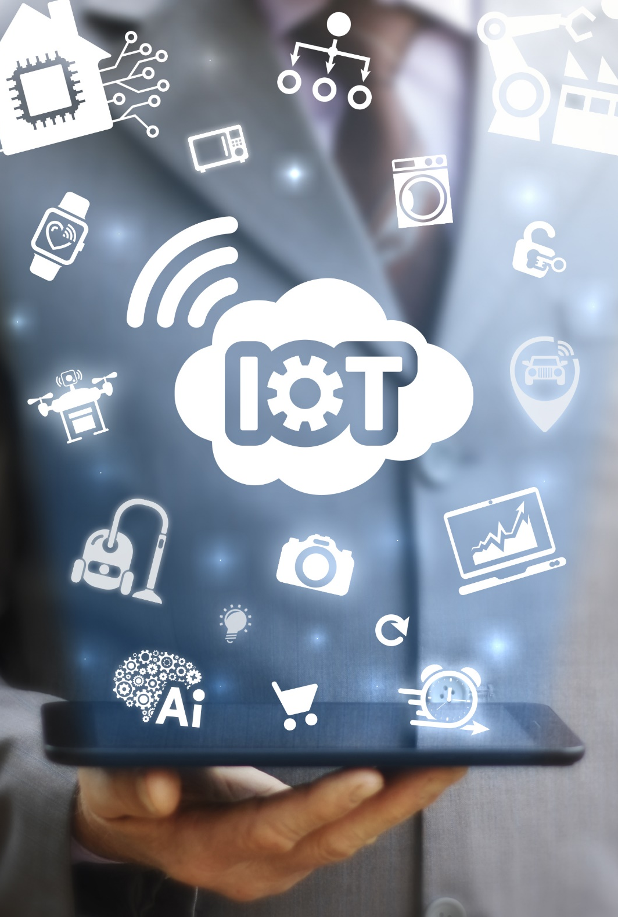
Module Summary
1
This module has discussed the IoT concepts and why organizations opt for IoT-enabled environments
2
It has discussed the IoT application areas and IoT devices
3
It has also discussed the IoT architecture and IoT communication models
4
This module also discussed the security in IoT-enabled environments and stack-wise IoT security principles
5
It has briefly discussed the security considerations of the IoT framework and IoT device management
6
Finally, this module ended with a detailed discussion on the best practices and tools for IoT security
7
In the next module, we will discuss on cryptography and PKI concepts in detail

