Slide 1


Module 10
Cryptography and PKI
Notes:
1087595063

Slide 2

Module Objectives
1
Understanding Cryptographic Techniques
2
Understanding the Different Encryption Algorithms
3
Understanding the Different Hashing Algorithms
4
Overview of Different Cryptography Tools and Hash Calculators
5
Understanding Public Key Infrastructure (PKI)
6
Understanding Digital Signatures and Digital Certificates

Slide 3
Module Flow
Discuss Cryptographic Techniques
01
02
Discuss Various Cryptographic Algorithms
Discuss Public Key Infrastructure (PKI)
04
03
Discuss Various Cryptography Tools

Slide 4




Cryptography
Cryptography is the conversion of data into a scrambled code that is encrypted and sent across a private or public network
Cryptography is used to protect confidential data, such as email messages, chat sessions, web transactions, personal data, corporate data, and e-commerce applications
Objectives of Cryptography
Confidentiality
Authentication
Integrity
Nonrepudiation
Encryption
Decryption
Plaintext
Ciphertext
Ciphertext
Plaintext

Slide 5










Encryption
Encryption is a way of protecting information by transforming it in such a way that the resulting transformed form is unreadable to an unauthorized party
To encrypt data, an encryption algorithm uses a key to perform a transformation on the data
Types of Encryption
Encryption
Symmetric Encryption
Asymmetric Encryption
Symmetric Key (FEK)
File
Encryption
Encrypted File
User’s Public Key
Encrypted File
with FEK in Header
Encryption
Encrypted FEK

Slide 6






Symmetric Encryption
Symmetric encryption is the oldest cryptographic technique used for encrypting digital data in order to ensure data confidentiality
It is called as symmetric encryption since a single key is used for encrypting and decrypting the data
It is used to encrypt large amounts of data
@##^%%$$##%$
Encrypted Message
Both the sender and the receiver share the same key to encrypt and decrypt the data
Decrypted Message
Hello How are you?
Sender
Receiver
(Sender uses a secret key to encrypt a confidential message and sends it to the receiver)
(Receiver decrypts the data using the secret key and reads the confidential message)

Slide 7




Asymmetric Encryption
Unlike symmetric encryption, asymmetric encryption uses two separate keys to carry out encryption and decryption; one key, called the public key, is used for encrypting messages, whereas the second key, called the private key, is used for decrypting messages
It is also called public key encryption and is used to encrypt small amounts of data
Public Key
Receiver selects a public and a private key and sends the public key to the sender
Private Key
Confidential
Message
Confidential
Message
Sender
Receiver
Sender uses the public key to encrypt the message and sends it to the receiver
Receiver decrypts the data using the private key and reads the message

Slide 8

Government Access to Keys (GAK)
GAK means that software companies will give copies of all keys (or at least a sufficient proportion of each key that the remainder could be cracked) to the government
The government promises that they will hold on to the keys in a secure manner and will only use them when a court issues a warrant to do so
To the government, this is similar to the ability to wiretapping phones
Cryptographic Key
…
Item A
Item B
Item C
Item D
Item E
Items to which the GAK has right of access
Items to which the GAK has NO right of access

Slide 9
Module Flow
Discuss Cryptographic Techniques
01
02
Discuss Various Cryptographic Algorithms
Discuss Public Key Infrastructure (PKI)
04
03
Discuss Various Cryptography Tools

Slide 10




Ciphers
Types of ciphers
Ciphers are algorithms used to encrypt or decrypt the data
Modern Ciphers
Classical Ciphers
Based on the type of key used
Substitution cipher
Based on the type of input data
Private Key
    A block of plaintext is replaced with ciphertext
    Same key is used for encryption and decryption
Block Cipher
Transposition cipher
Public Key
      Encrypts blocks of data of fixed size
    The letters of the plaintext are shifted about to form the cryptogram
    Two different keys are used for encryption and decryption
Stream Cipher
      Encrypts continuous streams of data

Slide 11

Data Encryption Standard (DES)
DES is designed to encipher and decipher blocks of data consisting of 64 bits under control of a 56-bit key
DES is the archetypal block cipher — an algorithm that takes a fixed-length string of plaintext bits and transforms it into a ciphertext bit string of the same length
Due to the inherent weakness of DES with today’s technologies, some organizations triple repeat the process (3DES) for added strength until they can afford to update their equipment to AES capabilities

Slide 12




Advanced Encryption Standard (AES)
AES is a symmetric-key algorithm used by the US government agencies to secure sensitive but unclassified material
AES is an iterated block cipher that works by repeating the same operation multiple times
It has a 128-bit block size with key sizes of 128, 192, and 256 bits for AES-128,
AES-192, and AES-256, respectively

Slide 13

RC4, RC5, and RC6 Algorithms
RC5 Algorithm
A variable key size symmetric key stream cipher with byte-oriented operations and is based on the use of a random permutation
RC4
It is a parameterized algorithm with a variable block size, variable key size, and variable number of rounds. The key size is 128 bits
RC5
RC6 is a symmetric key block cipher derived from RC5 with two additional features:
integer multiplication
four 4-bit working registers (RC5 uses two 2-bit registers)
RC6

Slide 14

Digital Signature Algorithm (DSA) and Rivest Shamir Adleman (RSA)
Digital Signature Algorithm (DSA)
Rivest-Shamir-Adleman (RSA)
Federal Information Processing Standard (FIPS) 186-2 specifies the digital signature algorithm (DSA) that can be used in the generation and verification of digital signatures for sensitive, unclassified applications
RSA is an Internet encryption and authentication system that uses an algorithm developed by Ron Rivest, Adi Shamir, and Leonard Adleman
It is commonly used and is one of the de-facto encryption standards

Slide 15



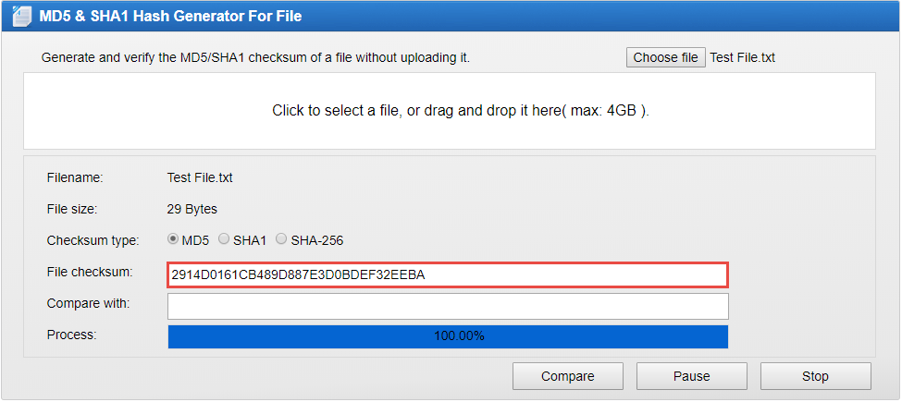










MD5 and MD6
The MD5 algorithm takes a message of arbitrary length as the input and then outputs a 128-bit fingerprint or message digest of the input
MD5 is not collision resistant; use of the latest algorithms, such as MD6, SHA-2 and SHA-3, is recommended
MD6 uses a Merkle tree-like structure to allow for immense parallel computation of hashes for very long inputs. It is resistant to differential cryptanalysis attacks
MD5 and MD6 are deployed for digital signature applications, file integrity checking, and storing passwords
  MD5 & SHA1 Hash Generator and Verifier
Sender
Receiver
MD5 Algorithm
http://onlinemd5.com

Slide 16
Secure Hashing Algorithm (SHA)
This algorithm generates a cryptographically secure one-way hash; it was published by the National Institute of Standards and Technology as a US Federal Information Processing Standard
SHA-1
    It produces a 160-bit digest from a message with a maximum length of (264 − 1) bits, and it resembles the MD5 algorithm
SHA
SHA-2
    It is a family of two similar hash functions with different block sizes, namely, SHA-256, which uses 32-bit words, and SHA-512, which uses 64-bit words
SHA-3
SHA-3 uses the sponge construction, in which message blocks are XORed into the initial bits of the state, which is then invertibly permuted

Slide 17

HMAC
The hash-based message authentication code (HMAC) is a type of message authentication code (MAC) that makes use of a cryptographic key in combination with a cryptographic hash function
This algorithm includes an embedded hash function such as SHA-1 or MD5
The strength of HMAC depends on the embedded hash function, key size, and the size of the hash output
As the HMAC executes the underlying hash function twice, it protects the data from various length extension attacks

Slide 18
Module Flow
Discuss Cryptographic Techniques
01
02
Discuss Various Cryptographic Algorithms
Discuss Public Key Infrastructure (PKI)
04
03
Discuss Various Cryptography Tools

Slide 19
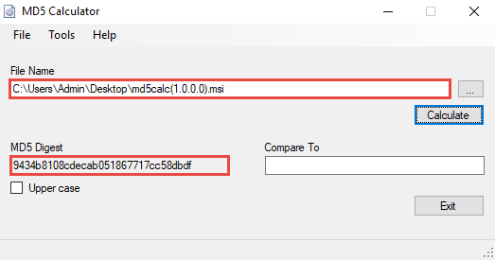
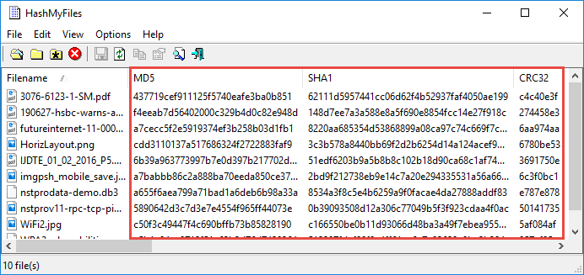
MD5 and MD6 Hash Calculators
MD5 Calculator
MD6 Hash Generator
https://www.browserling.com
All Hash Generator
https://www.browserling.com
MD6 Hash Generator
https://convert-tool.com
https://www.bullzip.com
md5 hash generator
https://onlinehashtools.com
HashMyFiles
HashCalc
https://www.slavasoft.com
https://www.nirsoft.net

Slide 20
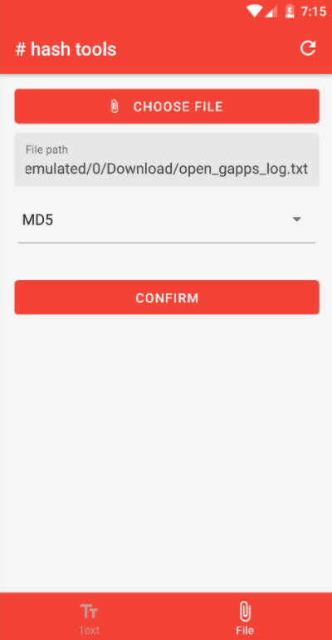
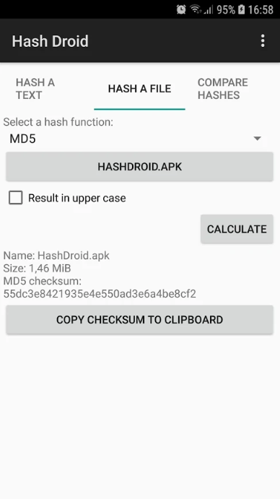
Hash Calculators for Mobile
Hash Tools
Hash Droid
Hash Checker
https://play.google.com
Hashr - Hash & Checksum Calculator
https://play.google.com
Hash Calc
https://play.google.com
Hash Generator - Checksum Calculator
https://play.google.com
Hash Smart Checker
https://play.google.com
https://play.google.com
https://play.google.com

Slide 21
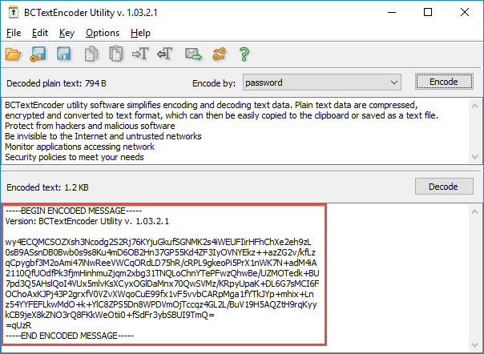
Cryptography Tools
BCTextEncoder
AxCrypt
https://axcrypt.net
Encrypts confidential text in your message
Uses strong symmetric and public-key algorithms for data encryption
Microsoft Cryptography Tools
https://docs.microsoft.com
Concealer
https://www.belightsoft.com
CryptoForge
https://www.cryptoforge.com
Cyphertop
https://cyphertop.com
https://www.jetico.com

Slide 22
Module Flow
Discuss Cryptographic Techniques
01
02
Discuss Various Cryptographic Algorithms
Discuss Public Key Infrastructure (PKI)
04
Discuss Various Cryptography Tools
03

Slide 23




Digital Signature
Digital signatures use the asymmetric key algorithms to provide data integrity
A specific signature function is added to the asymmetric algorithm at the sender's side to digitally sign the message and a specific verification function is added to verify the signature to ensure message integrity at the recipient side
The asymmetric algorithms that support these two functions are called digital signature algorithms
Digitally signing messages slows the performance of during verification; the hash value of the message is used instead of the message itself for better performance
A digital signature is created using the hash code of the message, the private key of the sender, and the signature function
It is then verified using the hash code of the message, the public key of sender, and the verification function
Sender uses the private key to "sign" the message and sends the message and signature to a receiver
Private Key
Confidential
Message
Sender
10010010
Hash Code
1001
0010
Sender selects a public and private key and sends the public key to the receiver
Public Key
Confidential
Message
Receiver verifies the signature using the public key and then reads the message
Receiver
10010010
Hash Code

Slide 24





Digital Signature (Cont’d)
Creating a digital signature at the sender side
Private Key
Message Containing the
Digital Signature
Confidential
Message
Confidential Message
Hashing
Algorithm
Hash Code
Signature Function
10010010
Hash Code
Verifying a digital signature at the recipient side
Message Containing the
Digital Signature
Public Key
Confidential
Message
10010010
Hashing
Algorithm
Hash Code
Verification
Function
Confidential
Message
Hash Code

Slide 25





The digital certificates are used for dealing with the security concerns regarding transmission of public keys securely to the receiver in the digital signature
A trusted intermediary solution is used for securing the public keys, where the public key is bound with the name of its owner
Owners of the public key need to acquire their public keys certified from the intermediary; the intermediary then issues certificates called digital certificates to the owners, which they can use to send the public key to a number of users
Digital Certificates
Private Key
Signature Function
Verification Function
Sender
Receiver
Sender signs a message digitally using his private key and sends it to a receiver along with a digital certificate
Receiver extracts the public key from the digital certificate and verifies the digitally signed message from the sender using the extracted public key
Public key
Digital Certificate
Digital Certificate

Slide 26
Digital Certificates (Cont’d)
Digital Certificate Attributes
Serial number: Represents the unique certificate identity
Issuer: Provides the identity of the intermediary who issued the certificate
Subject: Represents the owner of the certificate which may be a person or an organization
Valid from: Denotes the date from which the certificate is valid
Signature algorithm: States the name of the algorithm used for creating the signature
Valid to: Denotes the date till which the certificate is valid
Key-usage: Specifies the purpose of the public key, whether it should be used for encryption, signature verification, or both
Thumbprint algorithm: Specifies the hashing algorithm used for digital signatures
Thumbprint: Specifies the hash value for the certificate, which is used for verifying the certificate’s integrity
Public key: Used for encrypting a message or verifying the signature of the owner

Slide 27

Public Key Infrastructure (PKI)
A public key infrastructure (PKI) is a set of hardware, software, people, policies, and procedures required for creating, managing, distributing, using, storing, and revoking digital certificates
Components of a PKI
  A certificate authority (CA) that issues and verifies digital certificates
  A certificate management system for generation, distribution, storage, and verification of certificates
  A registration authority (RA) that acts as the verifier for the CA
  One or more directories where the certificates (along with their public keys) are stored

Slide 28


















Public Key Infrastructure (PKI) (Cont’d)
Certification Authority (CA)
Updates Information
Request for issuing certificate
Validation Authority (VA)
Verification of Applicant
Public Key
Certificate
Public Key
Certificate
Determined Result
Registration Authority (RA)
User applies for issuing certificate
Message with digital signature and copy of public key certificate
User
Public Key
Validation of electronic signature
Enquires about public key certificate validity to validation authority
Private Key

Slide 29
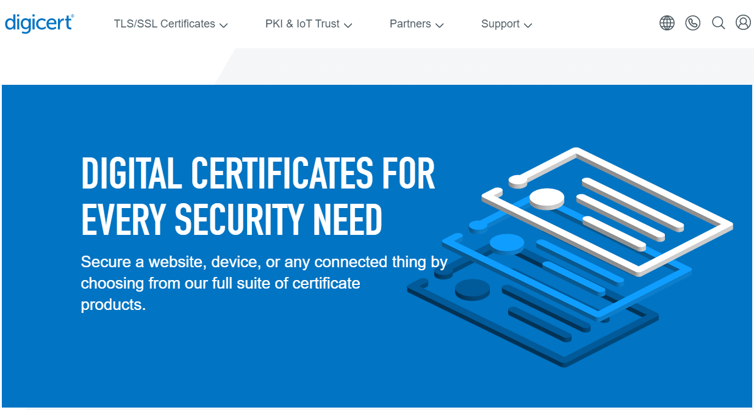
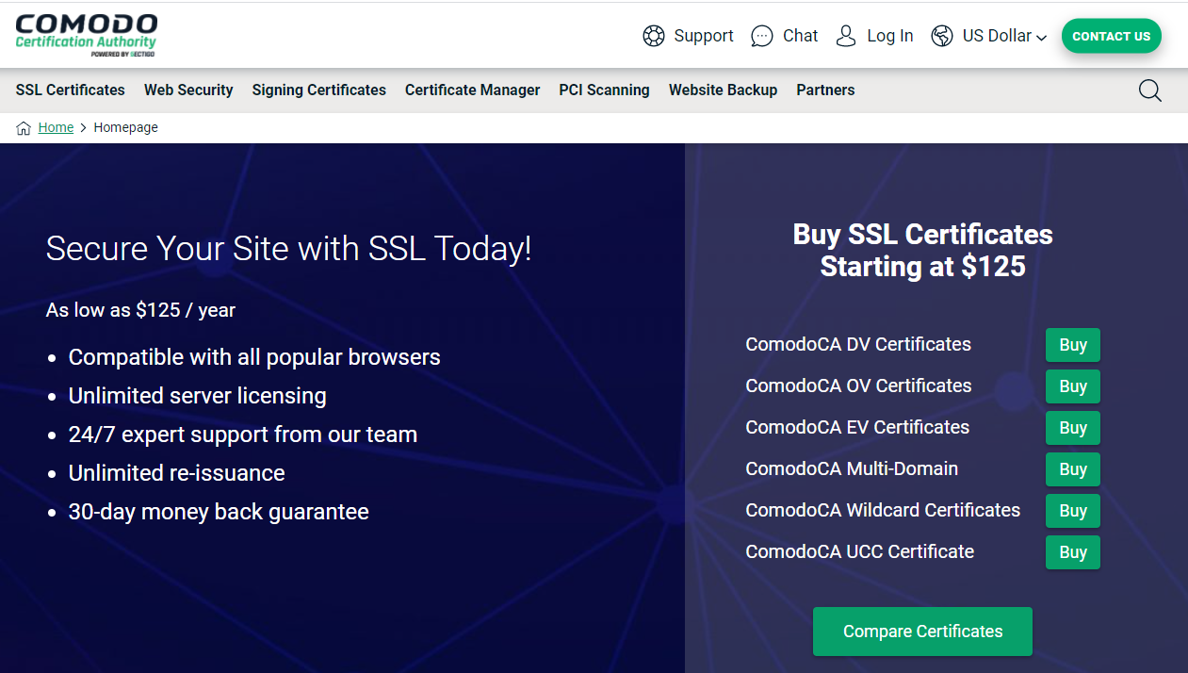

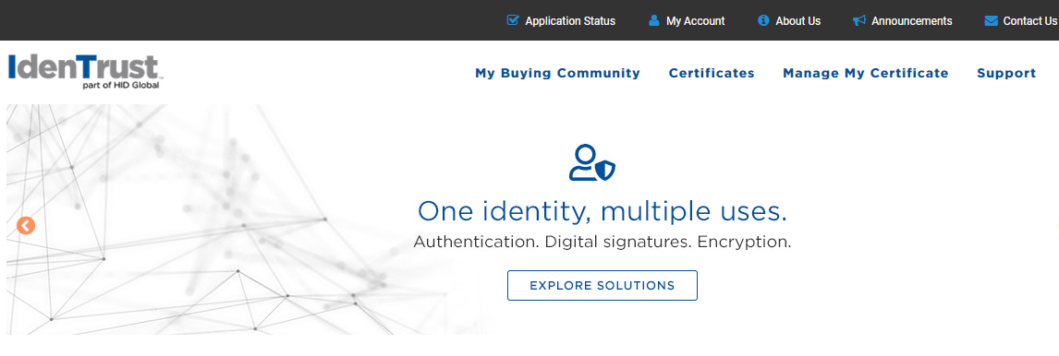
Certification Authorities
https://www.digicert.com
https://www.comodoca.com
https://www.godaddy.com
https://www.identrust.com
Notes:
Need to change GoDaddy screenshot

Slide 30
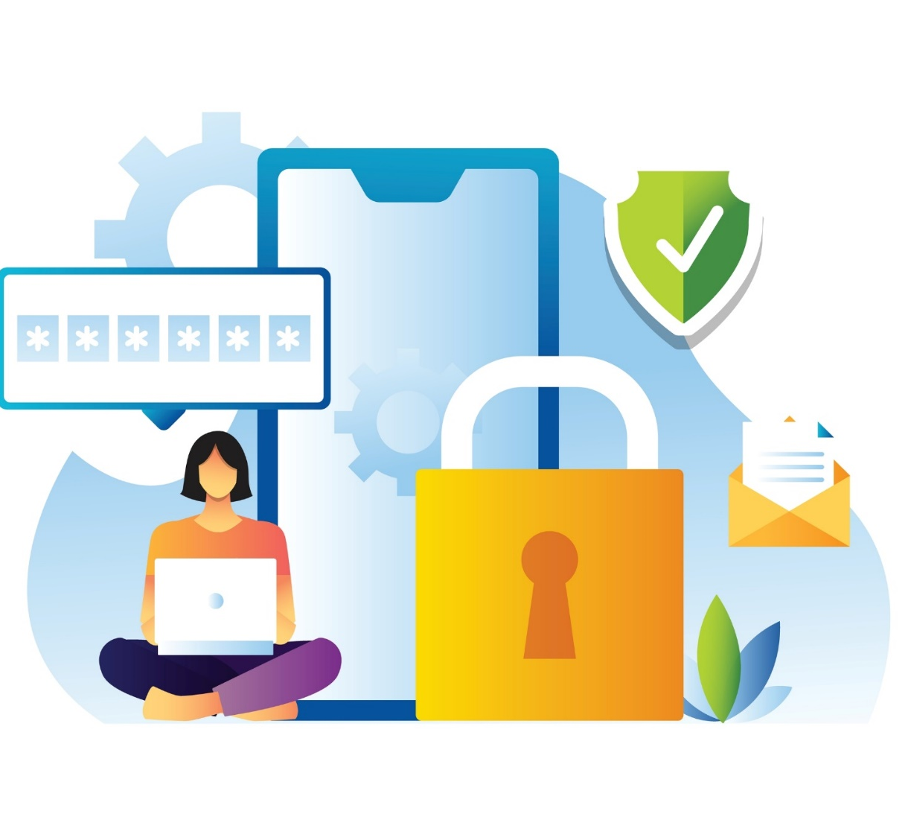
Module Summary
This module has discussed cryptographic techniques, different encryption algorithms, and hashing algorithms
It has discussed different cryptography tools and hash calculators
It has also discussed the public key infrastructure (PKI) concepts
Finally, this module ended with an overview of digital signatures and digital certificates
In the next module, we will discuss on data security in detail

