Slide 1


Module 11
Data Security
Notes:
423574282

Slide 2

Module Objectives
Creative idea
1
Understanding Data Security and its Importance
2
Understanding the Different Data Security Technologies
3
Understanding the Various Security Controls for Data Encryption
4
Overview of Disk Encryption, File Encryption, and Removable-media Encryption Tools
5
Understanding the Methods and Tools for Data Backup and Retention
6
Understanding the Data Loss Prevention (DLP) and DLP Solutions

Slide 3
Module Flow
04
03
Discuss Data Loss Prevention Concepts
02
Discuss Data Backup and Retention
01
Discuss Various Security Controls for Data Encryption
Understand Data Security and its Importance

Slide 4

What is Business Critical Data?
Data is the heart of any organization
Critical data contains information that is important for business operation
Identification and classification of business-critical data is the first step in securing an organization’s data
Examples of Critical Data
1
Important office documents, spreadsheets, etc.
4
Accounting files
2
Software downloaded (purchased) from the Internet
5
Databases or any business-related data
3
The operating system files purchased with a computer, CDs, software, etc.
Contact Information (email address book)
6

Slide 5






Need for Data Security
Data is an organization’s ultimate asset, which attackers may interested in
If an organization’s data is exposed or lost by any means, it can severely damage business and reputation
Data Loss Risks in Business Environment
Cause
Effect
Loss/theft of laptops and mobile devices
R&D
Customer Service
Brand damage and reputation loss
Corporate
Data
Customer
Data
Competitive advantage loss
Unauthorized data transfer to USB devices
Loss of customers
Sales
Contractor
Improper sensitive data categorization
Business Data
Market share loss
Data theft by employees/external parties
Shareholder value erosion
Personally
Identifiable Data
Transaction
Data
Fines and civil penalties
HR, Legal
Finance
Notes:
Old template image

Slide 6






Data Security
Data security involves the application of various data security controls to prevent any intentional or unintentional act of data misuse, data destruction, and data modification
Three Critical States of Data Security
Data in Use
Workstations
Laptops
1
Data at Rest
Data in Rest
Data in Transit
2
Data in Use
Databases/Repositories
3
Data in Transit
Firewall
Workstations
Data in Rest
Internet

Slide 7


Example: “Data at Rest” vs “Data in Use” vs “Data in Transit”
Proper implementation of data security measures are required in each state to proactively enhance data security
 | Data at Rest | Data in Use | Data in Transit
Description | Inactive data stored in digitally at a physical location | Data stored in memory | Data traversing using some means of communication
Examples | Customer bank balance stored in database | Data stored in RAM | An email being sent
Security Controls | Data encryption Password protection Tokenization Data federation | Authentication techniques Tight control on this data’s accessibility Full memory encryption Strong identity management | SSL and TLS Email encryption tools such as PGP or S/MIME Firewall controls

Slide 8

Data Security Technologies
Data Access Control
Authenticates and authorizes users to access data
Protecting information by transforming it in such a way that it cannot be read by an unauthorized party
Data Encryption
Protecting information by obscuring specific areas of data with random characters or codes
Data Masking
Making a duplicate copy of critical data that can be used for restore and recovery purposes when a primary copy is lost or corrupted either accidentally or on purpose
Data Resilience and Backup
Destroying data, so that it cannot be recovered and used for wrong motives
Data Destruction
Data Retention
Storing data securely for compliance or business requirements

Slide 9
Module Flow
04
03
Discuss Data Loss Prevention Concepts
02
Discuss Data Backup and Retention
01
Discuss Various Security Controls for Data Encryption
Understand Data Security and its Importance

Slide 10

Data Encryption Techniques
Disk Encryption
File-level Encryption
Removable Media Encryption
Full disk encryption is the encryption of all data in a disk except the master boot record (MBR)
In this type of encryption, the encryption occurs at a filesystem level, and in combination with a cryptographic algorithm, the encrypted data will be extremely secure
Removable media encryption prevents removable media devices such USB flash drives, portable hard disks, digital cameras, smartphones, tablets, etc. from unauthorized access

Slide 11
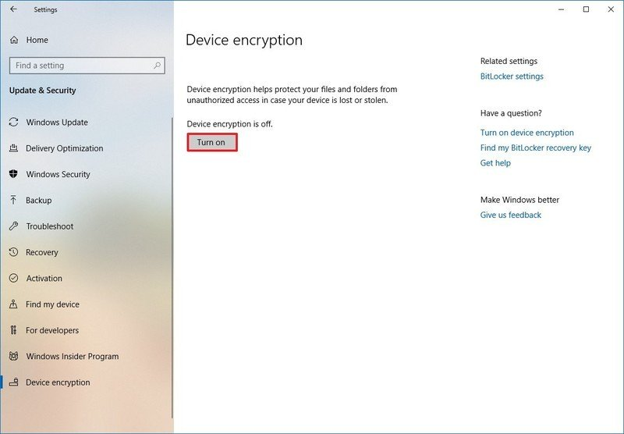
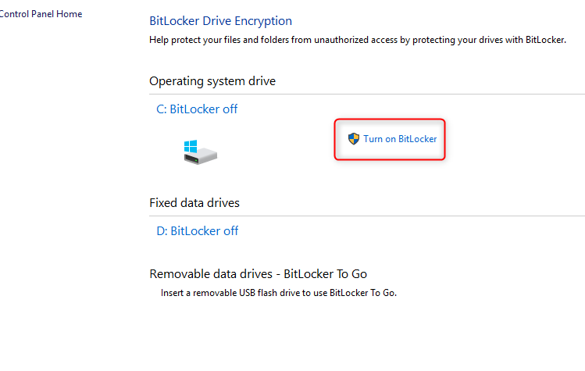
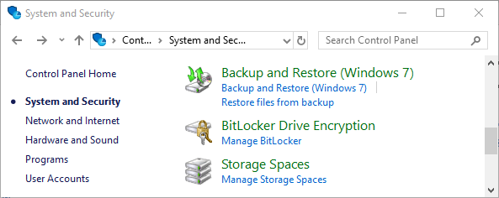
Disk Encryption: Implementing Built-in Disk Encryption for Windows
Enabling Device Encryption
2. Enabling Standard BitLocker Encryption
Go to Start → Settings → Update & Security → Device Encryption
Turn on Device encryption option
  Sign in with an Administrator Account. Select the Start button, Choose Control Panel, and then click System and Security
  Under BitLocker Drive Encryption, choose Manage BitLocker
  Select Turn on BitLocker

Slide 12
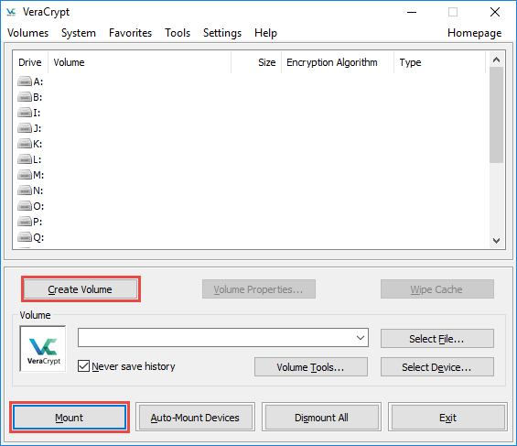
Disk Encryption Tools
VeraCrypt is a software for establishing and maintaining an on-the-fly-encrypted volume (data storage device)
On-the-fly encryption means that data is automatically encrypted immediately before it is saved and decrypted immediately after it is loaded, without any user intervention
VeraCrypt
BitLocker Drive Encryption
https://docs.microsoft.com
FinalCrypt
https://www.finalcrypt.org
Seqrite Encryption Manager
https://www.seqrite.com
FileVault
https://support.apple.com
Gilisoft Full Disk Encryption
http://www.gilisoft.com
https://www.veracrypt.fr

Slide 13
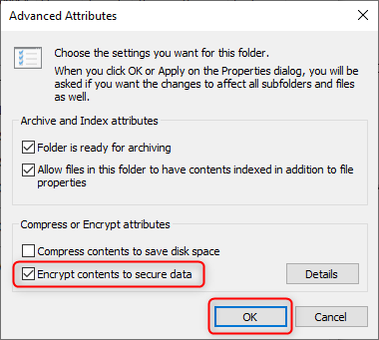

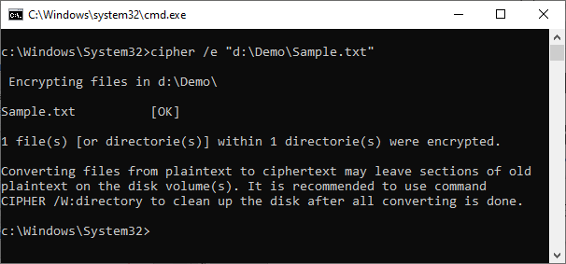
File Level Encryption: Implementing Built-in File System-level Encryption on Windows
The Encrypting File System (EFS) provides file system-level encryption in Windows

Slide 14
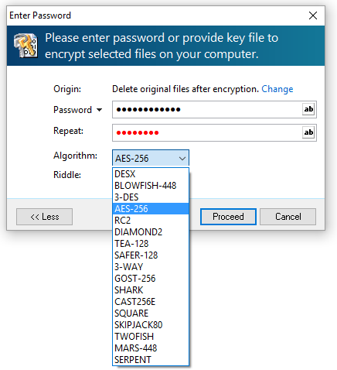
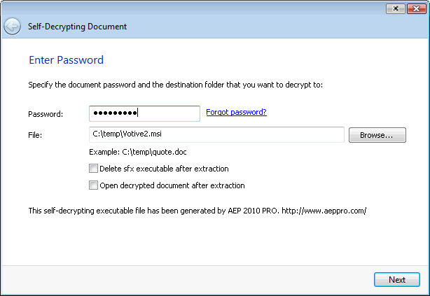
File Encryption Tools
Advanced Encryption Package
is a file encryption software for Windows 10, 8, and 7. It uses strong and proven algorithms to protect sensitive documents
AxCrypt
https://www.axcrypt.net
idoo File Encryption
https://www.idooencryption.com
Cryptomator
https://cryptomator.org
Encrypto
https://macpaw.com
AES Crypt
https://www.aescrypt.com
http://www.aeppro.com
Notes:
Need to change screenshots

Slide 15
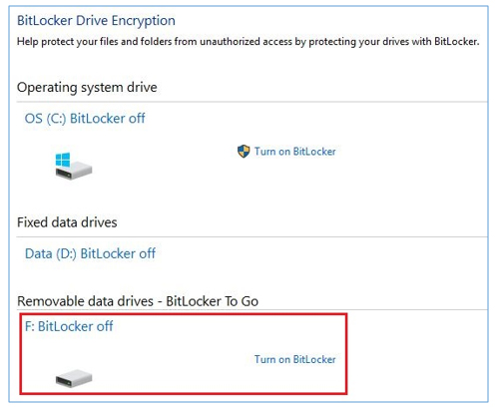
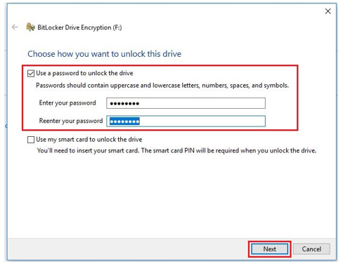
Removable Media Encryption: Implementing Removable Media Encryption in Windows
Plug the removable media device into a USB port on your computer
Go to Start → Control Panel → System and Security → BitLocker Drive Encryption (Manage BitLocker)

Slide 16
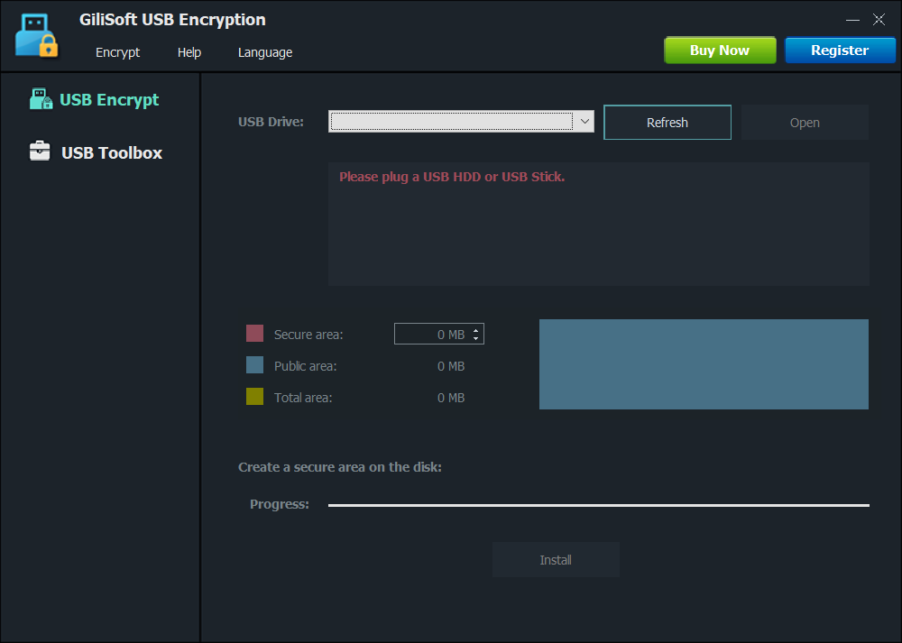
Removable Media Encryption Tools
A solution for USB security that supports encrypting portable storage device (external drive) and can divide external drive into two parts after encryption: the secure area and public area
GiliSoft USB Encryption
idoo USB Encryption
https://www.idooencryption.com
Kakasoft USB Security
https://www.kakasoft.com
Rohos Mini Drive
https://www.rohos.com
McAfee File & Removable Media Protection
https://www.mcafee.com
MFG’s Removable Media Encryption
https://www.managedencryption.co.uk
http://www.gilisoft.com

Slide 17
Module Flow
04
03
Discuss Data Loss Prevention Concepts
02
Discuss Data Backup and Retention
01
Discuss Various Security Controls for Data Encryption
Understand Data Security and its Importance

Slide 18

Introduction to Data Backup
Data backup is the process of making a duplicate copy of critical data, such as physical (paper) and computer records
It is mainly used for two purposes: to reinstate a system to its normal working state after damage, or to recover data and information following data loss or corruption
A successful data backup strategy is necessary to avoid severe damage to an organization’s assets

Slide 19
Data Backup Strategy/Plan
1
2
3
4
Identifying the critical business data
Selecting the backup media
Selecting a backup technology
Selecting the appropriate RAID levels
5
6
7
8
Selecting an appropriate backup method
Selecting the backup types
Choosing the right backup solution
Conducting a recovery drill test

Slide 20

Selecting the Backup Media
Data backups consume a large amount of storage space. Therefore, select the best backup method to meet the organization’s requirements
Availability
Reliability
Choose
your backup media based on these factors
Cost
Usability
Speed

Slide 21

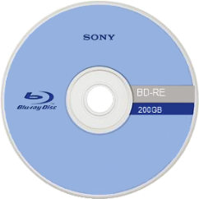
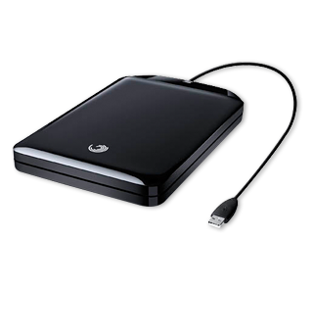

Examples of Data Backup Media Devices
Media | Capacity | Advantages | Disadvantages | Illustrations
Optical disks (CD, DVD, Blu-ray) | ~200 GB | Affordable, easy to store and transport | Several manual disk swaps may be required because of the limited data capacity Recording and verifying a backup is slow
Portable hard drives/USB flash drives | No limit | Relatively higher storage capacity than optical disks Ideal for the home or small offices Faster recording of backups | More expensive than DVD backups Less recommended for small backups
Tape drives | No limit | Media for enterprise-level backups Easy to store and transport | Expensive

Slide 22

Redundant Array Of Independent Disks (RAID) Technology
01
A method of combining multiple hard drives into a single unit and writing data across several disk drives, offering fault tolerance (if one drive fails, the system can continue operating)
02
Placing data on RAID disks enables a balanced overlap of input/output (I/O) operations, improving system performance, simplifying storage management, and protecting against data loss
03
RAID represents a portion of computer storage that can divide and replicate data among several drives by working as secondary storage
04
RAID has six levels: RAID 0, RAID 1, RAID 3, RAID 5, RAID 10, and RAID 50, to function effectively. All RAID levels depend on the following storage techniques:
        Striping
        Parity
        Mirroring

Slide 23
Advantages/Disadvantages of RAID Systems
Advantages
Disadvantages
RAID offers hot-swapping or hot plugging, that is, system component replacement (in case a drive fails) without affecting network functionality
RAID supports disk striping, resulting in an improved read/write performance as the system completely utilizes the processor speed
Increased RAID parity check prevents a system crash or data loss
RAID is not compatible with some hardware components and software systems, for example, system imaging programs
RAID data is lost if important drives fail one after another, for example, RAID 5, where a drive used exclusively for parity cannot recreate the first drive if a second drive fails too
RAID cannot protect the data and offer a performance boost for all applications

Slide 24
RAID Storage Architecture
Network Connection to Host
Configuration Data
RAID Controller Firmware
RAID Journal, Transaction, and Error Log File
SDRAM
DIMM
SAN/NAS/Host Interface
Multiport Memory Controller
Backup Control Processor
Processor
RAID Control Processor
SAS/SATA Interfaces
NAND
FLASH
SAS/SATA HDD or SSD
SAS/SATA HDD or SSD
SAS/SATA HDD or SSD
SAS/SATA HDD or SSD
Battery Backup or Ultracapacitor Unit
SATA/SAS Expander
Primary RAID Memory Cache
SAS/SATA HDD or SSD
SAS/SATA HDD or SSD
SAS/SATA HDD or SSD
SAS/SATA HDD or SSD

Slide 25
RAID Storage Architecture (Cont’d)
1
RAID Controller
Manages an array of physical disk drives and presents them to the computer as logical units
2
IDE, SATA, or SCSI Interface
Internal drives are connected using these interfaces; Connection to the server is also through one of these interfaces
Storage
3
Multiport Memory Controller
Provides access to a memory bank, and helps achieve a high efficiency with random address accesses
4
SDRAM
Dynamic random access memory (DRAM) that is synchronized with the CPU clock speed

Slide 26

RAID Storage Architecture (Cont’d)
Primary RAID Memory Cache
nvSRAM
NAND Flash Memory
Disk
Cache is used to write the data in transition. A RAID system uses a cache to speed up I/O performance on the storage system
nvSRAM is the fastest nonvolatile RAM in the industry with 20 ns read and write access time
Provides a nonvolatile storage for the RAID system's primary cache
The hardware presents the RAID to the host system as a single and large disk

Slide 27


RAID Level 0: Disk Striping
RAID Level 0 splits data into blocks that are written evenly across multiple hard drives
It improves I/O performance by spreading the I/O load across several channels and disk drives
Data recovery is not possible if a drive fails
It requires a minimum of two drives
It does not provide data redundancy
RAID 0
A
B
C
D
E
F
G
H
Disk 0
Disk 1

Slide 28

RAID Level 1: Disk Mirroring
Multiple copies of data are written to multiple drives at the same time
It provides data redundancy by duplicating the drive data in multiple drives
If one drive fails, data recovery is possible
It requires a minimum of two drives
RAID 1
A
A
B
B
C
C
D
D
Disk 0
Disk 1

Slide 29


RAID Level 3: Disk Striping with Parity
01
Data is striped at the byte level across multiple drives. One drive per set is taken up for parity information
02
If a drive fails, data recovery and error correction is possible using the parity drive in the set
03
The parity drive stores the information on multiple drives
Parity Generation
AP
A0
A1
A2
A3
BP
B0
B1
B2
B3
Cp
C0
C1
C2
C3
Dp
D0
D1
D2
D3
Disk 0
Disk 1
Disk 2
Disk 3
Disk 4

Slide 30

RAID Level 5: Block Interleaved Distributed Parity
The data is striped at the byte level across multiple drives, and the parity information is distributed among all the member drives
1
2
The data writing process is slow
3
This level requires a minimum of three drives to be set up
RAID 5
A1
A2
A_{P}
B1
B_{P}
B2
C_{P}
C1
C2
D1
D2
D_{P}
Disk 0
Disk 1
Disk 2

Slide 31
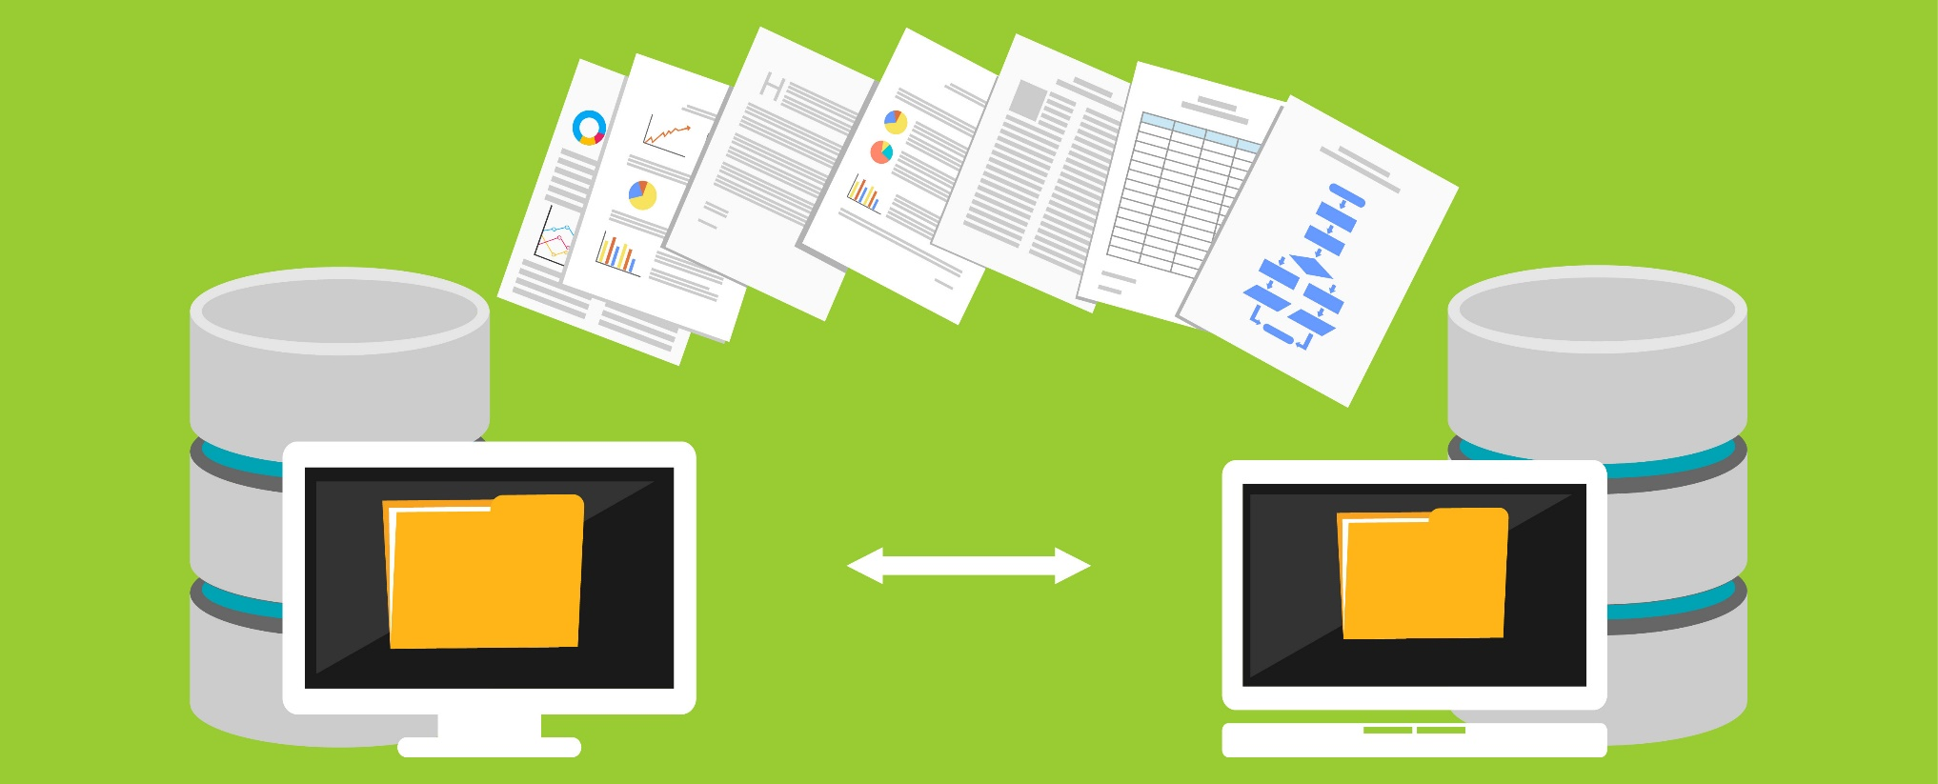
RAID Level 10: Blocks Striped and Mirrored
RAID 10 is a combination of RAID 0 (striping volume data) and RAID 1 (disk mirroring), and its implementation requires at least four drives
RAID 1+0
01
RAID 0
RAID 1
RAID 1
02
It has the same fault tolerance as RAID level 1, and the same mirroring overhead as Raid 0
A1
A1
A2
A2
A3
A3
A4
A4
A5
A5
A6
A6
It stripes the data across mirrored pairs. The mirroring provides redundancy and improves performance. The data striping provides maximum performance
03
A7
A7
A8
A8
Disk 0
Disk 1
Disk 2
Disk 3

Slide 32

RAID Level 50: Mirroring and Striping across Multiple RAID Levels
RAID 50 is a combination of RAID 0 striping and the distributed parity of RAID 5
It is more fault tolerant than a RAID 5 but uses twice the parity overhead
A minimum of six drives are required for setup. A drive from each segment can fail and the array will recover. If more than one drive fails in a segment, the array will stop functioning.
This RAID level offers better reads and writes than a RAID 5 and the highest levels of redundancy and performance
RAID 5+0
RAID 0
RAID 5
RAID 5
A1
A2
A_{P}
A3
A4
Ap
B1
B_{P}
B2
B3
B_{P}
B4
C_{P}
C1
C2
C_{P}
C3
C4
D1
D2
D_{P}
D3
D4
D_{P}
Disk 0
Disk 1
Disk 2
Disk 3
Disk 4
Disk 5

Slide 33











Storage Area Network (SAN)
A SAN is a specialized, dedicated, and discrete high-speed network that connects storage devices (disks, disk arrays, tapes, servers, etc.) with a high speed I/O interconnect (Fiber Channel, SAS, Ethernet, etc.)
Clients
Clients
LAN
Communication Infrastructure Layer
SANs are preferred in large enterprises because of reliable data transfer and flexible scalability
A SAN supports data archival, backup, restore, transfer, retrieval, migration, and mirroring from one storage device to another
Application Servers
NAS Filter
Database Servers
The communication infrastructure layer provides the physical connections to the network devices
Fiber Channel
Fiber Channel
SAN Switches
Fiber Channel
Management Layer
The management layer organizes the connections, storage elements, and computer systems
Storage Layer
The storage layer hosts the storage devices
Disk Systems
RAID
Tape Drive

Slide 34

Advantages of SAN
Storage consolidation
LAN-free and server-free data movement
Ease of data sharing
LAN-free and server-free backup
Improved backup and recovery
Highly available server clustering
Reliable and secure centralized data storage
Data integrity and a decreased load on the LAN
High performance and low latency
Disaster tolerance

Slide 35
Network Attached Storage (NAS)
NAS is a file-based data storage service and a dedicated computer appliance shared over the network
NAS is a high-performance file server optimized for storing, retrieving, and serving files
NAS servers contain proprietary or open-source operating systems optimized for file serving
Advantages
Disadvantages
Users with different operating systems can share files with no compatibility issues
A NAS can be connected to a LAN using the plug and play feature
Minimal administration required, unlike Unix or NT file servers
Applications that use most of the data transfer bandwidth will significantly reduce network performance
Data transfer is inefficient as it uses TCP/IP instead of a specialized data transfer protocol

Slide 36

Selecting an Appropriate Backup Method
Select a backup method based on its cost and ability according the organization’s requirements
Hot Backup (Online)
Cold Backup (Offline)
Warm Backup (Nearline)
Backup the data when the application, database, or system is running and available to users
Used when a service level down time is not allowed
Backup the data when the application, database, or system is not running (shutdown) and is not available to users
Used when a service level down time is allowed and a full backup is required
A combination of both hot and cold backups
Advantages:
Less expensive than a hot backup
Switching over the data backup takes less time than a cold backup but more time than a hot backup
Advantage:
Advantage:
Immediate data backup switch over is possible
Least expensive
Disadvantage:
Disadvantage:
Disadvantage:
Very expensive
Switching over the data backup requires additional time
It is less accessible than hot backup

Slide 37

Choosing the Backup Location
Onsite Data Backup
Offsite Data Backup
Cloud Data Backup
Storing backup data at onsite data storage only
Storing backup data in remote locations in fire-proof, indestructible safes
Storing backup data on storage provided by an online backup provider
Advantage:
Advantage:
Advantages:
Onsite backup data can be easily accessed and restored
Less expensive
Data is secured from physical security threats such as fire, floods, etc.
The data is encrypted and free from physical security threats
Data can be accessed from anywhere
Disadvantage:
Disadvantage:
Disadvantages:
Data loss risk is greater
Problems with a regular data backup schedule
No direct control of the backup data
More time to backup

Slide 38
Types of Backup
Full/Normal Data Backup
All system data is copied to the backup media
Differential Data Backup
All data that has been changed since the last full backup is copied to the backup media
Incremental Data Backup
Only files that have been changed or created after the last backup are copied to the backup media
Full Backup
Full Backup
Incremental 3
Backup
Differential 3
300MB
Differential 2
Incremental 2
Differential 1
Incremental 1
100MB
10GB
100MB
200MB
500MB
10GB
100MB
Sunday
Monday
Tuesday
Wednesday
Sunday
Monday
Tuesday
Wednesday

Slide 39
Backup Types: Advantages and Disadvantages
Type | Advantages | Disadvantages
Full Backup | Restoration is fast | Backup process is slow High storage requirements
Differential Backup | Faster than a full backup Restoration faster than an incremental backup Reduced amount of storage than a full backup | Restoring data is slower than a full backup Slower than an incremental backup
Incremental Backup | Fastest method Least amount of storage space among other backup types | Slowest restore speed among other backup types

Slide 40
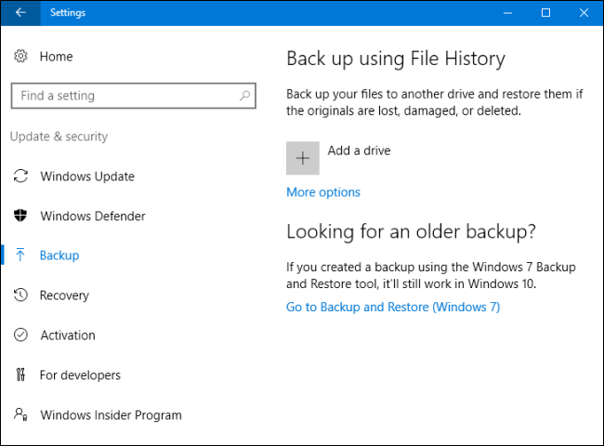
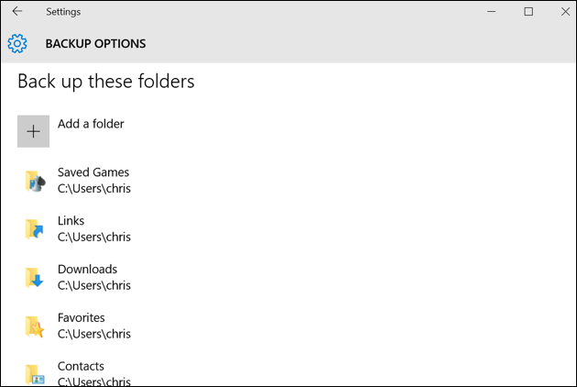
Data Backup Tools
File History is a built-In backup tool in Windows
It regularly backs up important folders like Desktop, Documents, Downloads, Music, Picture, Videos, and parts of AppData folder
File History Tool
Genie Backup Manager Pro
https://www.zoolz.com
BullGuard Backup
https://www.bullguard.com
NTI Backup Now EZ
https://www.nticorp.com
Power2Go 13
https://www.cyberlink.com
Backup4all
https://www.backup4all.com

Slide 41

Data Backup Retention
Data Retention
    Data Retention is the process of storing and maintaining important information for meeting compliance and business data archival requirements
    Data retention policy is a set of rules for preserving and maintaining data for operational or regulatory compliance requirements
    The policy defines the required retention periods for different data types, and sets the minimum standards for destroying certain information
Data Retention Policy
  Steps for Developing a Data Retention Policy
  Build a data retention policy development team
  Understand and determine the applicable legal requirements of the organization
  Identify and classify the data to be included in data retention policy
  Develop the data retention policy
  Ensure that all employees understand the organization’s data retention policy

Slide 42
Data Retention Policy Best Practices
Create a data retention policy that fulfils legal and business requirements
Create different data retention policies for different data types, as per their legal and business impacts
01
05
Justify the reasons behind the policy details
Retain customer, subscriber, and user information only till they are necessary
02
06
Start creating a policy with minimal requirements and add new requirements as and when required
Implement software to manage the data retention tasks
03
07
Create a simple policy which is easy for the employees to implement
04
08
Classify data and decide if it should be archived or deleted

Slide 43
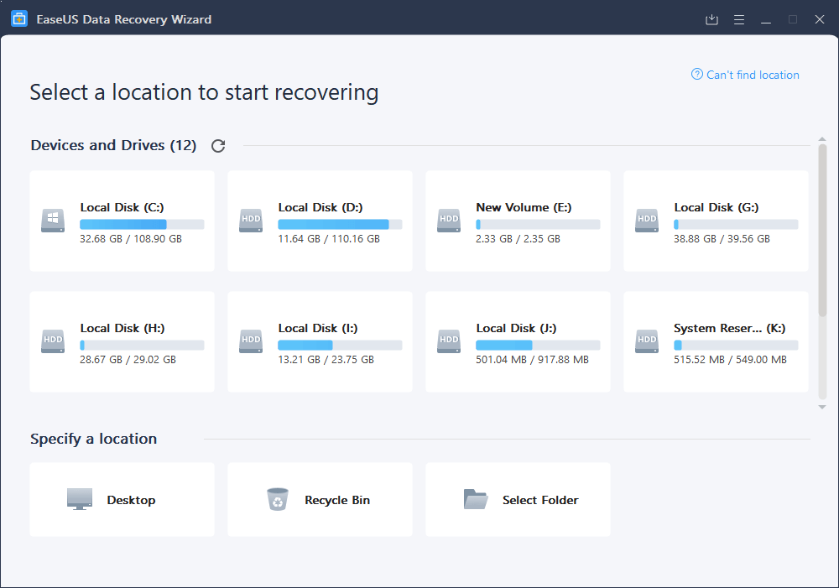
Data Recovery Tools
EaseUS Data Recovery Wizard
EaseUS data recovery software can quickly retrieve lost files after deletion or emptying the recycle bin
Recuva®
https://www.ccleaner.com
Puran File Recovery
http://www.puransoftware.com
Glary Undelete
https://www.glarysoft.com
SoftPerfect File Recovery
https://www.softperfect.com
Wise Data Recovery
https://www.wisecleaner.com
https://www.easeus.com

Slide 44
Module Flow
04
03
Discuss Data Loss Prevention Concepts
02
Discuss Data Backup and Retention
01
Discuss Various Security Controls for Data Encryption
Understand Data Security and its Importance

Slide 45


What is Data Loss Prevention?
Data loss prevention (DLP) includes a set of software products and processes that do not allow users to send confidential corporate data outside the organization
It is used by organizations to:
Discover sources of data leaks
Monitor the sources of data leakage
Protect organization assets and resources
Prevent accidental disclosure of sensitive information to unintended parties
Manage resources with business rules, security policies, and software

Slide 46
Types of Data Loss Prevention (DLP) Solutions
Endpoint DLP
A solution that monitors and protects PC-based systems such as tablets, laptops, etc.
It is used for preventing data leakage through clipboards, removable devices, and sharing applications
Network DLP
A solution that monitors, protects, and reports all data in transit
It is installed at the “perimeter” of an organization’s network
It helps the security professionals in scanning all data moving through the ports and protocols within the organization
Storage DLP
A solution that monitors and protects data at rest, that is, the data stored in an organization’s data center infrastructure such as file servers, SharePoint, and databases
It identifies the location where sensitive information is stored and helps users in determining whether it is stored securely

Slide 47
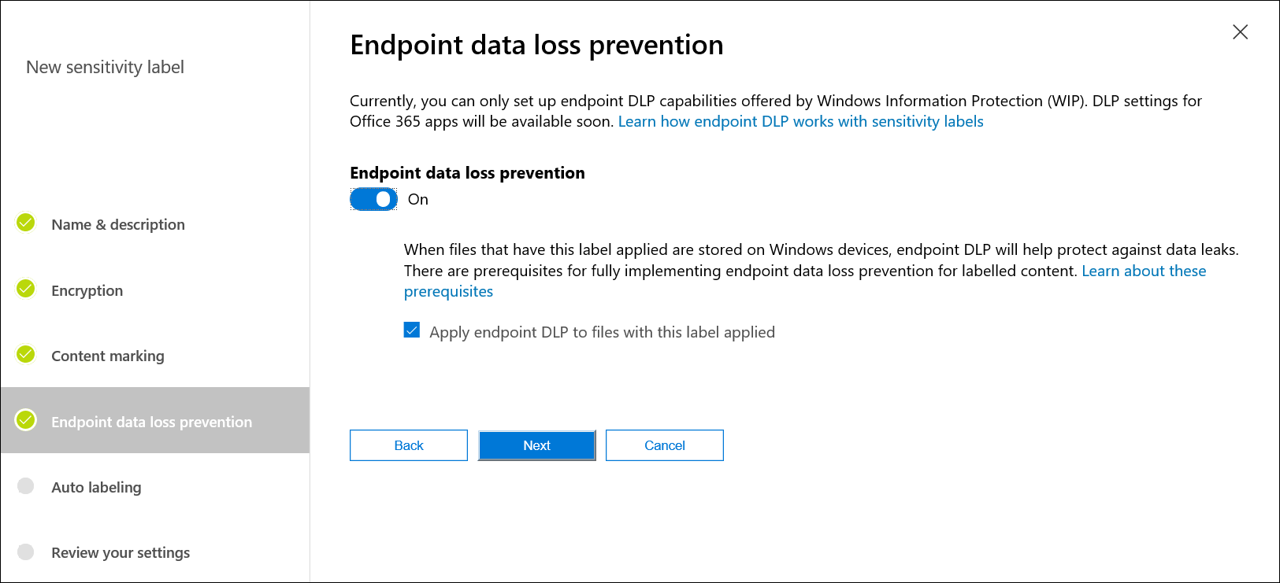


DLP Solution: Windows Information Protection (WIP)
Windows Information Protection (WIP) has an endpoint data loss prevention (DLP) capability that can be helpful in protecting local data at rest on endpoint devices
WIP can be configured to store business data only on approved devices / within approved applications

Slide 48
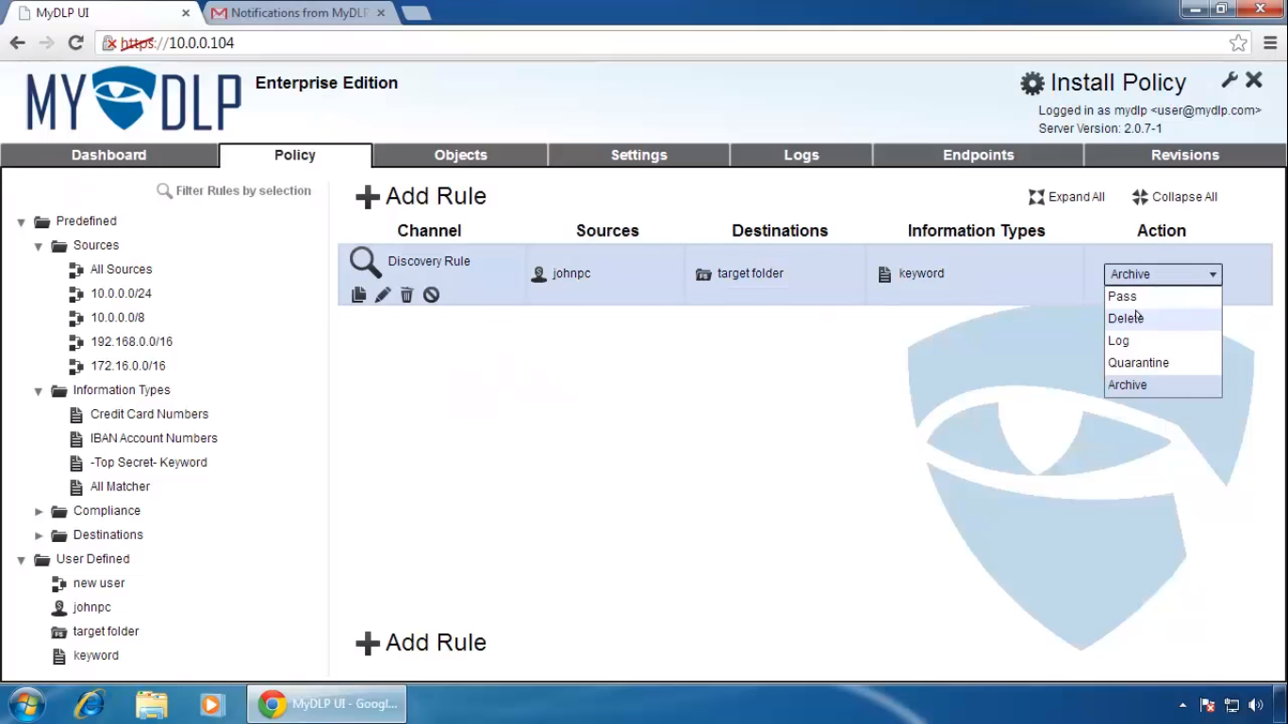
DLP Solutions
MyDLP allows the user to monitor, inspect, and prevent all outgoing confidential data without any hassle
MyDLP
Symantec Data Loss Prevention
https://www.symantec.com
SecureTrust Data Loss Prevention
https://www.securetrust.com
McAfee Total Protection
https://www.mcafee.com
Check Point Data Loss Prevention
https://www.checkpoint.com
Digital Guardian Endpoint DLP
https://digitalguardian.com
https://mydlp.com

Slide 49

Best Practices for a Successful DLP Implementation
Identify the main objective of DLP
Identify sensitive data for protection
Evaluate available DLP vendors
Ensure that the selected DLP product is compatible and supports the required data types and data stores of your organization
Identify the roles and responsibilities of individuals for implementing the DLP solution
Implement DLP with a minimal base to reduce false positives, and enhance the base gradually by identifying sensitive data
Enhance the DLP policies to support effective DLP operations and eliminate false positives

Slide 50

Module Summary
This module has discussed data security and its importance
It has discussed the different data security technologies
It has also discussed various security controls for data encryption
It has demonstrated various disk encryption, file encryption, and removable-media encryption tools
This module has also discussed the methods and tools for data backup and retention
Finally, this module ended with an overview of the data loss prevention (DLP) and DLP solutions
In the next module, we will discuss on network traffic monitoring in detail

