Slide 1


Module 12
Network Traffic Monitoring
Notes:
771480469

Slide 2

Module Objectives
1
Understanding the Need for and Advantages of Network Traffic Monitoring
2
Understanding the Network Traffic Signatures
3
Understanding the Categories of Suspicious Traffic Signatures
4
Overview of Attack Signature Analysis Techniques
5
Understanding Network Monitoring for Suspicious Traffic
6
Overview of Various Network Monitoring Tools

Slide 3

Module Flow
Understand the Need and Advantages of Network Traffic Monitoring
1
Determine Baseline Traffic Signatures for Normal and Suspicious Network Traffic
2
3
Perform Network Monitoring for Suspicious Traffic

Slide 4

Network Traffic Monitoring
Network monitoring is a retrospective security approach that involves monitoring a network for abnormal activities, performance issues, bandwidth issues, etc.
Network monitoring is an integral part of network security and is a demanding task within the network security operations of organizations
Continuous network traffic monitoring and analysis are required for effective threat detection

Slide 5

Need for Network Monitoring
Even when security tools are in place, attackers can find ways to bypass such security mechanisms to enter the network
Security tools generally use signature-based detection techniques. Hence, they are often unable to identify continuously changing attack signatures/patterns
Security tools are generally not designed to identify behavioral anomalies and are unable to detect activities of attackers that are initiated before and during an attack

Slide 6

Advantages of Network Monitoring
Understanding how data flows in a network
Optimizing network performance
Avoiding bandwidth bottlenecks
Monitoring network traffic helps in
Detecting signs of malicious activity
Finding unnecessary and vulnerable applications
Investigating security breaches

Slide 7

Module Flow
Understand the Need and Advantages of Network Traffic Monitoring
1
Determine Baseline Traffic Signatures for Normal and Suspicious Network Traffic
2
3
Perform Network Monitoring for Suspicious Traffic

Slide 8


Network Traffic Signatures
A signature is a set of traffic characteristics such as a source/destination IP address, ports, Transmission Control Protocol (TCP) flags, packet length, time to live (TTL), and protocols. Signatures are used to define the type of activity on a network
Types of Signatures
Normal Traffic Signature
Attack Signatures
Acceptable traffic patterns allowed to enter the network
Suspicious traffic patterns not allowed to enter the network

Slide 9

Baselining Normal Traffic Signatures
A network baseline is the accepted behavior for normal network traffic. It is a benchmark to differentiate between normal and suspicious traffic
Network traffic baselines differ between organizations and change over time according to the operating environment and prevailing threat scenario
Some considerations to create a baseline for normal traffic:
TCP/IP communication involves a three-way handshake for normal traffic
A SYN flag appears at the beginning and a FIN flag at the end of a connection
All conversations originating inside the demilitarized zone (DMZ) are trusted traffic items
Any traffic violating the network policies is malicious traffic; e.g., the existence of File Transfer Protocol (FTP) traffic when this type is restricted indicates a potential issue

Slide 10

Categories of Suspicious Traffic Signatures
Informational
Reconnaissance
Traffic containing certain signatures that may appear suspicious but might not be malicious
Traffic containing certain signatures that indicate an attempt to gain information
Unauthorized Access
Denial of Service
Traffic containing certain signatures that indicate an attempt to gain unauthorized access
    Traffic containing certain signatures that indicate a DoS attempt that floods a server with a large number of requests

Slide 11

Attack Signature Analysis Techniques
Content-based signature analysis
Context-based signature analysis
Attack signatures are contained in packet payloads
Attack signatures are contained in packet headers
HEADER
PAYLOAD
HEADER
PAYLOAD
    Inspect packets for unusual/suspicious header information such as the following:
Source and destination IP addresses
IP options, protocols, and checksums
Source and destination port numbers
IP fragmentation flags, offset, or identification
Check for specific strings occurring in the suspicious payload
Atomic-signature-based analysis
Composite-signature-based analysis
Single-packet analysis is sufficient to detect attack signatures
Multiple-packet analysis is required to detect attack signatures
HEADER
PAYLOAD
HEADER
PAYLOAD
HEADER
PAYLOAD

Slide 12
Module Flow
Understand the Need and Advantages of Network Traffic Monitoring
1
Determine Baseline Traffic Signatures for Normal and Suspicious Network Traffic
2
3
Perform Network Monitoring for Suspicious Traffic

Slide 13

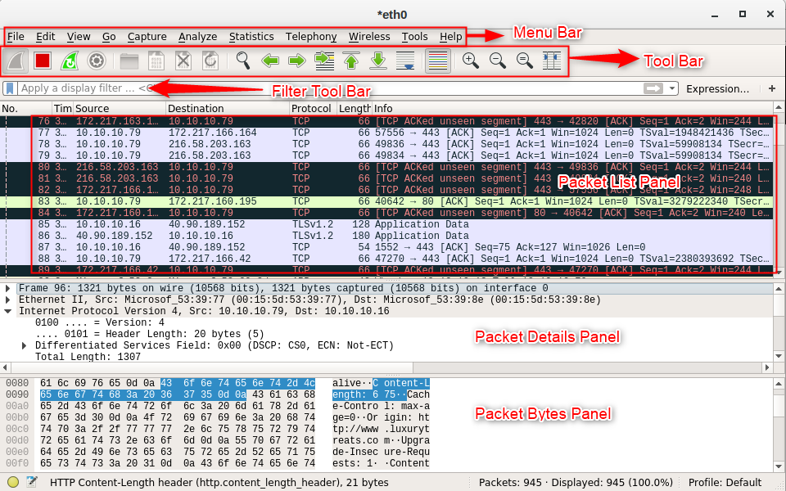
Wireshark
Wireshark is a widely used network sniffer for network monitoring and analysis
It captures and intelligently browses the traffic on a network
Components of Wireshark
Menu bar: Hosts the features of Wireshark
Toolbar: Hosts the most frequently used tools and icons
Filter toolbar: Filters the traffic based on filter options
Packet list panel: Displays the captured packets
Packet details panel: Displays detailed information about the captured packets at a granular level
Packet byte panel: Displays the captured packet’s bytes in a hex dump format
https://www.wireshark.org

Slide 14
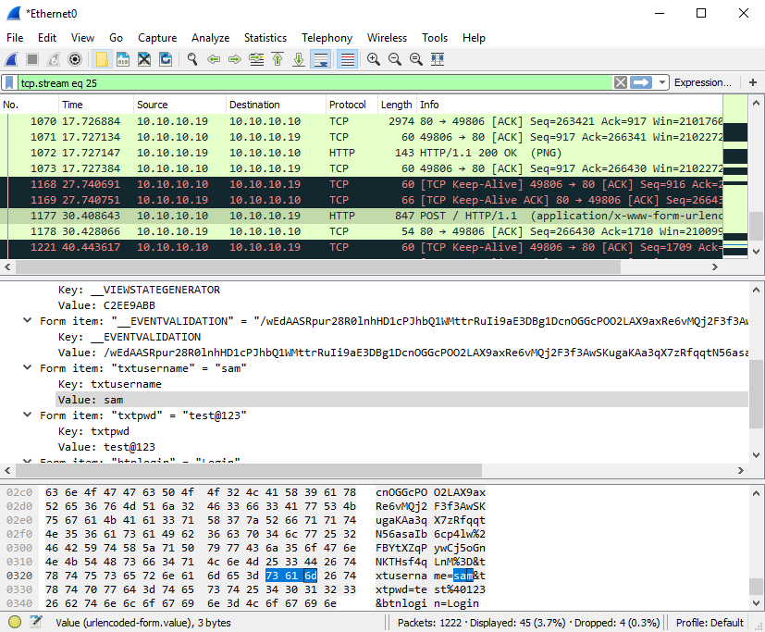
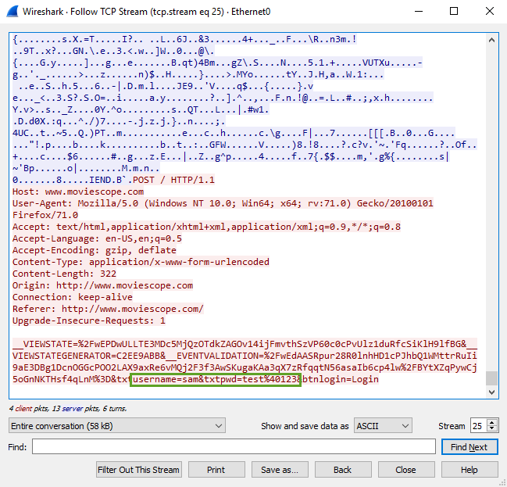
Follow TCP Stream in Wireshark
Password revealed in a TCP Stream
Notes:
Screenshots need to be changed

Slide 15
Display Filters in Wireshark
Display filters are used to change the view of packets in the captured files
1
Display Filtering by Protocol
Example: Type the protocol in the filter box; arp, http, tcp, udp, dns, or ip
2
Monitoring the Specific Ports
tcp.port==23
ip.addr==192.168.1.100 machine ip.addr==192.168.1.100 && tcp.port=23
3
Filtering by Multiple IP Addresses
ip.addr == 10.0.0.4 or ip.addr == 10.0.0.5
4
Filtering by IP Address
ip.addr == 10.0.0.4
ip.dst == 10.0.1.50 && frame.pkt_len > 400
ip.addr == 10.0.1.12 && icmp && frame.number > 15 && frame.number < 30
ip.src==205.153.63.30 or ip.dst==205.153.63.30
5
Other Filters

Slide 16
Additional Wireshark Filters
01
tcp.flags.reset==1
Displays all TCP resets
06
!(arp or icmp or dns)
Masks out arp, icmp, dns, or other protocols and allows you to view traffic of your interest
02
udp contains 33:27:58
Sets a filter for the HEX values of 0x33 0x27 0x58 at any offset
07
tcp.port == 4000
Sets a filter for any TCP packet with 4000 as a source or destination port
03
http.request
Displays all HTTP GET requests
08
tcp.port eq 25 or icmp
Displays only SMTP (port 25) and ICMP traffic
ip.src==192.168.0.0/16 and ip.dst==192.168.0.0/16
Displays only traffic in the LAN (192.168.x.x), between workstations and servers — no Internet
04
tcp.analysis. Retransmission
Displays all retransmissions in the trace
09
tcp contains traffic
Displays all TCP packets that contain the word “traffic”
ip.src != xxx.xxx.xxx.xxx && ip.dst != xxx.xxx.xxx.xxx && sip
Filter by a protocol ( e.g., SIP ) and filter out unwanted IPs
05
10

Slide 17

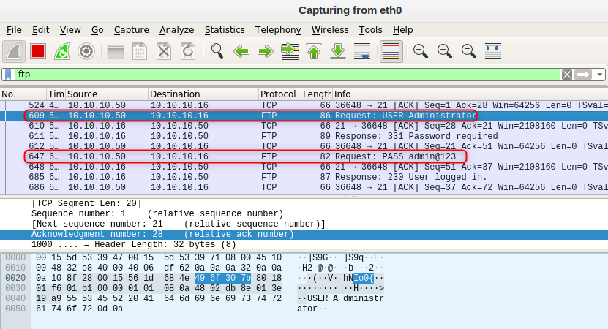
Monitoring and Analyzing FTP Traffic
FTP is used to transfer files over TCP, and its default port is 21
FTP sends data in a cleartext format
Use the ftp filter to check whether any unauthorized FTP sessions have been established in the network

Slide 18

Monitoring and Analyzing Telnet Traffic
Telnet can provide access to remote hosts including most network equipment and operating systems
Telnet is not encrypted; the password and all other data are transmitted as cleartext
Ideally, it should be disabled; enabling it poses huge security risks to the network
It is essential to check whether any Telnet session is established within the network

Slide 19
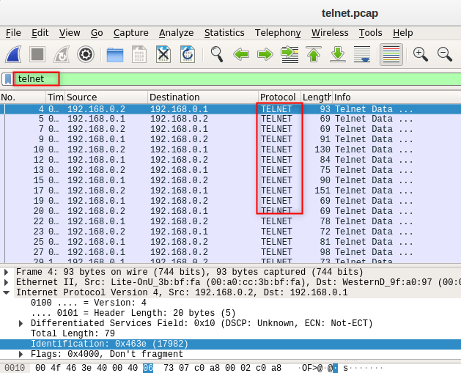
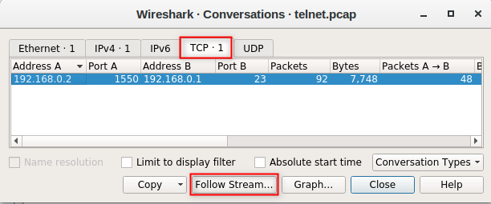
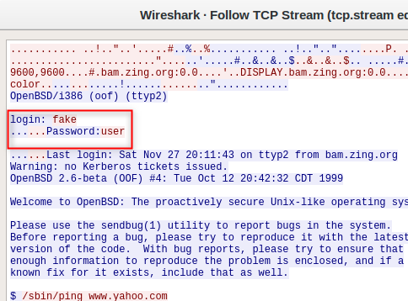
Monitoring and Analyzing Telnet Traffic (Cont’d)
Perform the following to check for established Telnet sessions:
  Go to the Statistics Menu and click on Conversations
  Go to the TCP tab and select the appropriate Telnet communication indicated by port 23 and click Follow Stream…
  The Telnet traffic and the credentials will be viewable in cleartext

Slide 20
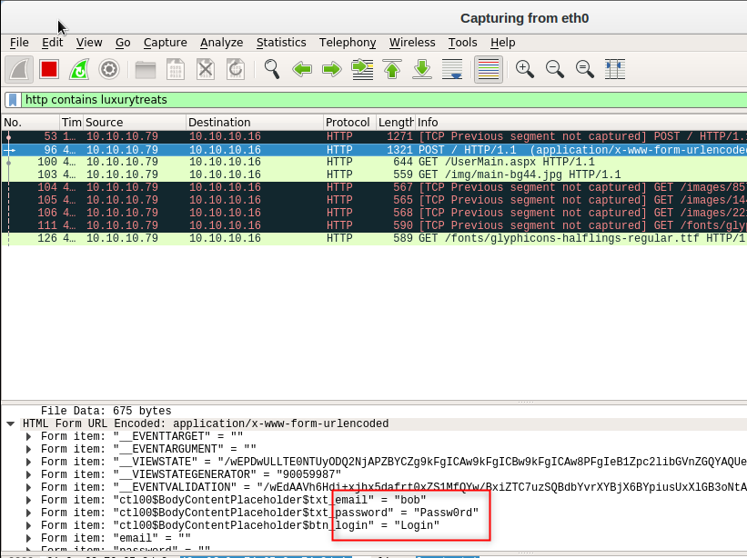
Monitoring and Analyzing HTTP Traffic
The HTTP sends information in plain text
Monitor and analyze HTTP traffic for the following purposes:
  Check whether any sensitive information is sent using HTTP
  Detect malicious traffic
  Check the traffic against a policy violation
  Detect applications using unnecessary/restricted services
Use the http filter to check the specific HTTP traffic

Slide 21
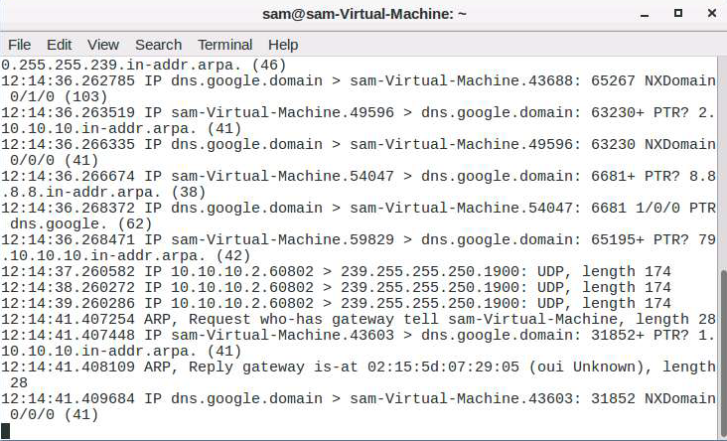
Network Sniffers for Network Monitoring
tcpdump is a command-line network analyzer or a packet sniffer that helps in capturing and analyzing network traffic
tcpdump
Riverbed Packet Analyzer Plus
https://www.riverbed.com
OmniPeek
https://www.liveaction.com
Observer Analyzer
https://www.viavisolutions.com
SolarWinds Deep Packet Inspection and Analysis
https://www.solarwinds.com
Xplico
https://www.xplico.org
https://www.tcpdump.org

Slide 22
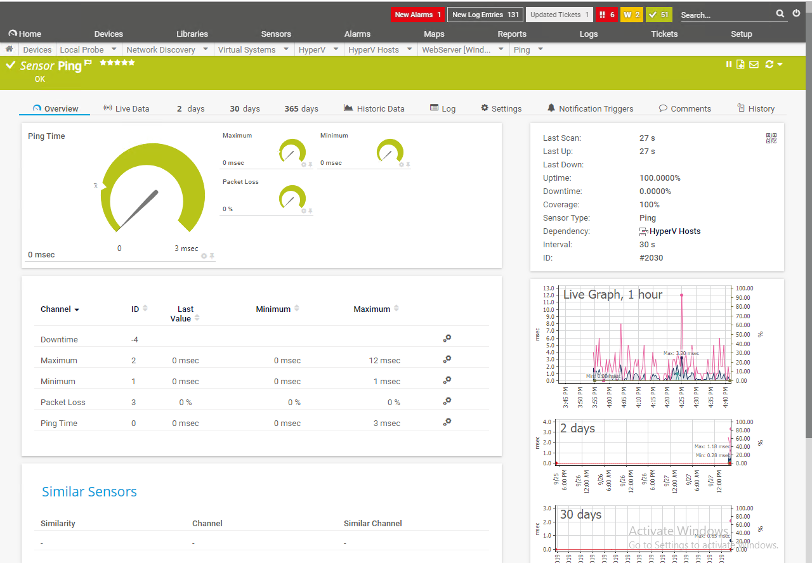
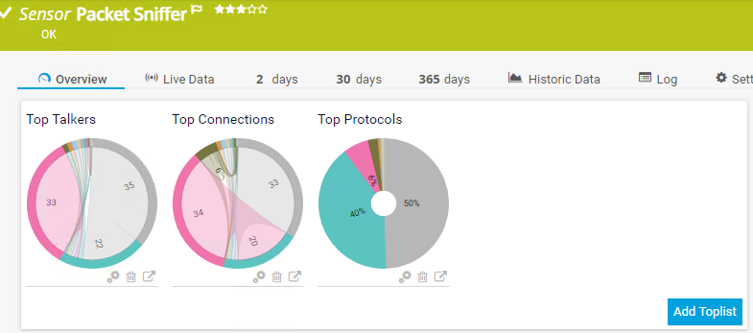
Network Monitoring Tools
PRTG Network Monitor
A network monitoring software that supports remote management using any web browser or smartphone, various notification methods, and the monitoring of multiple locations
SolarWinds Network Performance Monitor
https://www.solarwinds.com
ManageEngine OpManager
https://www.manageengine.com
Capsa Free Network Analyzer
https://www.colasoft.com
Monitis Network Monitoring Solution
https://www.monitis.com
Nagios Network Analyzer
https://www.nagios.com
https://www.paessler.com

Slide 23
Module Summary
This module has discussed the need for and advantages of network traffic monitoring
It has discussed the network traffic signatures
It has also discussed the categories of suspicious traffic signatures
This module also discussed the attack signature analysis techniques and network monitoring for suspicious traffic
Finally, this module ended with an overview of various network monitoring tools

